Slide 1
BCA-3RD SEM
Measures of Dispersion
UNIT-3RD
DR.VIPENDRA SINGH PARMAR
VSSD PG COLLEGE KANPUR

Slide 2
Measures of Dispersion:
UNIT-III
Measures of Dispersion:
Concept of dispersion, Absolute and relative measure of dispersion, range variance, Standard deviation, Coefficient of variation.

Slide 3
Measure of dispersion
Dispersion is a statistical concept that refers to the extent to which data points in a set are spread out from each other. There are several measures of dispersion, including:
Range: It’s the difference between the largest and the smallest value in a dataset.
Interquartile Range (IQR): It’s the difference between the third quartile and the first quartile, which represents the range of the middle 50% of the data.
Variance: It’s a measure of the spread of a set of data around its mean. Variance is the average of the squared differences between each data point and the mean.

Slide 4
Measure of dispersion
4.Standard Deviation: It’s the square root of the variance and provides a measure of how far each data point is from the mean.
5.Mean Absolute Deviation (MAD): It’s the average of the absolute differences between each data point and the mean.
6.Coefficient of Variation (CV): It’s the ratio of the standard deviation to the mean, expressed as a percentage, and provides a measure of relative dispersion.
These measures of dispersion help us to understand how much the data is spread out and how the data points are distributed around the central value

Slide 5
Concept of dispersion
Dispersion-
Dispersion, also known as variability or scatter, is a statistical concept that measures how spread out the values in a set of data are. It provides information about the distribution of the data, such as how much the data points vary from the center of the distribution and how much they vary from each other.
In other words, dispersion reflects the degree of variation or spread in the data. A set of data with high dispersion means that the data points are widely spread out, while a set of data with low dispersion means that the data points are clustered closely together.

Slide 6
Types of Measures of Dispersion
Types of Measures of Dispersion
Measures of dispersion can be classified into the following two types:
Absolute Measure of Dispersion
Relative Measure of Dispersion
These measures of dispersion can be further divided into various categories. They have various parameters, and these parameters have the same unit.

Slide 7
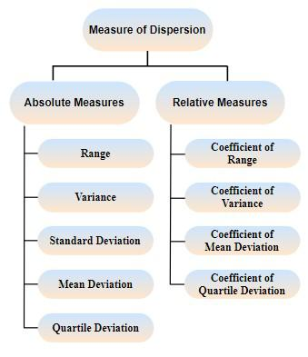

Slide 8
Types of Measures of Dispersion
Absolute Measure of Dispersion
The measures of dispersion that are measured and expressed in the units of data themselves are called the Absolute Measure of Dispersion. For example - Meters, Dollars, Kg, etc.
Relative Measure of Dispersion
For comparative study the concerning absolute measure is divided by the corresponding mean or some other characteristic value to obtain a ratio or percentage, which is known as the relative measure.

Slide 9
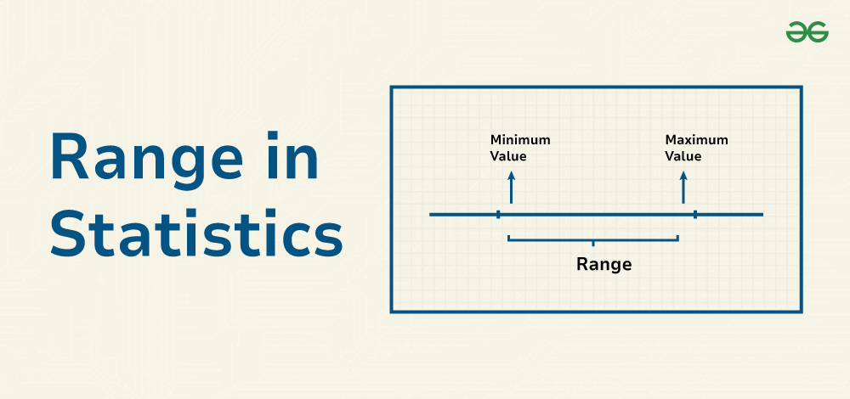
Absolute Measure of Dispersion
Range:It is defined as the difference between the largest and the smallest value in the distribution.
Formula- Range = Maximum Value - Minimum Value
R= L - S

Slide 10
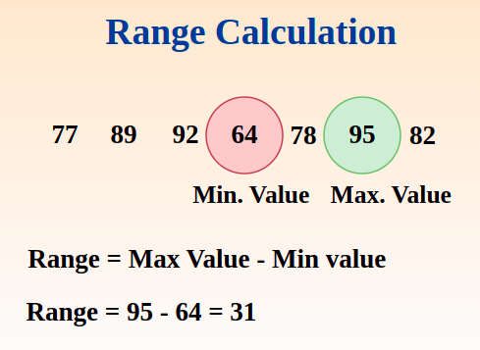
Example:
Example:
Consider the following dataset of exam scores for a class tenth: 77, 89, 92, 64, 78, 95, 82
Find the Range of the above data.

Slide 11
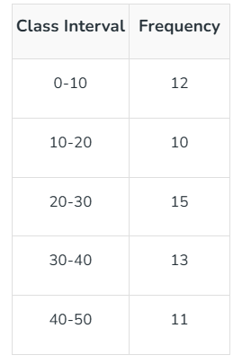
Range for Grouped Data
In Grouped data where the datasets are arranged in Class Intervals, the Range is find by subtracting the lower limit of the first class interval and the upper limit of the last class interval. We can understand it from the example mentioned below.
Range = Upper Limit of the Last Class Interval - Lower Limit of First Class Interval = 50-0 = 50

Slide 12
Relative Measure of Dispersion
Coefficient of Range:
The ratio of the difference between two extreme items (the largest and smallest) of the distribution to their sum is known as the Coefficient of Range. The coefficient of the range is a relative measure of dispersion. Symbolically, range can be expressed as:
Coefficient of Range= Largest Item (L)-Smallest Item (S)
Largest Item (L)+Smallest Item (S)
​

Slide 13
Quartile Deviation
It is based on the lower quartile Q1 and the upper quartile Q3. The difference Q3 – Q1 is called the inter-quartile range. The difference Q3 – Q1 divided by 2 is called semi-inter-quartile range or the quartile deviation.
Thus Quartile Deviation (Q.D) = Q3-Q1
2

Slide 14

Coefficient of Quartile Deviation
Coefficient of Quartile Deviation:
A relative measure of dispersion based on the quartile deviation is called the coefficient of quartile deviation. It is defined as

Slide 15
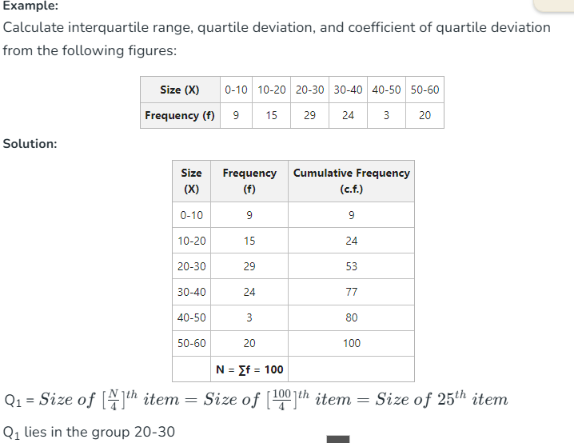

Slide 16
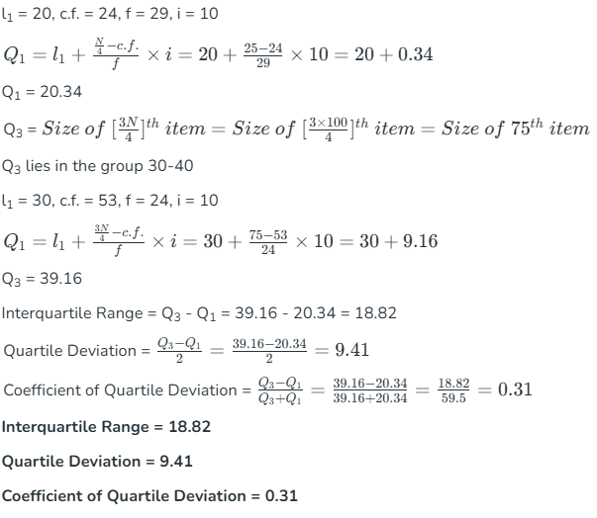

Slide 17
Mean Deviation
Mean deviation (MD) :
Mean deviation (MD) of a series is the arithmetic average of the deviation of various items from a measure of central tendency (mean, median and mode) Mean deviation is based on the items of the distribution and is calculated as an average, on the basis of deviation obtained from either mean, median or mode but generally from the median.
First we compute deviations of all the items from either mean or median ignoring plus (+) and (–) signs. They are called absolute values of deviations where the two parallel bars (ii) indicate that the absolute value is taken. This is also called modulus value. Then the aggregate of these deviations are divided by the number of observations this is called mean deviation.

Slide 18
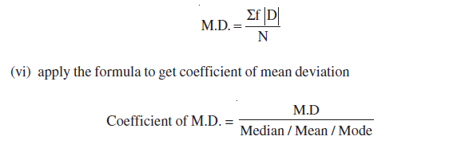
Calculation of mean deviation
Arrange the data in ascending order (for calculating of median)
Calculate median/mean/mode
Take deviations of items from median/mean ignoring ± signs and denote the column as |D|
Calculate the sum of these deviation in case of discrete and continuous series |D| is multiplied by respective frequency of the item to get Σf |D|
Divide the total obtained by number of items to get mean deviation

Slide 19

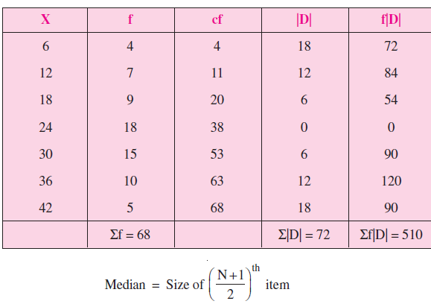
Calculation of Mean Deviation in Discrete series
Example : Calculate (a) median (b) mean deviation and (c) Coefficient of mean deviation.
Calculation of mean deviation from Median

Slide 20
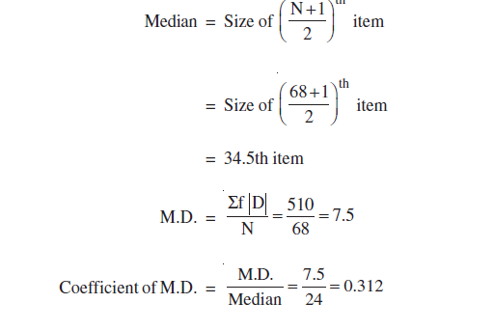

Slide 21
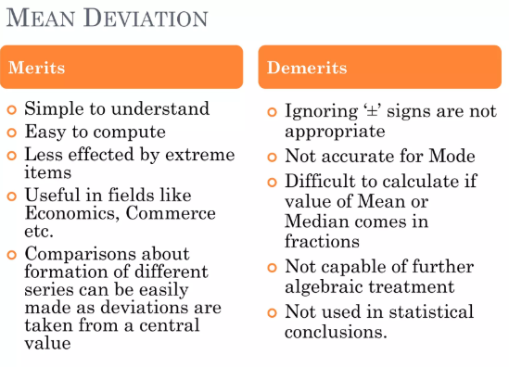

Slide 22
Standard Deviation
Standard deviation is the most important and commonly used measure of dispersion. It measures the absolute dispersion or variability of a distribution. Standard deviation is the positive square root of the mean of the squared deviations of observations from their mean. It is denoted by S.D. or σx).
A higher standard deviation means the data points are more spread out, while a lower standard deviation means they are closer to the mean. It is classified as:
Low standard deviation: The data points are close to the mean, meaning the values are relatively consistent.
High standard deviation: The data points are spread out over a wider range, meaning there's more variability in the data.

Slide 23
Mathematical Definition
In mathematical terms, the standard deviation is the square root of the variance. Variance is the average of the squared differences from the mean.
Standard Deviation is defined as the degree of dispersion of the data points from the mean value of the data points.
Standard deviation is a measure used in statistics to understand how the data points in a set are spread out from the mean value.
It indicates the extent of the data's variation and shows how far individual data points deviate from the average.

Slide 24
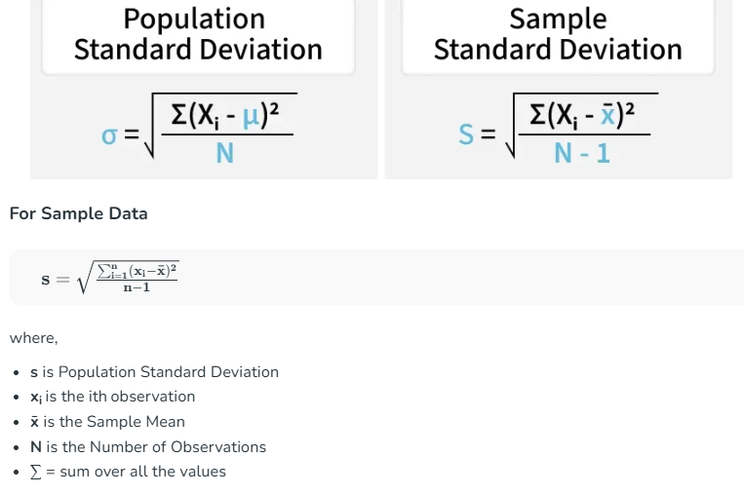
Standard Deviation Formulas

Slide 25
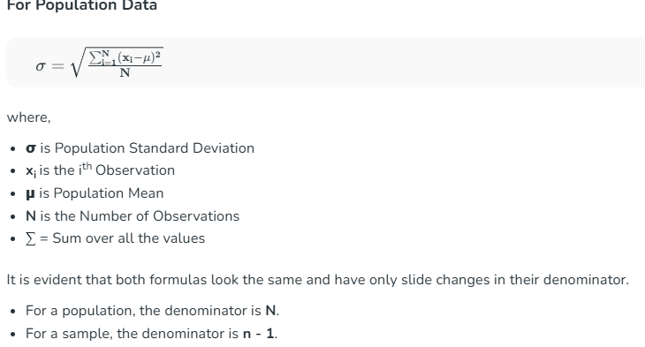

Slide 26
Steps to Calculate Standard Deviation
Generally, when we talk about standard deviation, we talk about population standard deviation. The steps to calculate the standard deviation of a given set of values are as follows,
Step 1: Calculate mean of observation using the data
(Mean = Sum of Observations/Number of Observations)
Step 2: Calculate squared differences of data values from the mean. (Data Value - Mean)2
Step 3: Calculate average of squared differences
(Variance = Sum of Squared Differences / Number of Observations)
Step 4: Calculate square root of variance this gives the Standard Deviation (Standard Deviation = √Variance)

Slide 27


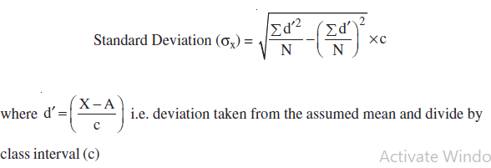
Computation of Standard deviation of Individual Series
Actual Mean Method-
Assumed Mean Method-
Step Deviation Method-

Slide 28
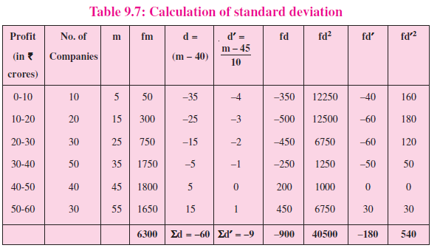

Slide 29
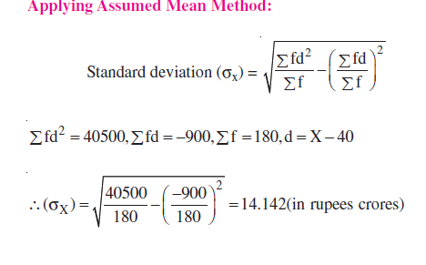
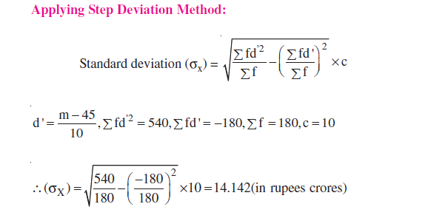

Slide 30
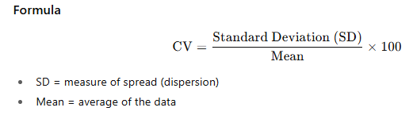
Co-efficient of Standard Deviation :
Co-efficient of Standard Deviation :
Standard deviation is an absolute measure. When comparison of variability in two or more series is required, relative measure of standard deviation is computed which is called coefficient of standard deviation. Coefficient of S.D. = σ / X Variance = σ2
Coefficient of variation (CV)
The Coefficient of Variation is a relative measure of dispersion. It shows the extent of variability in relation to the mean of the dataset.CV allows you to compare the consistency of different data sets, even if their units or means differ. Lower CV → more consistency or stability.
Higher CV → more variability relative to the mean.

Slide 31
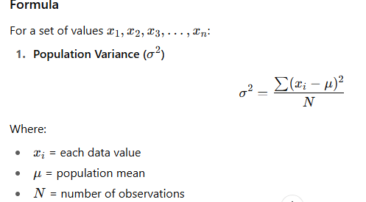
Variance
Variance is a statistical measure of dispersion that indicates how far each data point in a set is spread out from the mean (average) of the data. It tells us the degree of variability or spread in a dataset. The greater the variance, the more the data points are dispersed; the smaller the variance, the closer the data points are to the mean.

Slide 32
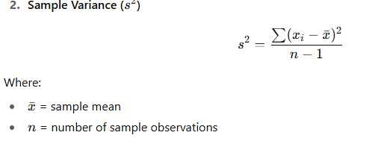
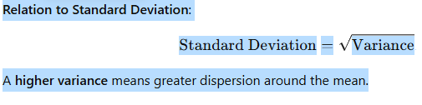
Steps to Calculate Variance
Find the mean of the dataset.
Subtract the mean from each observation and square the difference.
Add all squared differences.
Divide by the total number of observations (N) for population or by (n–1) for a sample
.

Slide 33
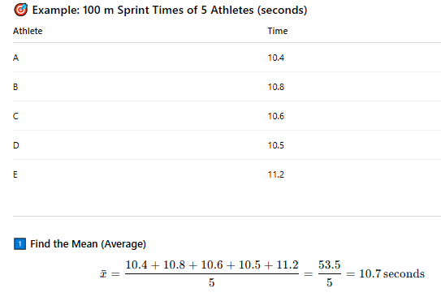
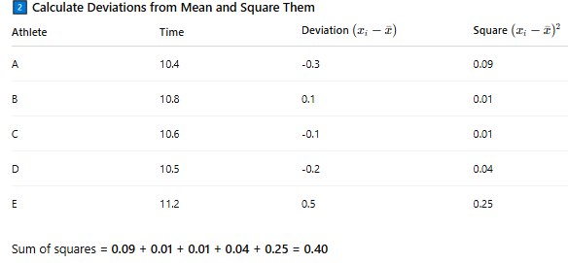

Slide 34
