Slide 1

Measures of Central Tendency
UNIT-2ND (BCA-3RD SEM)
DR.V.S.PARMAR
VSSD PG COLLEGE
KANPUR

Slide 2
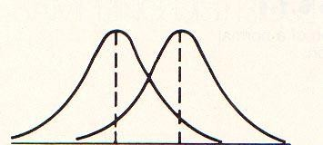
Measures of Central Tendency (Location)
Meaning of Central Tendency
The word “central” = middle/center.
“tendency” = inclination of data values toward a central point.
So, Central Tendency = “A single value that represents the entire data set and indicates the typical or most representative value.”
👉 In simple words: it tells us where the center of the data lies.
Definition of Central Tendency
Measures of central tendency is a single value that attempts to describe a set of data by identifying the central position within that set of data.
Measures of location indicate where on the number line the data are to be found. And commonly they are numbers that tend to cluster around the “middle” of a set of values.
Sometimes called Average
3

Slide 3
Concept of Central Tendency
Central tendency refers to a single value or typical value that summarizes the central location of a set of data. The idea is to find a single value that best represents the “center” of the data and gives a quick summary of its main characteristics. There are several measures of central tendency, including mean, median, and mode. Each measure provides a different perspective on the central location of the data and may be more or less appropriate depending on the type and distribution of the data, as well as the goals of the analysis.
In general, mean is a good representation of central tendency if the data is evenly distributed, but it can be significantly impacted by extreme values (outliers). Median provides a good representation of central tendency if there are outliers, as it is not affected by extreme values. Mode provides a good representation of central tendency if the data is not evenly distributed, such as in the case of categorical data.

Slide 4
Requirements of good measures of central tendency
For a measure of central tendency to be considered “good”, it should satisfy the following requirements:
Uniqueness: There should be a single value that summarizes the central location of the data, not multiple values or ranges.
Representativeness: The measure should provide an accurate representation of the central location of the data, capturing its main characteristics.
Stability: The measure should not change significantly with small variations in the data set.
Insensitivity to extreme values: The measure should not be greatly affected by outliers or extreme values in the data set.
Example: Suppose we have the following data set: 1, 2, 3, 4, 1000
Mean: (1 + 2 + 3 + 4 + 1000) / 5 = 200.8
Median: 3 (when the values are ordered from smallest to largest)
Mode: None (no value occurs more than once)
In this example, the median is a better measure of central tendency as it is not greatly affected by the extreme value of 1000. The mean is significantly impacted by this value and is not representative of the central location of the data. The lack of a mode suggests that this is not a good measure of central tendency for this data set.

Slide 5
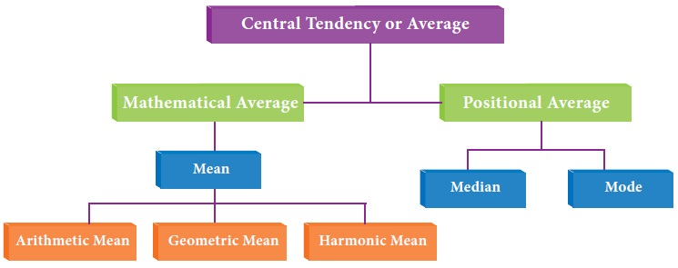
Measures of Central Tendency

Slide 6

Why Measures of central tendency?
MCT in aiding our understanding of the data
MTC useful in data editing as well as
MTC facilitate comparison.
MTC make further statistical analysis

Slide 7

The Arithmetic Mean
Arithmetic Mean Arithmetic mean is a mathematical average and it is the most popular measures of central tendency. It is frequently referred to as 'mean' it is obtained by dividing sum of the values of all observations in a series (ΣΧ) by the number of items (N) constituting the series.
Thus, mean of a set of numbers X1, X2, X3... Xn. denoted by x̄ and is defined as
Mean= Number of observations
Sum of observations ​​
​
6

Slide 8
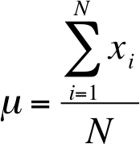
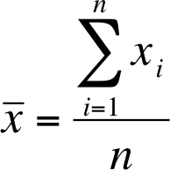
Arithmetic Mean…
Sample Mean
Population Mean
1.7

Slide 9
Example 1
The systolic blood pressure of seven middle aged men were as follows:
151, 124, 132, 170, 146, 124 and 113.
The mean is
_{x =} (151 +124 +132 +170 +146 +124 +113)
7
= 137.14

Slide 10
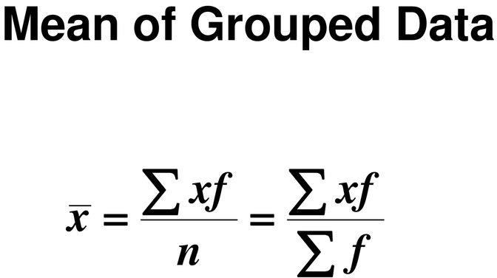
MCT: Mean for Grouped Data
The mean for grouped data is calculated by multiplying the frequencies and midpoints of the classes.

Slide 11
Example 2: Miles Run
Below is a frequency distribution of miles run per week. Find the mean.
No. | Class Boundaries | Frequenc y
I II III IV V VI VII | 5.5 - 10.5 10.5 - 15.5 15.5 - 20.5 20.5 - 25.5 25.5 - 30.5 30.5 - 35.5 35.5 - 40.5 | 1 2 3 5 4 3 2 Σf = 20

Slide 12
Example 2: Miles Run
Class | Frequency, f | Midpoint, X_{m} | f ·X_{m}
5.5 - 10.5 | 1 | 8 | 8
10.5 - 15.5 | 2 | 13 | 26
15.5 - 20.5 | 3 | 18 | 54
20.5 - 25.5 | 5 | 23 | 115
25.5 - 30.5 | 4 | 28 | 112
30.5 - 35.5 | 3 | 33 | 99
35.5 - 40.5 | 2 | 38 | 76
 | Σf = 20 |  | Σ f ·X_{m} = 490
_{X =} ∑ f ⋅ X_{m}
₌ 490 ₌
24.5 miles
n
20
11

Slide 13


Measures of Central Tendency: Weighted Mean
Find the weighted mean of a variable by multiplying each value by its corresponding weight and dividing the sum of the products by the sum of the weights.
₌ ∑wX
_{X =} w₁ X₁ + w₂ X ₂ +
+ w_{n} X_{n}
∑w
w₁ + w₂ + + w_{n}
12

Slide 14
Example: Grade Point Average
A student received the following grades. Find the corresponding GPA.
Course | Credits, w | Grade, X
English Composition | 3 | A (4 points)
Introduction to Psychology | 3 | C (2 points)
Biology | 4 | B (3 points)
Physical Education | 2 | D (1 point)
_{X =} ∑wX
₌ 3⋅ 4 + 3⋅ 2 + 4⋅3 + 2⋅1 ₌ 32 _{= 2.7}
∑w
3+ 3+ 4 + 2
12
The grade point average is 2.7.

Slide 15

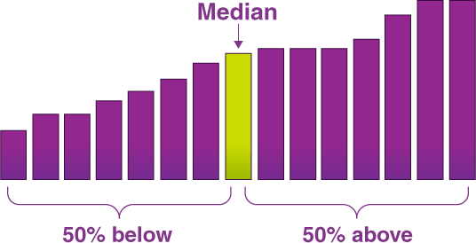
The Median
The median is the middle value in a set of numbers when they’re arranged in order, either from smallest to largest or vice versa. If there’s an odd number of numbers, the median is the one right in the middle. If there’s an even number, the median is the average of the two middle numbers.
Median formula= th item

Slide 16
Median Formula for Ungrouped Data
The following steps are helpful while applying the median formula for ungrouped data.
Step 1: Arrange the data in ascending or descending order.
Step 2: Secondly, count the total number of observations ‘n’.
Step 3: Check if the number of observations ‘n’ is even or odd.
Median = [(n + 1)/2]th term
EXAMPLE-Find the median of the following reordered systolic blood pressure data seen earlier are: 132, 124,146,151,124,170, and 113
Arrange the series
113, 124, 124, 132, 146, 151, and 170.
The Median is the middle value of the ordered data, i.e. 132.

Slide 17
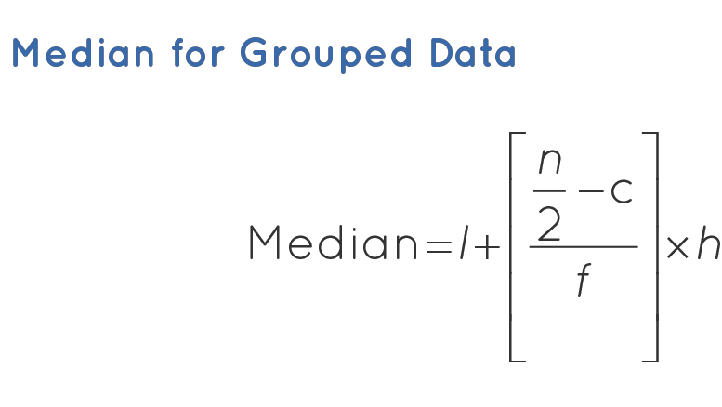
Median Formula for Grouped Data
When the data is continuous and in the form of a frequency distribution, the median is calculated through the following sequence of steps.
Step 1: Find the total number of observations(n).
Step 2: Define the class size(h), and divide the data into different classes.
Step 3: Calculate the cumulative frequency of each class.
Step 4: Identify the class in which the median falls. (Median Class is the class where n/2 lies.)
Step 5: Find the lower limit of the median class(l), and the cumulative frequency of the class preceding the median class (c).
Now, use the following formula to find the median value.

Slide 18
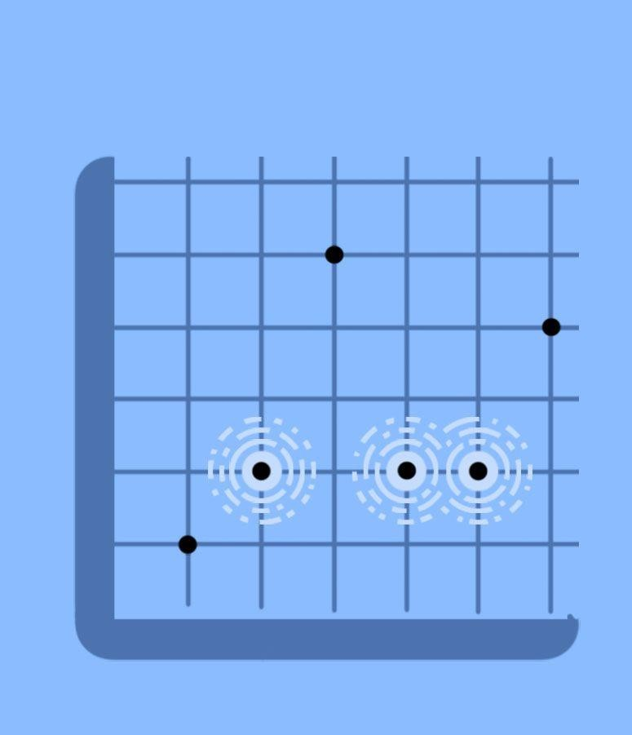
The Mode (Mo )
The mode is the most commonly occurring value.
The mode of a set of measurements is the most frequently occurring value; it is the value having the highest frequency among the measurements.
Mode is the value which is repeated the highest number of times in the series. It is the size of that item which possesses the maximum frequency.

Slide 19
Computation of Mode in case of Ungrouped Data/ Individual series
The mode of this series can be obtained by mere inspection. The number which occurs most often is the mode.
Note- that if in any series, two or more numbers have the maximum frequency, then the mode will be difficult to calculate. Such series are called as Bi-modal, Tri-modal or Multi-modal series.
Example : Find the mode of 15, 21, 26, 25, 21, 23, 28, 21
Solution: The mode is 21 since it occurs three times and the other values occur only once.

Slide 20
Computation of mode in case of discrete series
The mode in case of discrete series is calculated by applying the following methods:
(a) Simple inspection method:
By simple inspection, the modal value is the value of the variable against which the frequency is the largest.
Example: Find the modal age of boys studying in XII class from the following data.
Age (in yrs): 5 7 10 12 15 18
No. of Boys : 4 6 9 7 5 3
Solution: From the above data we can clearly see that modal age is 10 yrs because 10 has occurred maximum number of times i.e. 9.
b) Grouping and Analysis Table method: This method is generally used when
the difference between the maximum frequency and the frequency preceding it or
succeeding it is very small.

Slide 21
Process of Computation:
In order to find mode, a grouping table and an analysis table are to be prepared in the following manner:
Grouping Table:
A grouping table consists of 6 columns.
1. Arrange the values in ascending order and write down their corresponding
frequencies in the column-1.
2. In column-2 the frequencies are grouped into two’s and added.
3. In column-3 the frequencies are grouped into two’s, leaving the first frequency and added.
4. In column-4 the frequencies are grouped into three’s, and added.
5. In column-5 the frequencies are grouped into three’s, leaving the first
frequency and added.
6. In column-6 the frequencies are grouped into three’s, leaving the first and
second frequencies and added.
7. Now in each these columns mark the highest total with a circle.

Slide 22

Analysis Table:
After preparing a grouping table, prepare an analysis table. While preparing this table take the column numbers as rows and the values of the variable as columns. Now for each column number see the highest total in the grouping table (Which is marked with a circle) and mark the corresponding values of the variable to which the frequencies are related by using bars in the relevant boxes. Now the value of the variable (class) which gets highest number of bars is the modal value (modal class).
Applying grouping and Analysis Table Method to the given example for calculating the value of mode for discrete series.

Slide 23
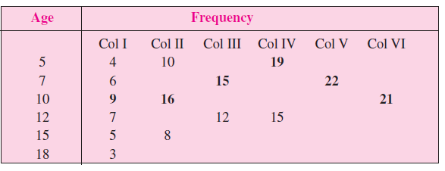
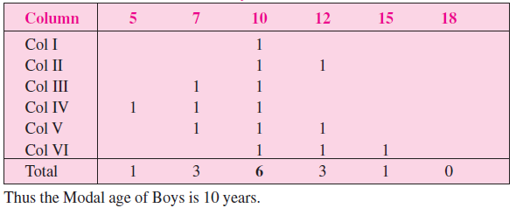
Grouping Table
Analysis Table

Slide 24

Computation of Mode in case of Continuous series
In case of continuous series, for calculating mode, first of all ensure that the given continuous series is the exclusive series with equal class intervals. In order to find out the mode we need one step more than those used for discrete series. As explained in the discrete series, modal class is determined by inspection or by preparing grouping and analysis tables. The steps involved are:
1. Determine the modal class which as the maximum frequency.
2. Value of the mode can be calculated by the formula :
l1 = lower limit of the modal class
f1 = frequency of the modal class
f0 = frequency of the preceeding the modal class
f2 = frequency of the succeeding the modal class
i = class interval of the modal class

Slide 25
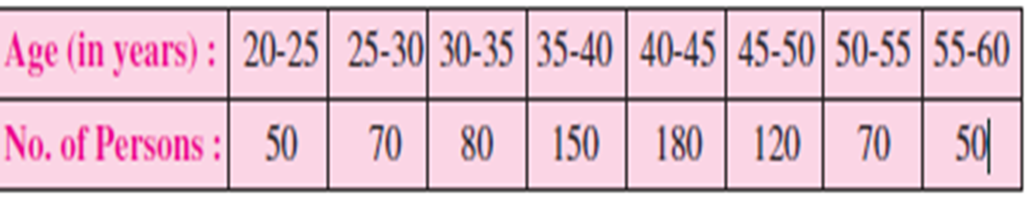
Note: 1.It may be noted that in case of continuous series, class intervals should be
equal and series should be exclusive to calculate the mode. If the given series is
inclusive and has unequal class interval then the same has to be converted into
exclusive series and series with equal class interval.
2. If mid points are given, class intervals are to be obtained.
Example : From the following data calculate mode:
The modal class is 40-45. Mode is given by:

Slide 26
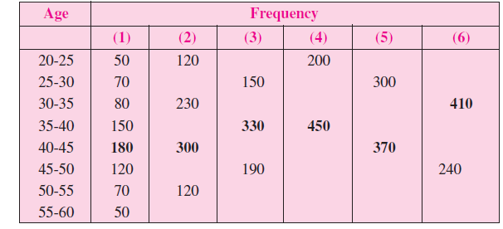
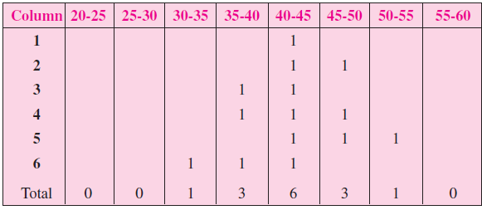
Solution: Computation of mode-Grouping Table:
Analysis Table-
The modal class is 40-45. Mode is given by:

Slide 27
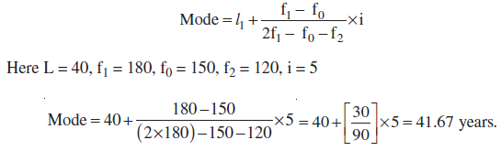
Relationship between mean, median and mode : Mode = 3median - 2 mean

Slide 28
GEOMETRIC MEAN
Definition:
Geometric mean of n observations is the nth root of product of n observations.
‘Geometric Mean is a Measure of Central Tendency, which takes into account the nth root of the product of all the observations’.
Geometric mean of N values is the Nth root of the product of the N values. It is
abbreviated as G.M.
Example-
Geometric Mean of 2 and 18 = 2√(2×18 )=6
Geometric Mean = 3√(10×51.2×8)=16
Geometric Mean = 5√(1×3×9×27×81)=9

Slide 29
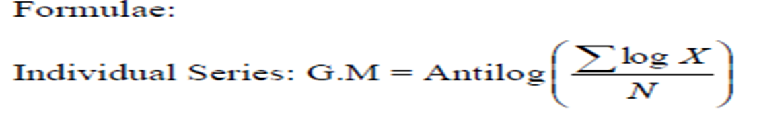
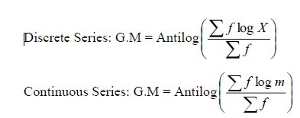

Slide 30
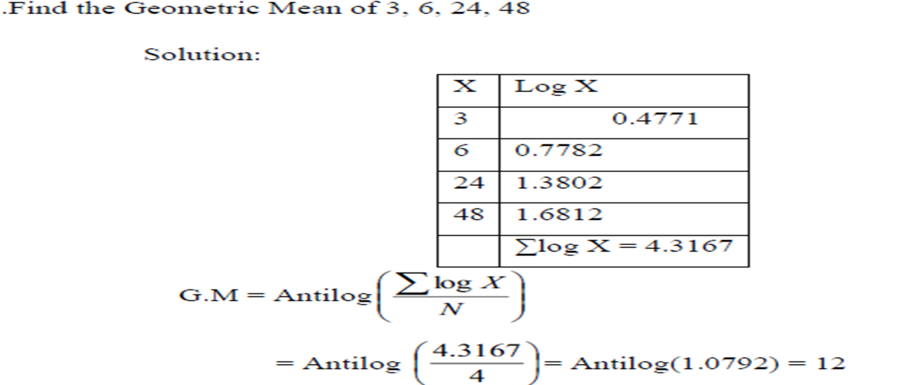
Calculate the Geometric Mean for the Individual Series

Slide 31
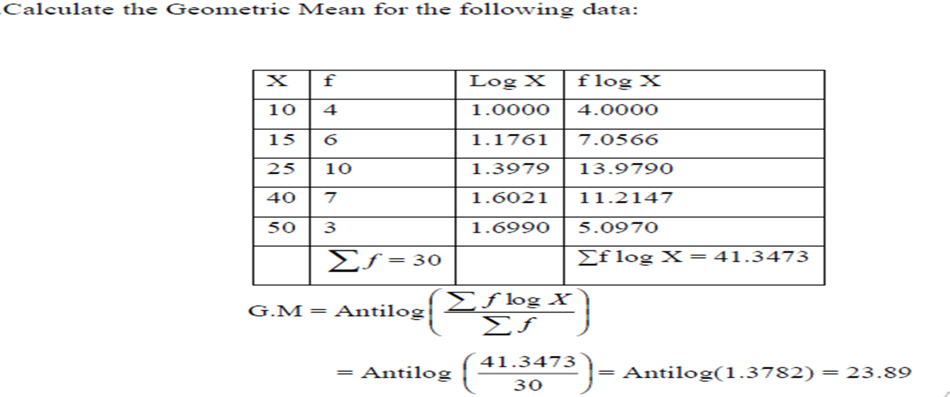
Calculate the Geometric Mean for the Discrete Series:

Slide 32
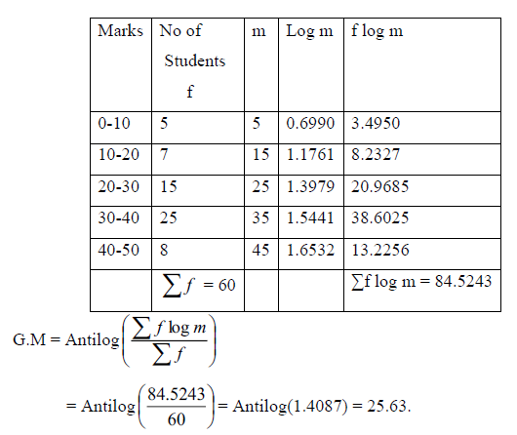
Compute the Geometric Mean for the following Continuous Series:

Slide 33
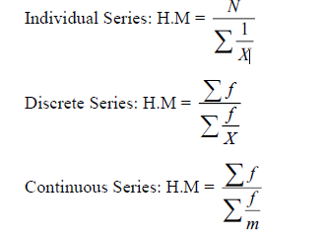
HARMONIC MEAN (HM)
Definition:
Harmonic mean is the reciprocal of the arithmetic mean of the reciprocal of observation.It is abbreviated as H.M.

Slide 34
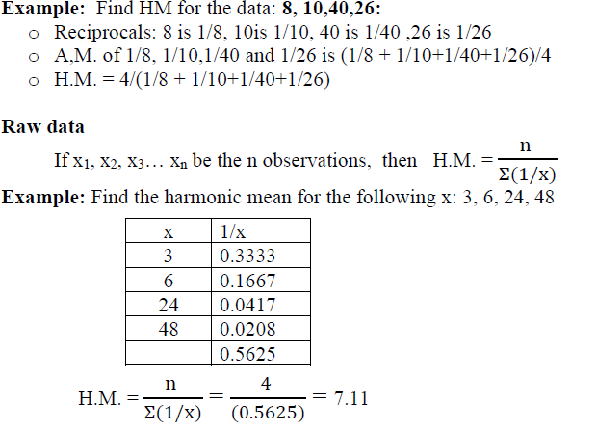
HARMONIC MEAN IN INDIVIDUAL SERIES:

Slide 35
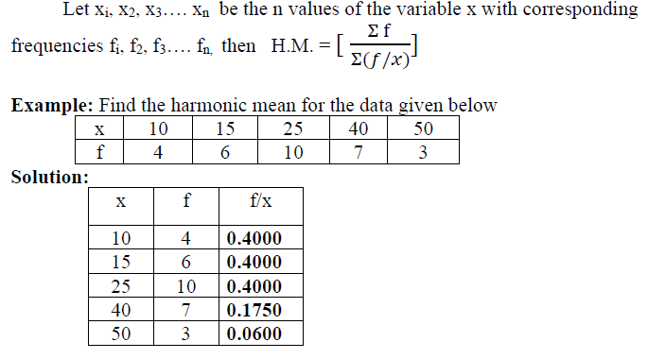
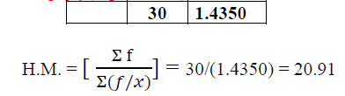
HARMONIC MEAN IN DISCRETE SERIES:

Slide 36
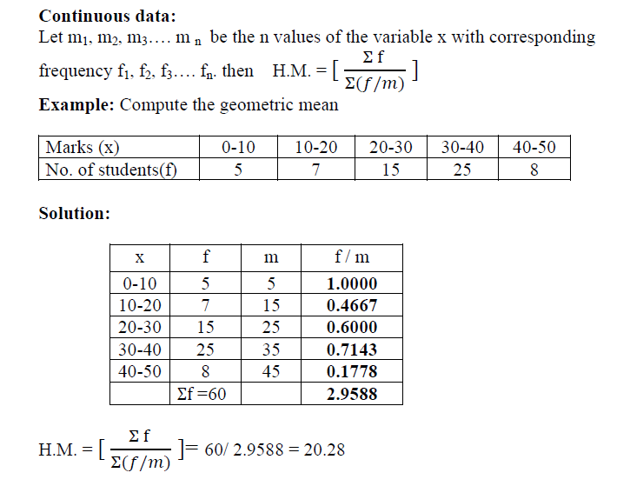
HARMONIC MEAN IN CONTINUOUS SERIES:

Slide 37


Which central tendency to use?
The level of measurement of the
data.
Mode---Nominal, Ordinal, Interval or Ratio
Median--- Ordinal, Interval, or Ratio
Mean---Interval or Ratio

