Slide 1
Biomechanical & Kinesiological Analysis in Sports
Pre.Ph.D Course work (Physical Education)
TOPIC-Fundamental Motor Skills
DR.VIPENDRA SINGH PARMAR
(Dean and H.O.D. Physical Education)
VSSD PG COLLEGE KANPUR

Slide 2
Learning Objectives
🧠
Define biomechanics & kinesiology
⚡
Explain basic mechanical principles
🏃
Analyse walking, running, jumping, throwing, catching
🏥
Explain role of therapeutic exercise in rehab
🦴
Describe posture, deformities & corrective exercises

Slide 3
What is Biomechanics?
Study of human movement using laws of mechanics
Combines anatomy, physics, engineering
Aims: performance enhancement & injury prevention

Slide 4
Branches of Biomechanics
Statics
Dynamics
Bodies at rest / constant velocity
Bodies with acceleration
Kinematics
Kinetics
Description of motion (displacement, velocity, acceleration)
Forces causing motion (force, torque, impulse)

Slide 5
Basic Anatomical Planes & Axes
Sagittal plane – flexion/extension
Frontal plane – abduction/adduction
Transverse plane – rotation
Axes: frontal, sagittal, vertical
3D human model with colored planes

Slide 6
Types of Motion
Linear (Translatory)
Angular (Rotatory)
Sliding, straight sprint
Movement around an axis (e.g., elbow flexion)
General Motion
Combination of linear & angular (common in sports)

Slide 7
Forces in Human Movement
Internal Forces
Muscle tension, ligament tension
External Forces
Gravity, ground reaction force, friction, air resistance
Resultant force determines motion

Slide 8
Newton's Laws in Sport
1st (Inertia): Start/stop/change requires force
2nd (Acceleration): F = m × a
3rd (Action–Reaction): Equal & opposite forces
Runner at blocks • Sprinter accelerating • Jumper pushing ground

Slide 9
Levers & Torque
Bones = levers, joints = fulcrums, muscles = force
1st, 2nd, 3rd class levers in body
Torque = Force × Moment arm
Importance for strength & range of motion
Lever diagrams overlaid on elbow, ankle, neck

Slide 10
What is Kinesiological Analysis?
Study of muscles, joints & movement patterns
Identifies prime movers, stabilizers, antagonists
Helps plan training & rehab programs
Muscle-labeled figure performing a squat

Slide 11
Muscle Actions & Contractions
Types of Contractions
Concentric
Eccentric
Isometric
Kinetic Chain Exercises
Open kinetic chain exercises (e.g., leg extension)
Closed kinetic chain exercises (e.g., squat)

Slide 12
Fundamental Motor Skills (FMS)
Basic building blocks of complex skills
Locomotor: walking, running, jumping
Object control: throwing, catching
Stability: balance, posture
Grid of icons for each FMS

Slide 13
Mechanical Analysis: Walking (Gait)
WALKING (चलना)
Definition-A rhythmic, cyclic locomotor movement where one foot is always in contact with the ground.
Phases:
Stance Phase (70%) – पैर ज़मीन पर
Heel strike → Foot flat → Mid stance → Toe off
शरीर का वजन एक पैर पर शिफ्ट होता है
Swing Phase (30%) – पैर हवा में
Early swing → Mid swing → Late swing
Key Mechanics-
Centre of Gravity (COG) कम ऊँचाई पर रखी जाती है
Arms Swing संतुलन बनाए रखता है
Stride Length स्थिर और रिदमिक
Knee Flexion झटके (impact) को कम करती है
•

Slide 14
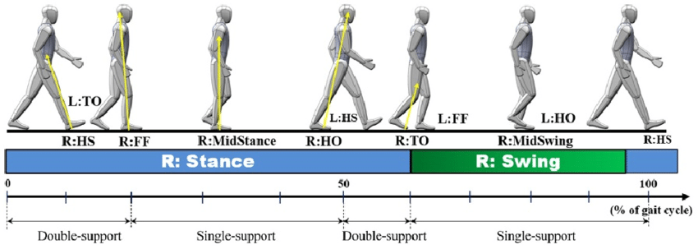
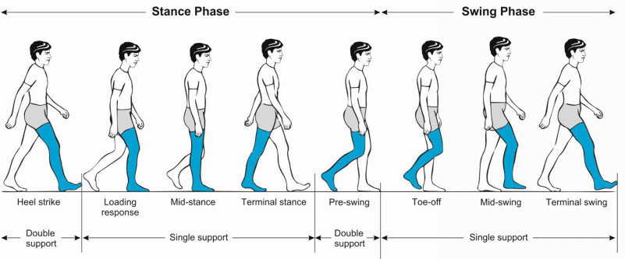

Slide 15
Mechanical Analysis: Running
Definition.
A locomotor movement where both feet leave the ground during the flight phase.
Phases- Support Phase → Drive Phase → Recovery Phase → Flight
Phases:
1. Support Phase
o Foot strike → Mid support → Toe off
2. Flight Phase
o दोनों पैर हवा में (walking से मुख्य अंतर)
Key Mechanics
• Longer Stride Length (बड़ा कदम)
• Greater Forward Lean (थोड़ा आगे झुकना)
• More Knee Lift
• Arms Drive the Movement – हाथों का तेज़ स्विंग गति बढ़ाता है
• Higher Ground Reaction Force (ज़मीन का जोर अधिक)

Slide 16
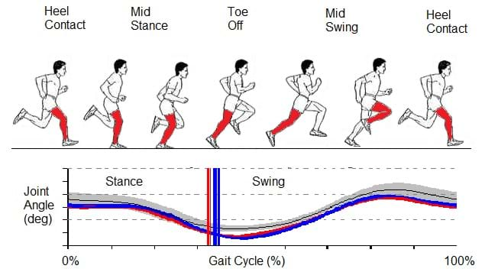
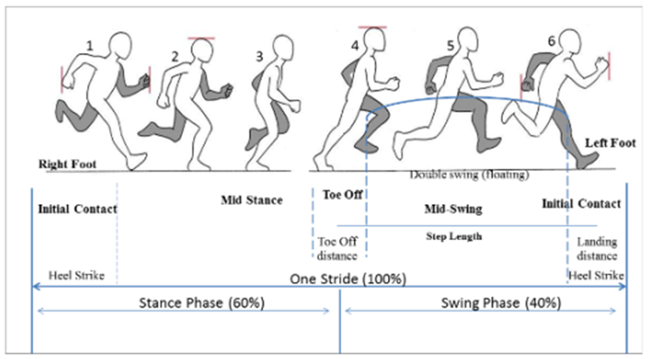

Slide 17
Mechanical Analysis: Jumping
Definition-Projecting the body upward or forward by forceful extension of the lower limbs.
Phases-Preparatory → Take-off → Flight → Landing
1. Preparatory Phase (लोडिंग)
o घुटने मोड़ना, हाथ पीछे ले जाना
2. Take-off Phase
o पैर ज़ोर से सीधा, हाथ ऊपर
3. Flight Phase
o शरीर हवा में
4. Landing Phase
o घुटने मोड़कर झटका कम करना
Key Mechanics
• Impulse = Force × Time → जितना अधिक बल और समय → उतनी ऊँची छलांग
• Arm Swing → 10–15% jump height बढ़ाता है
• Knee & Hip Extension मुख्य शक्ति स्रोत

Slide 18
Mechanical Principles
Force Production
Key is explosive extension at hip, knee, ankle (triple extension).
Impulse–Momentum Relationship
Longer force application time → greater jump height/distance.
Projection Angle
Vertical jump: ~90°
Long jump: 18–22°
Center of Gravity
COG follows a parabolic path once airborne.
Landing Mechanics
Flexion at knees/hips to reduce impact forces.

Slide 19
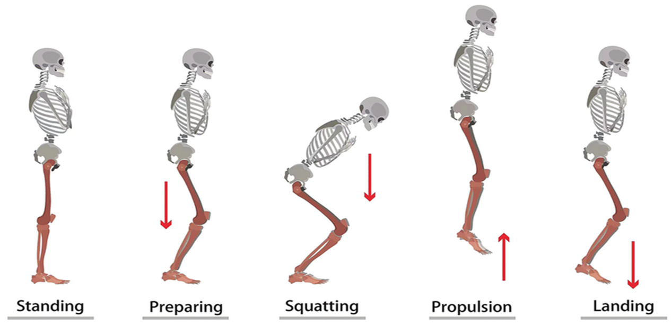

Slide 20
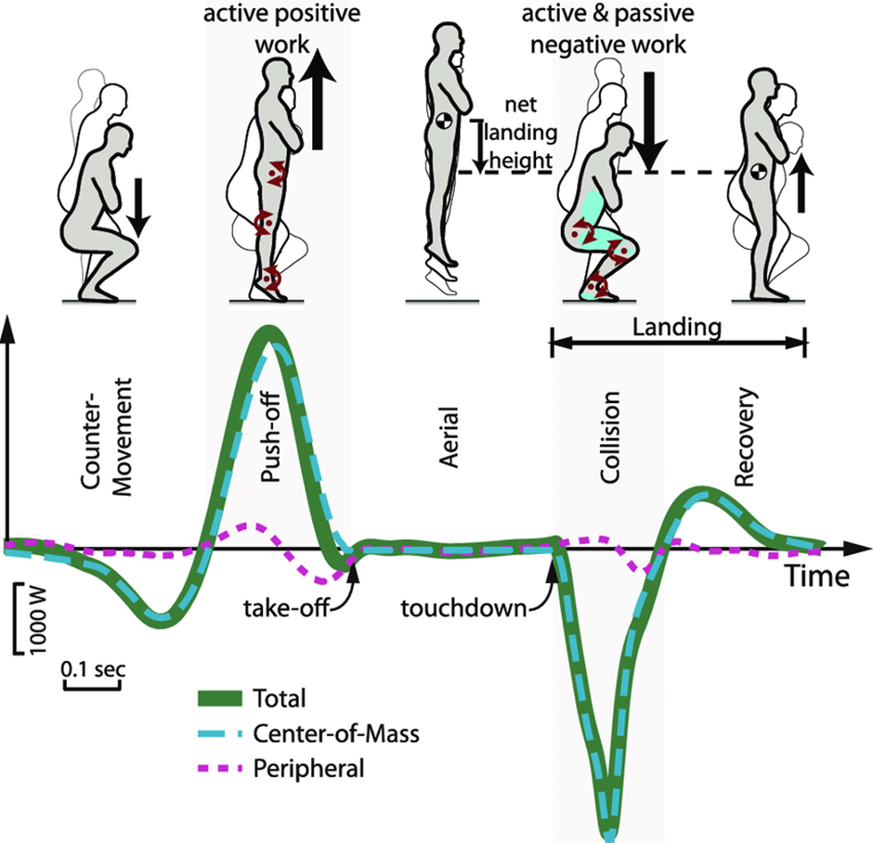

Slide 21
Mechanical Analysis: Throwing
Definition
Propelling an object by coordinated movement of body segments.
Phases-
Wind-up (तैयारी) – हाथ पीछे
Early Cocking – शरीर घुमाना
Late Cocking – अधिकतम हाथ पीछे
Acceleration – हाथ आगे तेजी से
Release – वस्तु छोड़ना
Follow-through – शरीर आगे झुकना
Key Mechanics
Sequential Motion (Proximal → Distal) Hips → Torso → Shoulder → Elbow → Wrist
Angular Velocity कलाई और कोहनी से गति बढ़ती है
Opposite Foot Step संतुलन और शक्ति बढ़ाता है

Slide 22
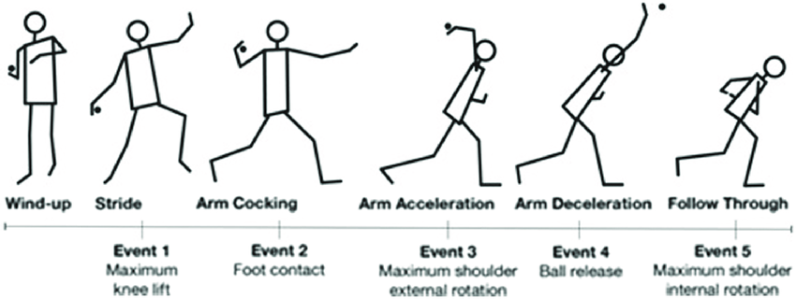
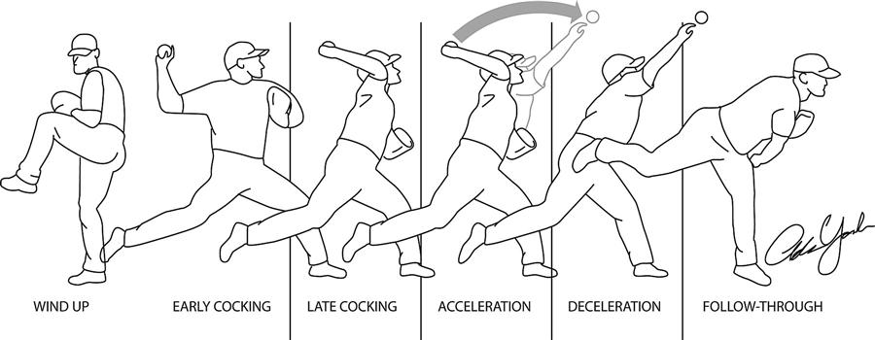

Slide 23
Mechanical Analysis: Catching
Definition-
Receiving and controlling an incoming object.
Mechanical Principles
Absorption of Force
Body moves backward with the ball to reduce impact (Impulse theory).
Hand–Eye Coordination
Tracking trajectory of the object.
Center of Gravity & Balance
Lower COG improves stability.
Positioning
Hands form a "soft cradle" for secure catching.
Newton’s Laws
Reducing the object’s momentum smoothly prevents rebound.

Slide 24
Mechanical Analysis
Key Points:
Eyes on object (दृष्टि केंद्रित रखना)
Arms extend → गेंद को मिलने की जगह बढ़ती है
Absorbing Force
गेंद पकड़ते समय हाथ पीछे खींचना ताकि टक्कर का झटका कम हो
Hand Position
बड़ी गेंद: हाथ बाहर की ओर
छोटी गेंद: हाथ कप-आकार में
Purpose of Mechanics
गति कम करके नियंत्रण बढ़ाना
शरीर का संतुलन बनाए रखना

Slide 25
SHORT COMPARISON TABLE
| Skill | Key Mechanical Feature | Determining Factor |
| Walking | Constant ground contact | Stride length & cadence |
| Running | Flight phase | Horizontal force & GRF |
| Jumping | Projection mechanics | Impulse & take-off angle |
| Throwing| Sequential summation of forces | Release speed & angle |
| Catching | Force absorption & tracking | Momentum control |

Slide 26
Common Errors & Injury Risks in FMS
Overstriding in running → knee/hip stress
Poor landing mechanics → ACL/ankle injuries
Throwing with only arm → shoulder strain
Incorrect catching technique → finger injuries
"Wrong vs Right" comparisons for each issue

Slide 27
Types/Concepts of Mechanical Analysis
Qualitative
Observational, coaching eye
Quantitative
Measurements, force plates, video analysis
Selection depends on: purpose, equipment, athlete level

Slide 28
Therapeutic Exercise: Definition & Goals
Planned physical movements to restore function
Reduce pain & swelling
Restore range of motion & strength
Improve functional capacity
Must be: individualized & progressive

Slide 29
Role in Acute Injury Rehab
Protection & controlled loading
Early pain-free range of motion
Isometric strengthening
Prevention of stiffness & muscle atrophy
Staged timeline from injury to early exercises

Slide 30
Role in Chronic/Overuse Injuries
Correct faulty biomechanics & technique
Improve flexibility, strength, endurance
Address muscle imbalance & poor posture
Gradual return-to-sport programs
Athlete doing corrective strengthening under supervision

Slide 31
Posture: Definition & Importance
Alignment of body segments against gravity
Good posture: minimal stress on supporting structures
Affects breathing, circulation, movement efficiency
Types: static vs dynamic posture
Side-view comparison of good vs poor posture skeleton

Slide 32
Postural Deformities & Corrective Exercise
Kyphosis: extension & strengthening exercises
Lordosis: core strengthening, stretch hip flexors
Scoliosis: strengthen concave side, stretch convex
Flat foot: arch-strengthening, proper footwear

Slide 33
Summary & Key Takeaways
Biomechanics + kinesiology = understanding & improving movement
Mechanical analysis of FMS helps performance & reduces injury risk
Therapeutic exercise is central to rehabilitation
Correct posture & corrective exercises prevent long-term problems

