Slide 1
Drug Master File (DMF)

Slide 2
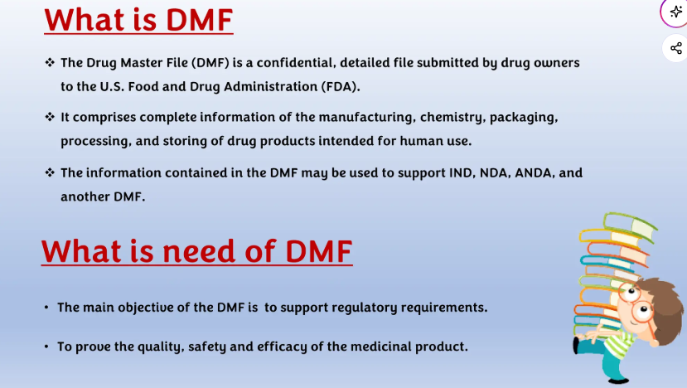

Slide 3
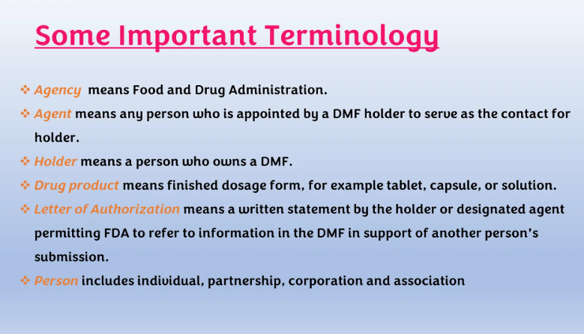

Slide 4
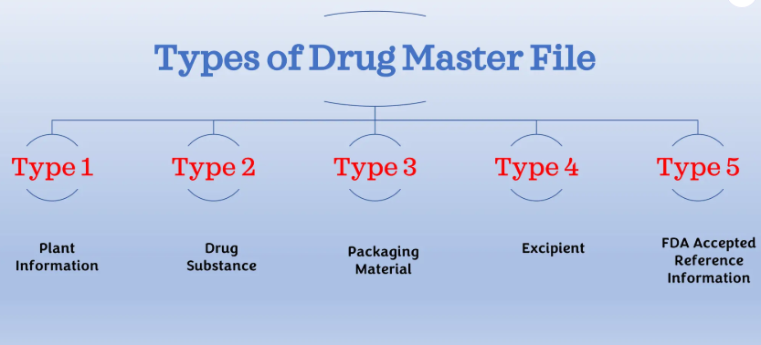

Slide 5
Type I: Manufacturing Site, Facilities, Operating Procedures, and Personnel
A Type I DMF is recommended for a person outside of the United States to assist FDA in conducting on-site inspections of their manufacturing facilities. The DMF should describe the manufacturing site, equipment capabilities, and operational layout.
A Type I DMF is normally not needed to describe domestic facilities, except in special cases, such as when a person is not registered and not routinely inspected.
The description of the site should include actual site address, and a map showing its location with respect to the nearest city. An aerial photograph and a diagram of the site may be helpful.
A diagram of major production and processing areas is helpful for understanding the operational layout. Major equipment should be described in terms of capabilities, application, and location. Make and model would not normally be needed unless the equipment is new or unique.

Slide 6
Type II: Drug Substance, Drug Substance Intermediate, and Material Used in Their Preparation, or Drug Product
A Type II DMF should, in general, be limited to a single drug intermediate, drug substance, drug product, or type of material used in their preparation.
DMF for:
1. Drug Substance Intermediates, Drug Substances, and Material Used in their Preparation
Summarize all significant steps in the manufacturing and controls of the drug intermediate or substance.
Guideline for Submitting Supporting Documentation in Drug Applications for the Manufacture of Drug Substances.
Guideline for the Format and Content of the Chemistry, Manufacturing, and Controls (CMC) Section of an Application.
2. Drug Product
Guideline for the Format and Content of the Chemistry, Manufacturing, and Controls section of an Application.
Guidelines for submitting documentation for the manufacture of and controls for drug products.
Guidelines for submitting samples and analytical data for methods validation.

Slide 7
Type III: Packaging Material
Each packaging material should be identified by the intended use, components, composition, and controls for its release. The names of the suppliers or fabricators of the components used in preparing the packaging material and the acceptance specifications should also be given.
Data supporting the acceptability of the packaging material for its intended use should also be submitted as outlined in the Guideline for Submitting Documentation for Packaging for Human Drugs and Biologics.
Toxicological data on these materials would be included under this type of DMF, if not otherwise available by cross reference to another document.

Slide 8
Type IV: Excipient, Colorant, Flavor, Essence, or Material Used in Their Preparation
Each additive should be identified and characterized by its method of manufacture, release specifications, and testing methods.
Toxicological data on these materials would be included under this type of DMF, if not otherwise available by cross reference to another document.
Usually, the official compendia and FDA regulations for color additives (21 CFR parts 70 through 82), direct food additives (21 CFR parts 170 through 173), indirect food additives (21 CFR parts 174 through 178), and food substances (21 CFR parts 181 through 186) may be used as sources for release tests, specifications, and safety.
Guidelines suggested for a Type II DMF may be helpful for preparing a Type IV DMF.

Slide 9
Type V: FDA Accepted Reference Information
FDA discourages the use of Type V DMFs for miscellaneous information, duplicate information, or information that should be included in one of the other types of DMFs.
If any holder wishes to submit information and supporting data in a DMF that is not covered by Types I through IV, a holder must first submit a letter of intent to the Drug Master File Staff. FDA will then contact the holder to discuss the proposed submission.

Slide 10
Submission to Drug Master Files
Each DMF submission should contain a transmittal letter, administrative information about the submission, and the specific information to be included in the DMF as described in this section.
The DMF must be in the English language. Whenever a submission contains information in another language, an accurate certified English translation must also be included.
Each page of each copy of the DMF should be dated and consecutively numbered.
An updated table of contents should be included with each submission.

Slide 11
A. Transmittal Letters
1. Original Submissions
Identification of submission: Original, the type of DMF as classified in types of DMF.
Signature of the holder or the authorized representative.
Typewritten name and title of the signer.
2. Amendments
Identification of submission: Amendment, the DMF number, type of DMF, and the subject of the amendment.
A description of the purpose of submission, e.g., update, revised formula, or revised process.
Signature of the holder or the authorized representative.
Typewritten name and title of the signer.

Slide 12
B. Administrative Information
Original Submission
Names and Address of the following
DMF holder
Corporate headquarter
Manufacturing/Processing Facilities
Contact for FDA Correspondence
Agent if any
The specific responsibilities of each person listed in any of the categories in Section A.
Statement of commitment
2. Amendments
Name of DMF holder
DMF number
Name and address for correspondence
Affected section or page numbers of the DMF
The number of each IND, NDA. ANDA, DMF and export application that relies on the subject of the amendments for support, if known.

Slide 13
C. General Information and Suggestions
Environmental Assessment
Type II, Type III, and Type IV DMFs must include a commitment from the firm stating that all facilities operate in compliance with applicable environmental laws and regulations.
Stability
Stability study design, data, and interpretation must be submitted where applicable.
Documentation should follow the Guideline for Submitting Documentation for the Stability of Human Drugs and Biologics.

Slide 14
D. Format & Assembly
The DMF should be submitted in Original and Duplicate jackets, properly collated, assembled, paginated, and jacketed using covers obtained from the Government Printing Office specifically provided for DMFs.
Multiple volumes must be clearly numbered, and the paper should be of standard size.
Paper length should be not less than 10 inches and not more than 12 inches.
Each volume of a DMF should not exceed 2 inches in thickness.

Slide 15
E. Delivery to FDA
Drug Master File (DMF) submissions and related correspondence should be addressed as follows:
Drug Master File Staff Food and Drug Administration 5901-B Ammendale Road Beltsville, MD 20705-1266 USA

Slide 16
F. Authorization to Refer to a Drug Master File
Letter of Authorization (LOA) to FDA
Before the FDA can review DMF information in support of an application, the DMF holder must submit (in duplicate) a Letter of Authorization (LOA) permitting the FDA to reference the DMF.
If the holder cross-references its own DMF, a Letter of Authorization must still be supplied. A separate transmittal letter is not required with the LOA.

Slide 17
Contents of the Letter of Authorization (LOA)
The Letter of Authorization should include the following:
Date
Name of the DMF holder
DMF number
Name of the person authorized to incorporate information from the DMF by reference
Specific product covered by the DMF
Submission date
Section numbers and page numbers to be referenced
Statement confirming that the DMF is current and that the holder will comply with all statements made in it
Signature of the authorizing official
Typed name and title of the official authorizing reference to the DMF

Slide 18
Drug Master File (DMF) Review
A DMF is neither approved nor disapproved by the FDA.
A DMF is reviewed only when referenced by a sponsor in an application (e.g., IND or NDA).
If FDA reviewers identify deficiencies in a DMF, a deficiency letter is sent to the DMF holder.
The general subject of the deficiency is identified; however, detailed information is disclosed only to the DMF holder.
When responding to a deficiency letter, the DMF holder should submit the requested information and provide a copy of the accompanying transmittal letter to affected parties relying on the DMF.
The transmittal letter serves as notification that the deficiencies have been addressed.

Slide 19
Holder Obligation
Any change or addition, including changes in authorization related to specific customers, must be submitted in duplicate and properly cross-referenced to the previous submission.
Each reference should clearly include the date, volume number, section number, and page number affected.

Slide 20
DMF Updates and Notifications (Continued)
A. Notice Required for Changes to a DMF
The DMF holder must notify each affected applicant or sponsor who has referenced the DMF of any relevant change (21 CFR 314.420).
Notice should be provided before making the change to allow the applicant/sponsor to amend their application if necessary.
B. Listing of Persons Authorized to Refer to a DMF
The DMF must contain a complete list of persons authorized to incorporate information by reference (21 CFR 314.420).
This list should be updated annually and must include:
Holder’s name
DMF number
Date of update
Identification of each authorized person
Location of referenced information (date, volume, section, page number)
C. Annual Update
The DMF holder must submit an annual report on the anniversary date of the original submission.
If no changes are made, a statement confirming that the DMF remains current should be submitted.
Failure to update may lead to FDA initiating DMF closure procedures.

Slide 21
Continued…
D. Appointment of an Agent
Upon appointing an agent, the holder must provide the DMF with a signed letter of appointment that includes the agent's name, address, and area of authority (administrative or scientific).
While foreign DMF holders are being encouraged to work with a U.S. agent, domestic DMF holders are not required to designate an agent or representative.
E. Transfer of Ownership
To transfer ownership of a DMF to another party, the holder should so notify FDA and authorized persons in writing. The letter should include the following:
Name of transferee
Address of transferee
Name of responsible official of transferee
Effective date of transfer
Signature of the transferring official
Typewritten name and title of the transferring official.

Slide 22
CLOSURE OF A DRUG MASTER FILE
A holder who wishes to close a DMF should submit a request to the Drug Master File Staff stating the reason for the closure.
The Agency may close a DMF that does not contain an annual update of persons authorized to incorporate information in the DMF by reference and a list of changes made since the previous annual report. The holder will be notified of FDA’s intent to close the DMF.

