Slide 1

Emerging Concepts in Marketing

Slide 2
Emerging Concepts in Marketing
Marketing is an ever-evolving field, and there are several emerging concepts that are gaining traction in the industry.
Here are a few examples:
Personalization:
Personalization involves tailoring marketing messages and experiences to individual consumers based on their preferences and behavior.
With the rise of big data and AI, companies are increasingly able to personalize their marketing efforts and create more meaningful connections with customers.

Slide 3
Experiential marketing:
Experiential marketing focuses on creating memorable experiences for customers through immersive events or interactions.
This approach can help to build brand loyalty and increase engagement, particularly among younger consumers.
Influencer marketing:
Influencer marketing involves partnering with social media influencers to promote products or services.
Influencer marketing has become increasingly popular in recent years, particularly on platforms like Instagram and YouTube.

Slide 4
Purpose-driven marketing:
Purpose-driven marketing involves aligning a brand's values and messaging with a larger social or environmental cause.
This approach can help to build brand loyalty and attract customers who are looking to support companies that are making a positive impact.
Omnichannel marketing:
Omnichannel marketing involves providing a seamless and consistent experience across all channels, including social media, email, website, and brick-and-mortar stores.
This approach recognizes that customers often use multiple channels to interact with a brand and seeks to provide a cohesive experience regardless of where the customer is engaging.

Slide 5
Voice search optimization:
With the rise of smart speakers and voice assistants, optimizing for voice search is becoming increasingly important.
This involves optimizing website content and search engine optimization (SEO) strategies to ensure that they are easily discoverable through voice search.

Slide 6
Vertical & Horizontal Marketing
Vertical marketing, also known as niche marketing, involves targeting a specific industry or market segment with a specialized product or service.
The idea behind vertical marketing is to focus on a particular vertical market and offer a product or service that meets the specific needs of that market.
For example, a company that specializes in producing medical devices may focus exclusively on marketing their products to hospitals and healthcare providers.

Slide 7
Horizontal marketing, on the other hand, involves targeting a broad range of customers with a single product or service.
The goal of horizontal marketing is to appeal to as many customers as possible, regardless of their industry or market segment.
For example, a company that produces a popular soft drink may market their product to consumers of all ages and demographics.

Slide 8
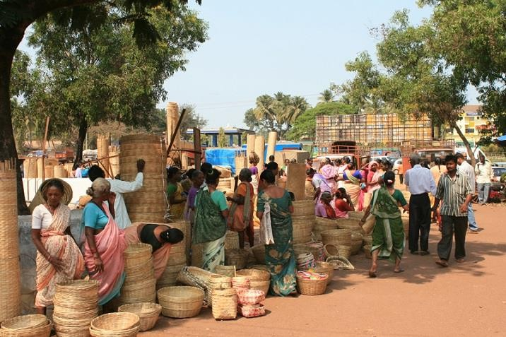
Rural Marketing
Marketing to rural areas can be challenging due to the unique characteristics of rural consumers and the lack of infrastructure and distribution channels in these areas.
However, there are several strategies that companies can use to effectively market their products and services to rural consumers, including:

Slide 9
Developing products that meet the specific needs and preferences of rural consumers, such as low-cost and durable products that are suitable for rural lifestyles.
Creating marketing campaigns that resonate with rural consumers and highlight the benefits of the product or service.
Partnering with local organizations and community leaders to build trust and establish a presence in rural areas.

Slide 10

Using innovative distribution channels, such as mobile vans or local retailers, to reach consumers in remote rural areas.
Offering after-sales support and servicing to build customer loyalty and satisfaction.
Providing education and awareness programs to educate rural consumers about the benefits and usage of the product or service.

Slide 11
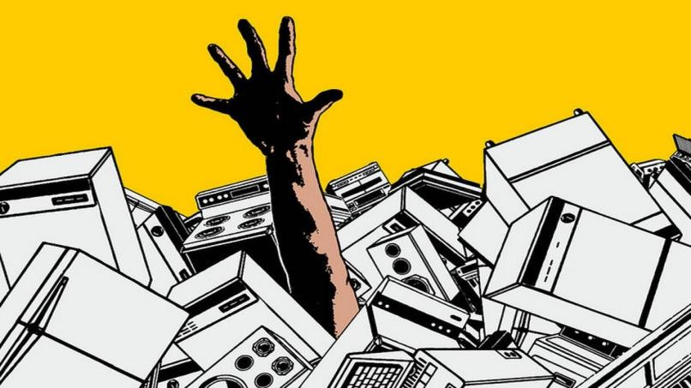
Consumerism
Consumerism refers to a social and economic movement that advocates for the rights and protection of consumers in the marketplace.
It emerged in the 1960s and 1970s as a response to the perceived exploitation of consumers by businesses, and has since evolved into a broader movement focused on promoting sustainable consumption and ethical business practices.

Slide 12
There are several key aspects of consumerism, including:
Consumer protection:
Advocating for laws and regulations that protect consumers from fraud, deception, and other harmful practices.
Consumer education:
Encouraging consumers to become more informed and educated about their choices, and to make purchasing decisions that align with their values.

Slide 13
Sustainable consumption:
Promoting the use of products and services that are environmentally and socially sustainable, and advocating for businesses to adopt sustainable practices.
Ethical business practices:
Advocating for businesses to adopt ethical practices that prioritize the well-being of consumers, employees, and other stakeholders.
Corporate responsibility:
Holding businesses accountable for their actions and encouraging them to be transparent about their practices and policies.

Slide 14

Industrial Marketing
Industrial marketing, also known as business- to-business (B2B) marketing, refers to the marketing of products and services from one business to another.
Industrial marketing differs from consumer marketing in that the target market is other businesses, rather than individual consumers.

Slide 15
Some key strategies used in industrial marketing include:
Developing strong relationships with customers:
Industrial marketers often rely on long-term relationships with their customers, as these relationships can help to build trust and loyalty over time.
Offering customized products and services:
Industrial marketers often develop customized products and services that are tailored to the specific needs and preferences of their customers.

Slide 16
Providing after-sales support:
Industrial marketers often provide extensive after-sales support to ensure that their customers are satisfied with their purchases and to address any concerns or issues that may arise.
Building strong distribution networks:
Industrial marketers often work closely with distributors and other partners to ensure that their products and services are available to customers when and where they need them.
Providing technical assistance and training:
Industrial marketers often provide technical assistance and training to help their customers understand how to use their products and services effectively.

Slide 17

Global Marketing
Global marketing refers to the process of planning, producing, promoting, and distributing products and services on a global scale.
It involves identifying and targeting consumers in different countries and regions around the world, and adapting marketing strategies and tactics to meet the unique needs and preferences of these consumers.

Slide 18

Some key strategies used in global marketing include:
1. Conducting market research:
Global market needs,
marketers must conduct extensive research to
understand the unique
preferences, and behaviors of
consumers in different countries and regions.

Slide 19
Developing a global marketing strategy:
Global marketers must develop a comprehensive marketing strategy that takes into account the unique needs and preferences of consumers in different countries and regions, as well as the company's overall goals and objectives.
Adapting products and services:
Global marketers must adapt products and services to meet the unique needs and preferences of consumers in different countries and regions.
This may involve making changes to the product itself, as well as packaging, labeling, and other aspects of the marketing mix.

Slide 20
Adapting marketing communications:
Global marketers must adapt their marketing communications to the language, culture, and regulatory environment of different countries and regions.
This may involve translating advertising messages, using different media channels, and complying with local advertising regulations.
Building global partnerships:
Global marketers may build partnerships with other companies, distributors, or other stakeholders in different countries and regions to help facilitate the production, promotion, and distribution of their products and services.

