Slide 1

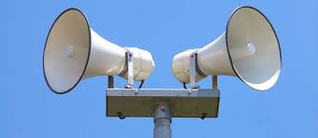
BUSINESS COMMUNICATION
L9- PUBLIC ADDRESS SYSTEM
Dr Prabhat K Dwivedi, Associate Professor
School of Business Management

Slide 2
Topics to be covered
Public Address System of Communication
Dr Prabhat K Dwivedi, Associate Professor

Slide 3
“90% of how well the talk will go is determined before the speaker steps on the platform.” – Somers White
Dr Prabhat K Dwivedi, Associate Professor

Slide 4
What Public Address System?
A public address (PA) system is an electronic sound amplification and distribution system designed to make voices, music, or alerts audible to a large audience or across a wide area.
It typically consists of a microphone (input), amplifier (power), and loudspeakers (output)
Dr Prabhat K Dwivedi, Associate Professor

Slide 5
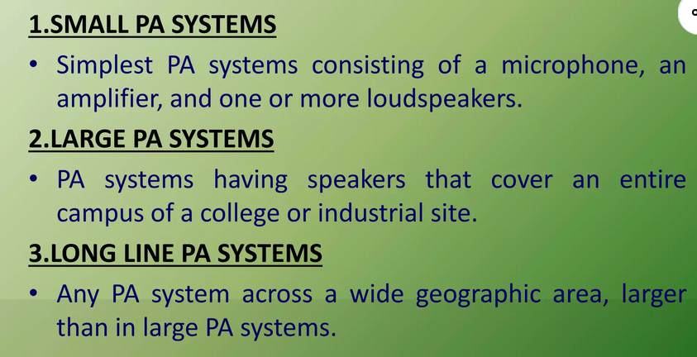
Types of Public Address System
Dr Prabhat K Dwivedi, Associate Professor

Slide 6
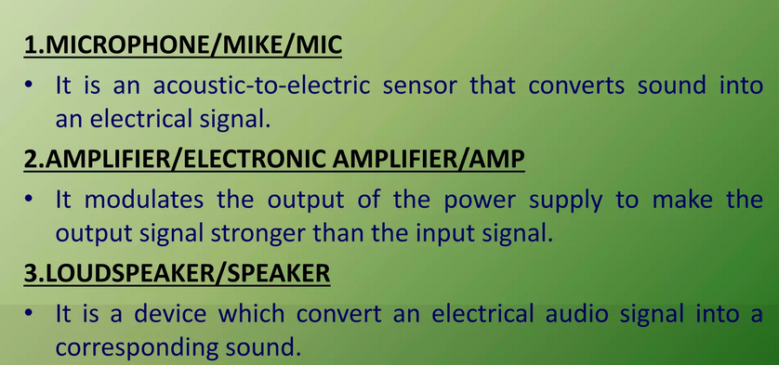
Components of Public Address System
Dr Prabhat K Dwivedi, Associate Professor

Slide 7
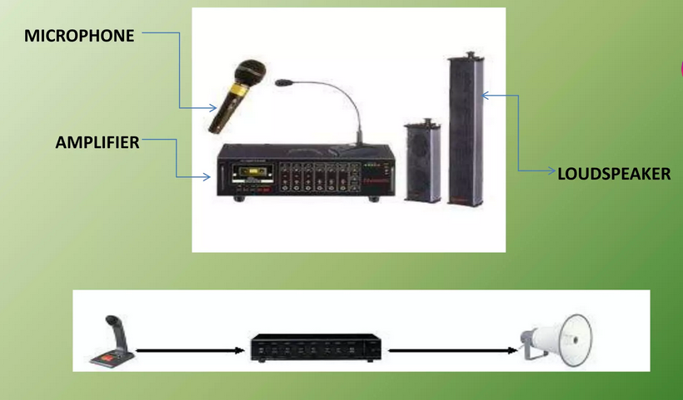
Components of Public Address System
Dr Prabhat K Dwivedi, Associate Professor

Slide 8
Key Characteristics and Components
Purpose: To increase the volume of sound, ensuring clear communication in public venues.
Components:
  Microphone: Captures sound waves and converts them into electrical signals.
  Mixer/Amplifier: Combines, processes, and increases the power of the signals.
  Speakers: Convert the amplified signals back into sound.
Applications: Used in stadiums, schools, transportation hubs, airports, factories, and event venues for announcements, live performances, and emergency alerts.

Slide 9
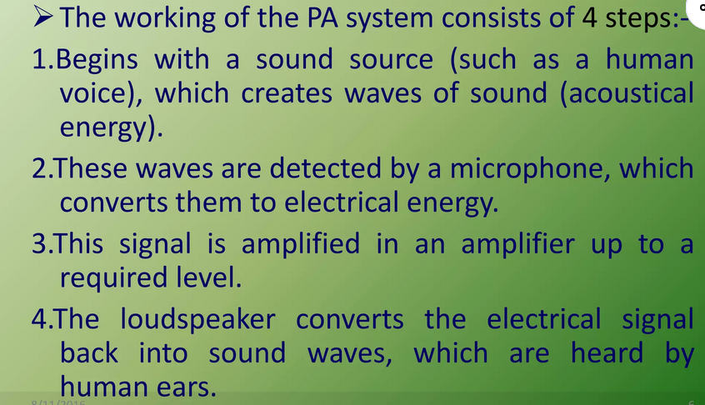
Working of PAS

Slide 10
Applications of PAS
1 | Announcement broadcast | Location, information, or alarm broadcasts
2 | Audio boost | Conferences, debates, roundtables, temples...
3 | Background music | Low-level music broadcast
4 | Music | High-level music broadcast in HIFI quality
5 | Speech and music | Common application for PA systems
Dr Prabhat K Dwivedi, Associate Professor

Slide 11


Dr Prabhat K Dwivedi, Associate Professor

Slide 12
References
https://professional.dce.harvard.edu/blog/8-ways-you-can-improve-your-communication-skills/#1-Be-clear-and-concise
Dr Prabhat K Dwivedi, Associate Professor

Slide 13

Dr Prabhat K Dwivedi, Associate Professor

