Slide 1


BUSINESS COMMUNICATION
L5-TYPES OF BUSINESS COMMUNICATION
Dr Prabhat K Dwivedi, Associate Professor
School of Business Management

Slide 2
Topics to be covered
Types of Business Communication
Dr Prabhat K Dwivedi, Associate Professor

Slide 3
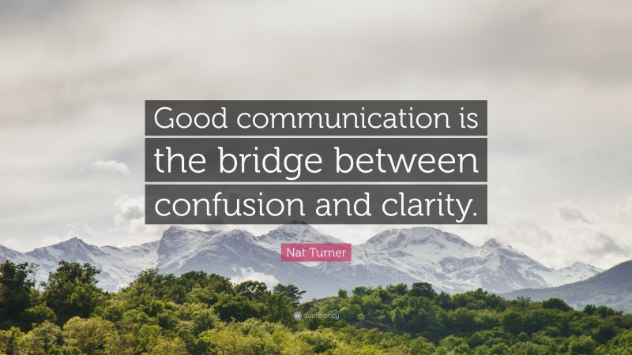
Dr Prabhat K Dwivedi, Associate Professor

Slide 4
Verbal Communication
Verbal communication is the exchange of knowledge, concepts, ideas, and emotions through spoken or written words.
It involves sending messages from one person to another using language.
It can be spoken or written.
Examples include face-to-face conversations, speeches, video conferences, phone calls, and presentations.
It can also take the form of written messages like letters, emails, and text messages.
It is essential in interpersonal interactions, business negotiations, professional contacts, education, public speaking, and other areas.
It allows people to communicate, exchange ideas, collaborate, and build relationships.

Slide 5
Written Communication
Written communication is the transmission of information, concepts, thoughts, and messages through written language.
It involves expressing ideas and communicating information using written symbols such as letters, words, phrases, and paragraphs.
Examples include memoranda, reports, articles, books, emails, texts, social media postings, and memos.
It provides a record of the information, allowing for reference and review.
It allows for careful consideration and editing before delivering the message, leading to a clearer expression of thoughts.
It is suitable for long-distance and asynchronous communication, enabling communication across boundaries and time zones.
Compared to verbal communication, written communication offers a more controlled and enduring form of communication.
Dr Prabhat K Dwivedi, Associate Professor

Slide 6
Nonverbal Communication
Nonverbal communication is the exchange of information, thoughts, and emotions without the use of words or verbal language.
Examples include body language, facial expressions, gestures, posture, eye contact, touch, and voice intonation.
It can support, reinforce, or contradict spoken communication in interpersonal relationships.
It helps in interpreting the underlying meaning and emotions conveyed through spoken words.
Nonverbal cues may have different meanings in different cultural contexts, highlighting the importance of considering cultural differences in nonverbal communication.
The interpretation of nonverbal indicators take into account individual characteristics and societal conventions.
Dr Prabhat K Dwivedi, Associate Professor

Slide 7
Electronic Communication
Electronic communication refers to the transmission of information, messages, and data using electronic devices and digital technology.
It involves transmitting data in various formats, such as text, photographs, audio, and video, through electronic channels like the Internet, email, instant messaging, social media platforms, and telecommunications networks.
It allows for rapid and extensive delivery of information across large distances.
It has become increasingly important in modern life, revolutionizing communication in areas, such as business, education, government, entertainment, and interpersonal connections.
It has transformed how people connect, collaborate, and exchange information, enhancing the effectiveness and accessibility of communication.
Dr Prabhat K Dwivedi, Associate Professor

Slide 8
Formal communication
Formal communication in an organization refers to regulated and structured communication that follows predetermined channels, rules, and standards.
It is used to convey precise messages on official topics, rules, processes, and work-related activities.
It flows in a purposeful, organized, and systematic manner.
The top-down hierarchical structure is often followed in formal communication.
Examples include memos, reports, meetings, official emails, newsletters, and formal presentations.
The language used in formal communication is typically formal, precise, and aligned with the accepted norms and standards of the company or industry.
It is employed by organizations to establish strategic plans, share official information, assign responsibilities, and communicate major news.
It ensures effective and efficient communication in the workplace by maintaining order, clarity, and accountability.
Dr Prabhat K Dwivedi, Associate Professor

Slide 9
Informal communication
Informal communication is the casual and unofficial exchange of information, ideas, and messages in an organization or social setting.
It occurs through talks, unofficial meetings, social gatherings, phone calls, instant messaging, and casual contacts.
It takes place outside formal channels and structures.
Participants engage in informal communication in a casual and unstructured manner, often disregarding hierarchical norms.
It facilitates the spontaneous sharing of ideas, viewpoints, and personal experiences, strengthening bonds of friendship and trust.
It is important in organizations as it promotes employee engagement, cooperation, and the sharing of tacit knowledge.
It fosters a positive work environment, trust, and interpersonal relationships.
It serves as a form of social support, allowing individuals to seek advice, express concerns, and participate in informal mentoring.
Dr Prabhat K Dwivedi, Associate Professor

Slide 10
Upward Communication
Feedback: Employees share their views, ideas, and concerns about their work, projects, or organizational procedures.
Suggestions and Ideas: Employees provide comments, ideas, and innovations to enhance productivity, work procedures, and organizational effectiveness.
Grievances or Concerns: Employees may express grievances or concerns about the work environment, company rules, or interpersonal disputes.
Performance Reports: Employees provide their bosses reports on their success, setbacks, and advancement for appraisal and criticism.
Seeking Clarification: When it comes to problems at work, employees go to their superiors for advice, direction, or information.
Dr Prabhat K Dwivedi, Associate Professor

Slide 11
Business Communication Channels
Email: Electronic messaging for formal written communication and document exchange within and outside the organization.
Face-to-face meetings: In-person gatherings facilitating direct communication, ideal for discussions, decision-making, and collaboration.
Video conferencing: Virtual face-to-face communication using technology, enabling real-time interaction for remote teams or clients.
Telephone/Conference calls: Voice-based communication over the phone, including conference calls for multi-participant discussions.
Instant messaging (IM): Real-time text-based communication for quick and informal exchanges within a team or organization.
Memoranda (Memos): Written documents conveying official announcements or updates for internal communication.
Reports and documentation: Formal creation of detailed documents for conveying information, analysis, or research findings.
Presentations: Communicating information using visual aids, such as slides, in person or virtually.
Social media: Utilizing online platforms for business communication, including customer engagement and brand promotion.
Intranet: Private network within an organization facilitating internal communication, document sharing, and collaboration.
Newsletters: Periodic publications offering updates and information to employees or external stakeholders.
Blogs: Corporate blogs for sharing insights, industry updates, and company news with a wider audience.
Dr Prabhat K Dwivedi, Associate Professor

Slide 12
Downward Communication
The transfer of information, guidelines, orders, criticism, and announcements from higher-level management or supervisors to employees or subordinates within an organization is referred to as downward communication. The following are characteristics of downward communication:
Instructions and Directives: Management gives employees specific instructions, rules, and directions regarding their jobs, obligations, and expected outcomes.
Feedback on Performance: When it comes to an employee’s job performance, strengths, and areas for development, supervisors provide them feedback, assessments, and performance reviews.
Organizational Announcements: Management informs staff members of any relevant updates, news, or changes to organizational policies.
Setting Goals and Objectives: To ensure that employees’ efforts are in line with the broader organizational vision, management communicates with them the organization’s goals, objectives, and targets.
Dr Prabhat K Dwivedi, Associate Professor

Slide 13
Lateral or Horizontal Communication
Peer-to-peer Communication: Lateral communication takes place between people or groups within the same organizational level, without the involvement of superiors or inferiors.
Collaboration and Coordination: It makes it easier for people or departments working toward a shared objective to coordinate their efforts, collaborate on initiatives, and share resources.
Sharing of Information: Peers can exchange knowledge, skills, best practices, and lessons learned through lateral communication.
Problem-Solving: It enables groups of people or departments to jointly address problems, generate ideas for solutions, and get feedback or counsel from peers.
Cross-Functional Communication: In an organization, lateral communication frequently takes place between people or departments from several functional areas or departments, promoting interdisciplinary cooperation.
Dr Prabhat K Dwivedi, Associate Professor

Slide 14
External Communication
Marketing and Advertising: It uses a variety of marketing and advertising channels to reach consumers and the general public, including print media, television, radio, internet commercials, social media, and promotional campaigns.
Public Relations: It influences public opinion and sustains a favorable public image. Public relations include interacting with the media, releasing press releases, planning events, and managing connections with journalists.
Customer Service: Customer service is the process of interacting with consumers through a variety of channels, including live chat, emails, phone calls, and social media, to respond to their questions, offer assistance, and guarantee their happiness.
Investor Relations: It provides information on a company’s financial performance and operations to shareholders, potential investors, and financial analysts through reports, annual meetings, investor presentations, and other channels.
Government and Regulatory Communications: This is done by getting in touch with governmental organizations, regulatory authorities, and business groups to meet legal obligations, disseminate information, and promote the interests of the company
Dr Prabhat K Dwivedi, Associate Professor

Slide 15

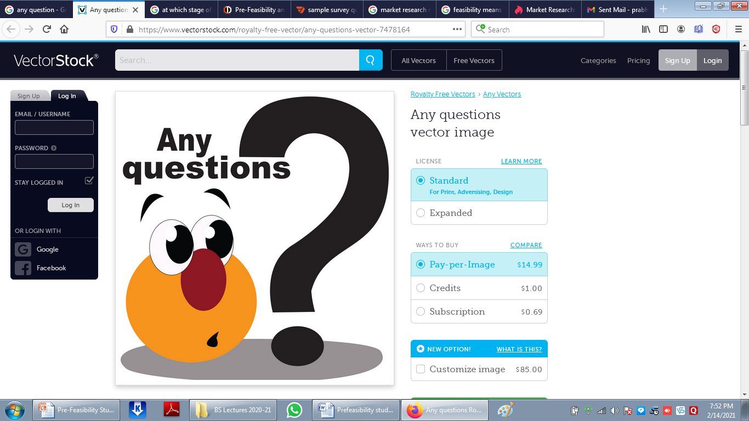
Dr Prabhat K Dwivedi, Associate Professor

Slide 16
References
https://clearinfo.in/blog/what-is-business-communication/
https://www.managementstudyguide.com/management_principles.htm
https://getuplearn.com/blog/motivation-in-hrm/
Porter, L. W. & Lawler, E. E. (1968). Managerial attitudes and performance. Dorsey Press.
https://collegevidya.com/blog/business-communication-explained/
Dr Prabhat K Dwivedi, Associate Professor

Slide 17

Dr Prabhat K Dwivedi, Associate Professor

