Slide 1


BUSINESS COMMUNICATION
L6-VERBAL COMMUNICATION
Dr Prabhat K Dwivedi, Associate Professor
School of Business Management

Slide 2
Topics to be covered
Verbal Communication
Dr Prabhat K Dwivedi, Associate Professor

Slide 3
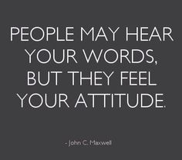
Dr Prabhat K Dwivedi, Associate Professor

Slide 4
What is Verbal Communication?
At its core, verbal communication is the art of conveying messages through words. It’s the vehicle through which we express our thoughts, share ideas, and connect with others.

Slide 5
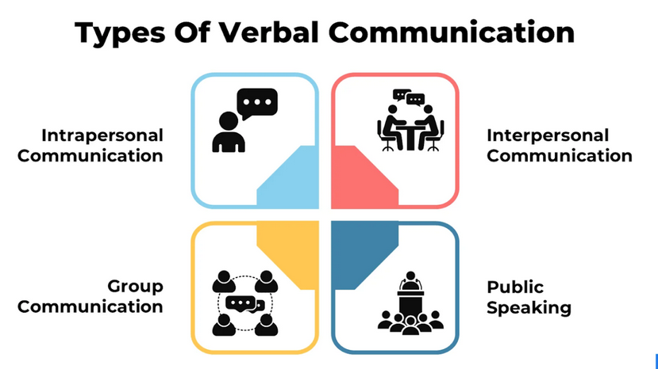

Slide 6
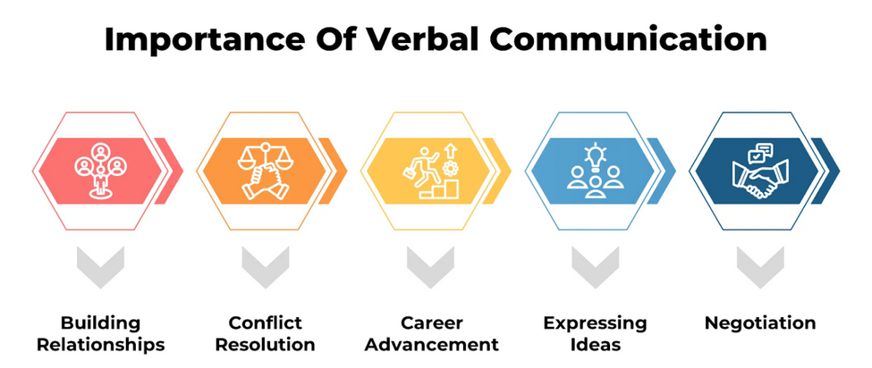

Slide 7
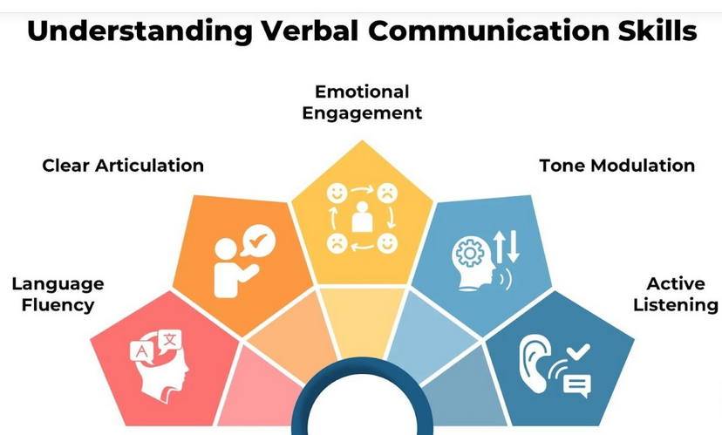
Dr Prabhat K Dwivedi, Associate Professor

Slide 8
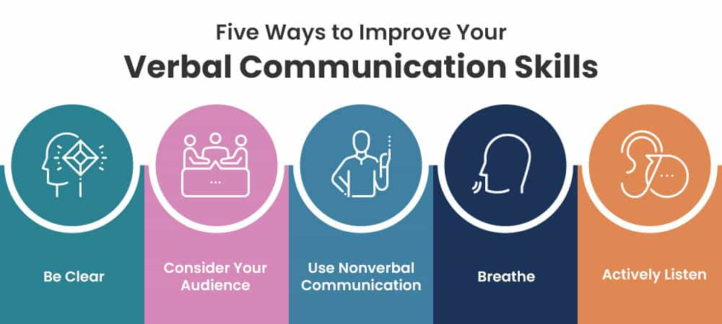
Dr Prabhat K Dwivedi, Associate Professor

Slide 9
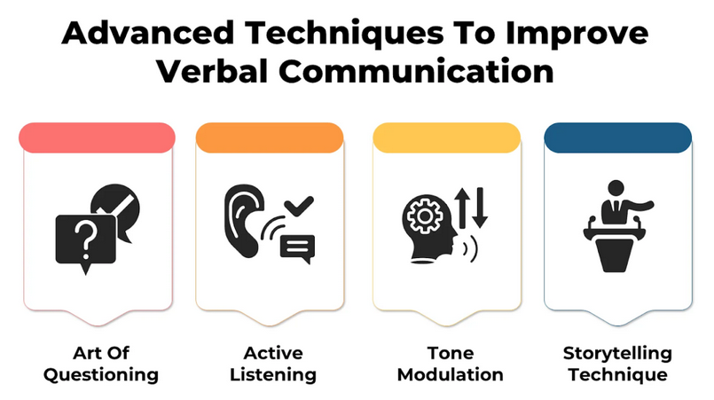
Dr Prabhat K Dwivedi, Associate Professor

Slide 10
8 Ways to Improve Your Communication Skills
1. Be clear and concise
2. Prepare ahead of time
3. Be mindful of nonverbal communication
4. Watch your tone
5. Practice active listening
6. Build your emotional intelligence
7. Develop a workplace communication strategy
8. Create a positive organizational culture
Dr Prabhat K Dwivedi, Associate Professor

Slide 11

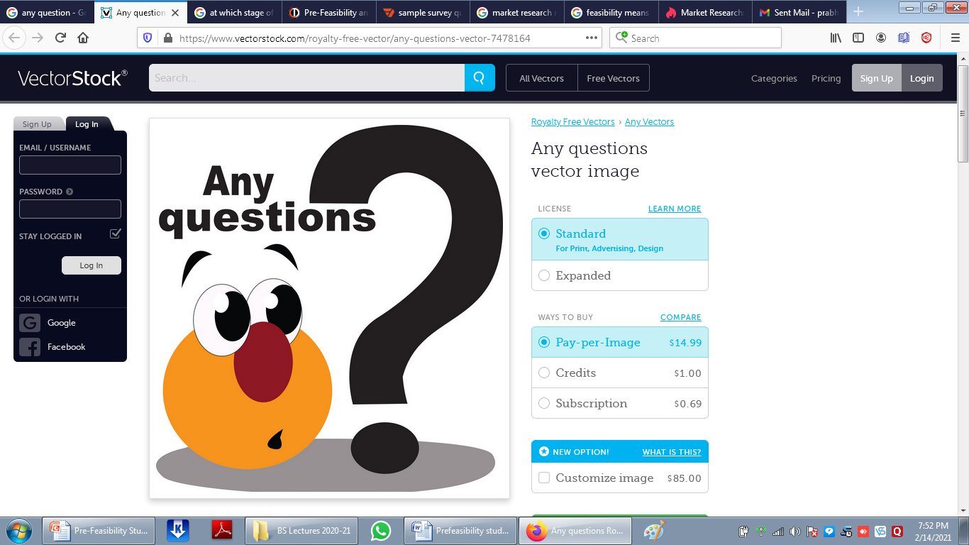
Dr Prabhat K Dwivedi, Associate Professor

Slide 12
References
https://professional.dce.harvard.edu/blog/8-ways-you-can-improve-your-communication-skills/#1-Be-clear-and-concise
Dr Prabhat K Dwivedi, Associate Professor

Slide 13

Dr Prabhat K Dwivedi, Associate Professor

