Slide 1

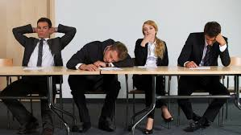
BUSINESS COMMUNICATION
L7-8: NON-VERBAL COMMUNICATION
Dr Prabhat K Dwivedi, Associate Professor
School of Business Management

Slide 2
Topics to be covered
Non-Verbal Communication
Dr Prabhat K Dwivedi, Associate Professor

Slide 3
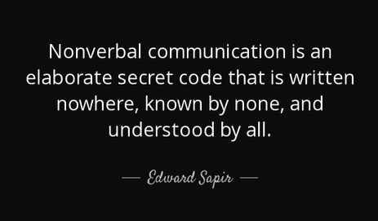
Dr Prabhat K Dwivedi, Associate Professor

Slide 4
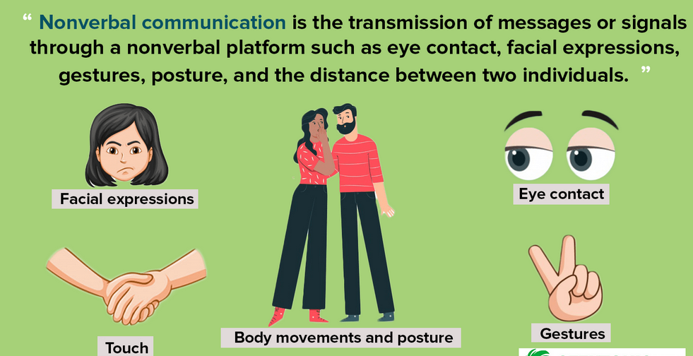
What is Non-Verbal Communication?
Dr Prabhat K Dwivedi, Associate Professor

Slide 5
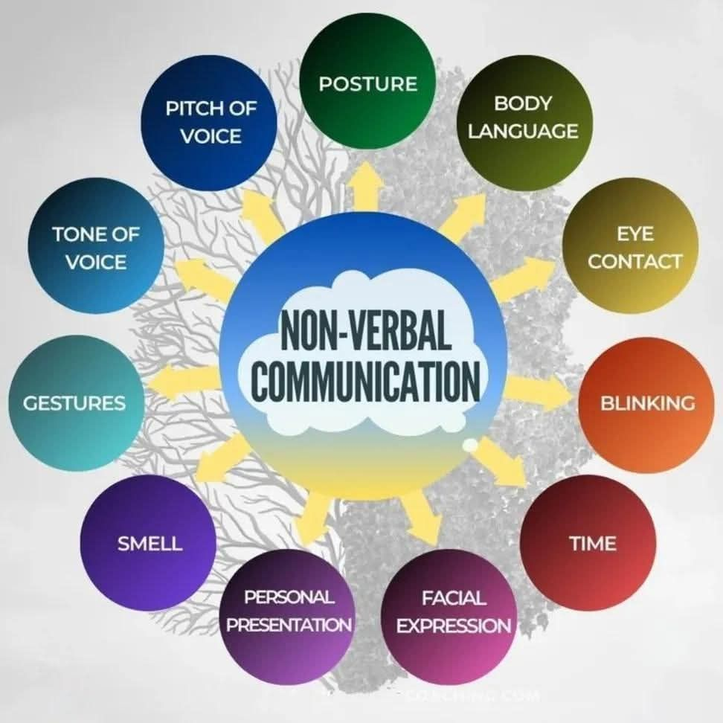
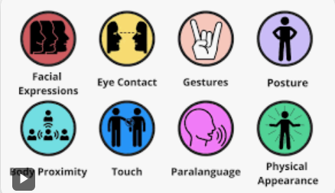
Types of Non-Verbal Communication
Dr Prabhat K Dwivedi, Associate Professor

Slide 6
Types of Non Verbal Communication
Facial Expressions: Facial movements and expressions convey a wide range of emotions, including happiness, sadness, anger, surprise, and more.
Body Language: Body language involves the use of gestures, postures, and movements to communicate messages. For example, crossing arms may signal defensiveness, while leaning forward can indicate interest or engagement.
Gestures: Hand movements and gestures are used to emphasize or complement verbal communication. Common gestures include waving, pointing, or using thumbs up or down.
Eye Contact: The level and duration of eye contact can convey various messages, such as attentiveness, sincerity, or confidence. Lack of eye contact may suggest discomfort or disinterest.
Proximity (Personal Space): The physical distance between individuals during communication can communicate social norms, intimacy, or personal boundaries. Different cultures may have varying expectations regarding personal space.
Tone of Voice: The pitch, tone, and volume of one's voice contribute to the overall message. Changes in tone can convey emotions, intentions, or emphasis.
Touch: Physical contact, such as handshakes, hugs, or pats on the back, can communicate a range of emotions, from warmth and support to authority or dominance.
Posture: The way individuals position their bodies can convey openness, confidence, or defensiveness. For instance, standing tall may signal confidence, while slouching might suggest a lack of interest.
Appearance: Clothing, grooming, and overall appearance can communicate information about a person's identity, status, or professionalism.
Silence: Silence can be a powerful form of nonverbal communication. It can convey agreement, disagreement, discomfort, or the need for reflection.
Facial Microexpressions: Brief, involuntary facial expressions that reveal genuine emotions. These microexpressions often occur quickly and can be challenging to conceal.
Paralinguistics: This includes elements like intonation, pitch, and rhythm of speech, which can convey additional meaning beyond the actual words spoken.
Dr Prabhat K Dwivedi, Associate Professor

Slide 7
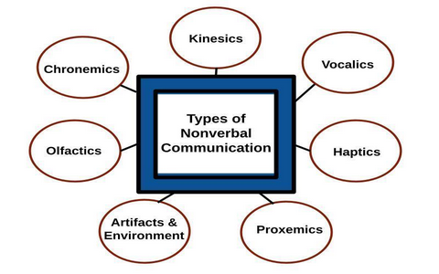

Slide 8
1. Kinesics
It refers to body movements used to communicate. Examples: facial expressions, hand gestures, posture, eye contact, nodding of head.
2. Vocalics (Paralanguage)
It refers to how we say something, not what we say. Examples: tone of voice, pitch, loudness, speed of speaking, pauses.
3. Haptics
It means communication through touch. Examples: handshake, hug, pat on the back, holding hands.
4. Proxemics
It refers to the use of space and distance between people while communicating. Examples: personal space, standing close or far, seating arrangement.
5. Artifacts & Environment
It includes objects and surroundings that convey messages. Examples: clothes, jewellery, hairstyle, room decoration, office layout.
6. Olfactics
It refers to communication through smell. Examples: perfume, body odour, smell of food, fragrance in a room.
7. Chronemics
It means use of time in communication. Examples: punctuality, waiting time, response time, importance given to time.
Dr Prabhat K Dwivedi, Associate Professor

Slide 9
10 Types of Nonverbal Communication Explained in 3 minutes
https://www.youtube.com/watch?v=5nLQl9e5NV8
Dr Prabhat K Dwivedi, Associate Professor

Slide 10
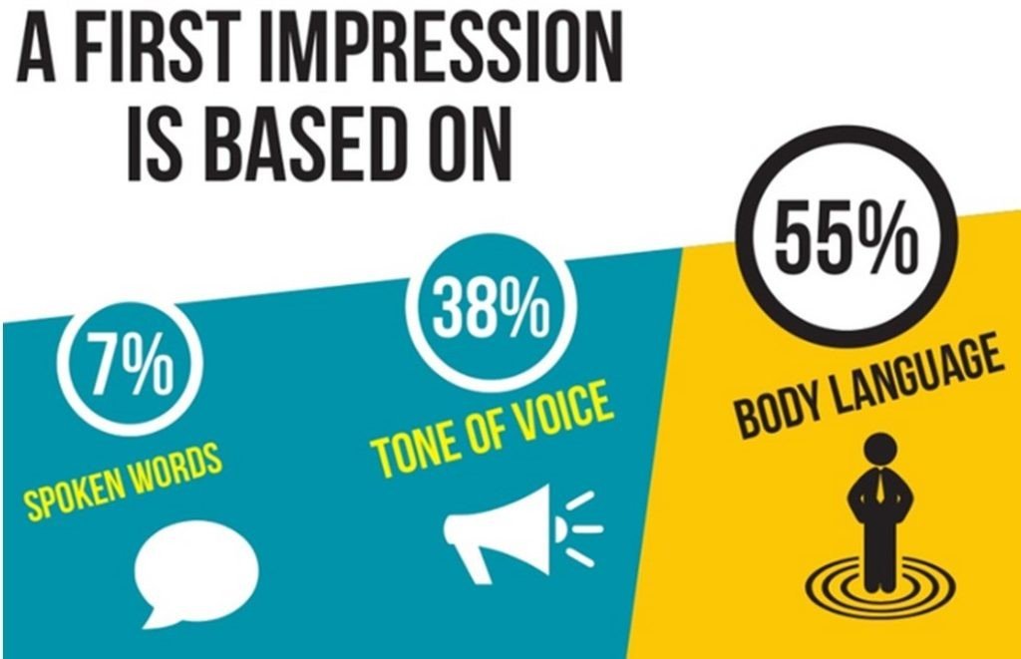
"7 rule" in body language by Albert Mehrabian's
Dr Prabhat K Dwivedi, Associate Professor

Slide 11
The " 7-38-55 rule" states that in face-to-face communication, only 7% of meaning comes from words, while 38% comes from tone of voice, and 55% from body language (facial expressions/gestures). It highlights that when people convey feelings or attitudes, nonverbal cues are far more powerful, and if words conflict with body language, people tend to believe the nonverbal signals. The breakdown of the 7-38-55 rule:
7% Words: The actual spoken words.
38% Tone of Voice: The pitch, volume, and inflection of the voice.
55% Body Language: Facial expressions, gestures, posture, and eye contact.
Key takeaways:
Focus on nonverbals:
This model emphasizes that how you look and sound often matters more than what you say, especially when discussing emotions.
Inconsistency is key:
If someone says "I'm fine" but frowns and crosses their arms, you'll likely trust the frown and
crossed arms over the words.
Context matters:
This rule applies primarily to conveying feelings and attitudes, not necessarily factual information (like yelling "Fire!").
Useful for negotiation:
Negotiators, like former FBI agent Chris Voss, use this to understand when someone's words
don't align with their nonverbal signals, indicating potential deception or lack of conviction.
Dr Prabhat K Dwivedi, Associate Professor

Slide 12

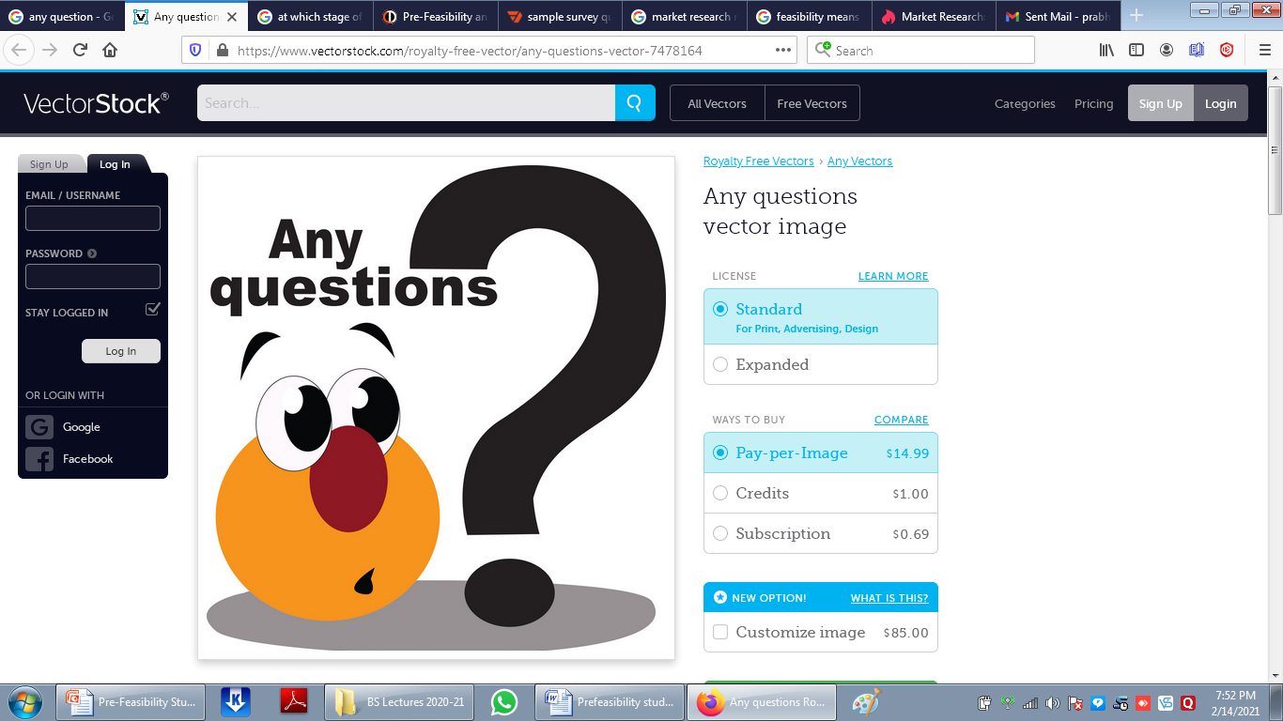
Dr Prabhat K Dwivedi, Associate Professor

Slide 13
References
https://professional.dce.harvard.edu/blog/8-ways-you-can-improve-your-communication-skills/#1-Be-clear-and-concise
Dr Prabhat K Dwivedi, Associate Professor

Slide 14

Dr Prabhat K Dwivedi, Associate Professor

