Slide 1


BUSINESS COMMUNICATION
INTRO. TO BUSINESS COMMUNICATION
Dr Prabhat K Dwivedi, Associate Professor
School of Business Management

Slide 2
Topics to be covered
Meaning & definitions of communication/ Bus. Communication
Communication process
Types of communication
Characteristics of Business Communication
Business Communication vs. Other Communication
Business Communication Channels
Why is Business Communication Important?
Strategies
Barriers
7Cs of Effective Communication
Dr Prabhat K Dwivedi, Associate Professor

Slide 3
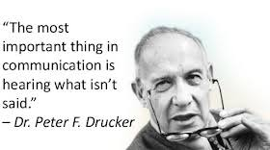
Dr Prabhat K Dwivedi, Associate Professor

Slide 4
COMMUNICATION
Communication is the process of two or more people or groups exchanging information, ideas, thoughts, and feelings. It is a basic human activity that enables individuals to communicate with one another and exchange ideas, feelings, and experiences.
Dr Prabhat K Dwivedi, Associate Professor

Slide 5
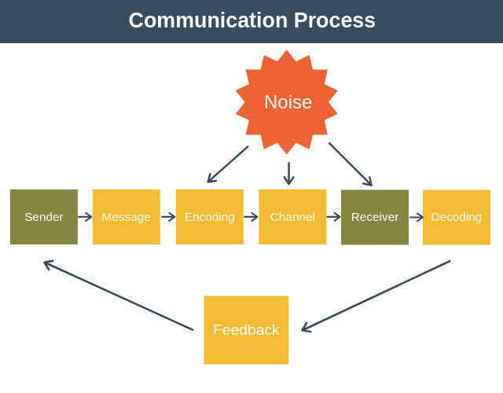
Dr Prabhat K Dwivedi, Associate Professor

Slide 6
Types of Communication
Verbal Communication
Nonverbal Communication
Visual Communication
Interpersonal Communication
Communication Across Cultures
Mass Communications
Electronic communication
Dr Prabhat K Dwivedi, Associate Professor

Slide 7
Business Communication
Business communication is the exchange of information, ideas, and feedback within and outside an organization, using verbal, written, non-verbal, or digital methods, to achieve specific company goals, improve operations, and foster relationships with employees, customers, and stakeholders. It covers everything from internal emails and meetings to external marketing and client interactions, ensuring everyone has the right information to work together effectively and meet objectives.
Dr Prabhat K Dwivedi, Associate Professor

Slide 8
Definitions of Business Communication
Prof. J. Haste stated that when communication occurs between two or more business people for effective organization and administration of business, it is considered business communication.
Raymond Lesikar views business communication as a process or activity that enables individuals to collaborate and work together.
According to W.H., business communication is exchanging business-related views, ideas, and news among the related parties.
Ricks and Gow defined business communication as a system that affects change throughout the whole organization.
Dr Prabhat K Dwivedi, Associate Professor

Slide 9
Characteristics of Business Communication
Goal-oriented: Business communication is purposeful and directed towards achieving specific objectives.
Formality: It generally follows a formal and structured tone, with attention given to language, tone, and etiquette.
Audience-specific: Successful business communication, consider the requirements, preferences, and expectations of the target audience.
Documented: Business communication is often documented in writing, whether in the form of emails, memos, reports, or other written materials.
Dr Prabhat K Dwivedi, Associate Professor

Slide 10
Business Communication vs. Other Communication
Differentiating Aspect | Business Communication | Other Communication
Purpose | To achieve business objectives. | To exchange information or ideas.
Audience | Internal and external business stakeholders. | Anyone.
Tone | Professional and formal. | Informal and casual.
Format | Structured and formal documents. | Varied formats, such as emails, texts, or social media messages.
Content | Business-related information, such as proposals, reports, or memos. | Personal or social information, such as greetings, small talk, or sharing of experiences.
Feedback | Often formal and structured, such as performance reviews or customer feedback. | Informal and less structured, such as reactions or responses to social media posts.
Channels | Traditional, such as letters or meetings, and digital, such as email or video conferencing. | Varied, depending on the medium used, such as phone, text, or social media platforms.
Consequences | Can have a significant impact on business outcomes, such as sales, profits, or reputation. | May have social or personal consequences, but generally less significant than business communication.
Dr Prabhat K Dwivedi, Associate Professor

Slide 11
Business Communication Channels
Email: Electronic messaging for formal written communication and document exchange within and outside the organization.
Face-to-face meetings: In-person gatherings facilitating direct communication, ideal for discussions, decision-making, and collaboration.
Video conferencing: Virtual face-to-face communication using technology, enabling real-time interaction for remote teams or clients.
Telephone/Conference calls: Voice-based communication over the phone, including conference calls for multi-participant discussions.
Instant messaging (IM): Real-time text-based communication for quick and informal exchanges within a team or organization.
Memoranda (Memos): Written documents conveying official announcements or updates for internal communication.
Reports and documentation: Formal creation of detailed documents for conveying information, analysis, or research findings.
Presentations: Communicating information using visual aids, such as slides, in person or virtually.
Social media: Utilizing online platforms for business communication, including customer engagement and brand promotion.
Intranet: Private network within an organization facilitating internal communication, document sharing, and collaboration.
Newsletters: Periodic publications offering updates and information to employees or external stakeholders.
Blogs: Corporate blogs for sharing insights, industry updates, and company news with a wider audience.
Dr Prabhat K Dwivedi, Associate Professor

Slide 12
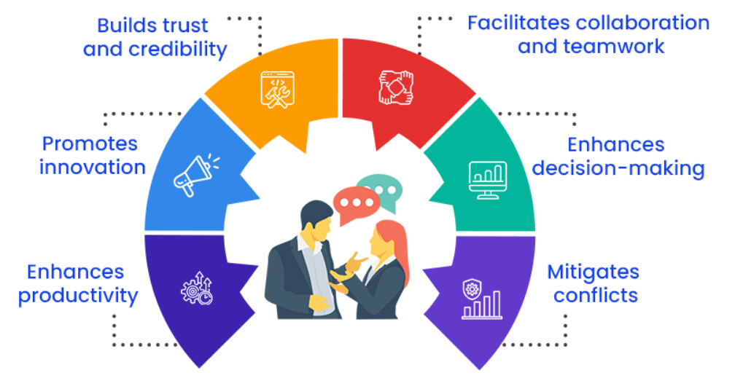
Why is Business Communication Important?
Dr Prabhat K Dwivedi, Associate Professor

Slide 13
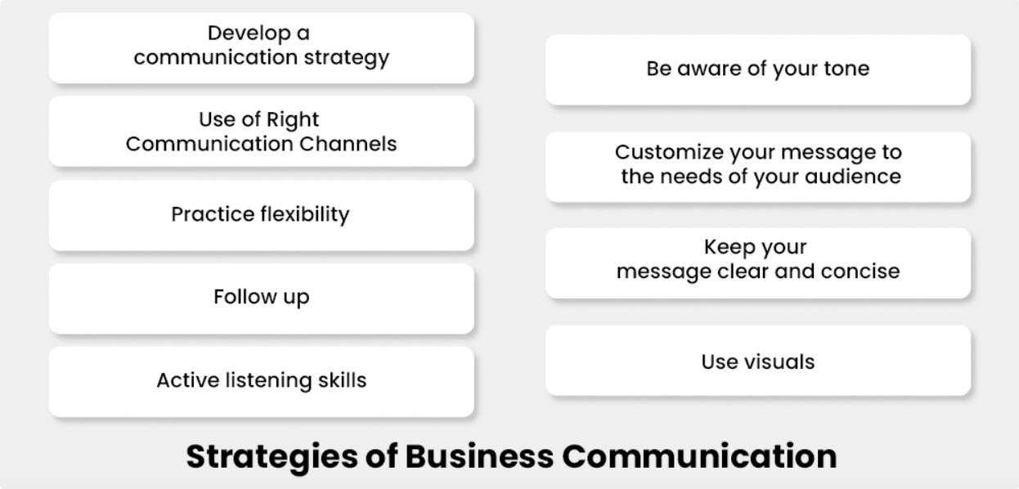
Dr Prabhat K Dwivedi, Associate Professor

Slide 14
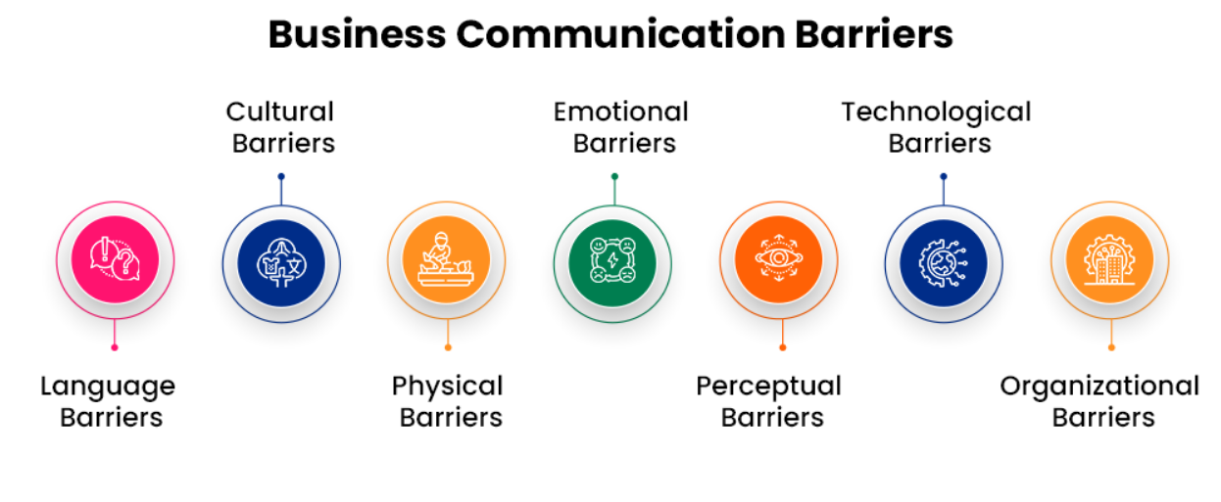
Dr Prabhat K Dwivedi, Associate Professor

Slide 15
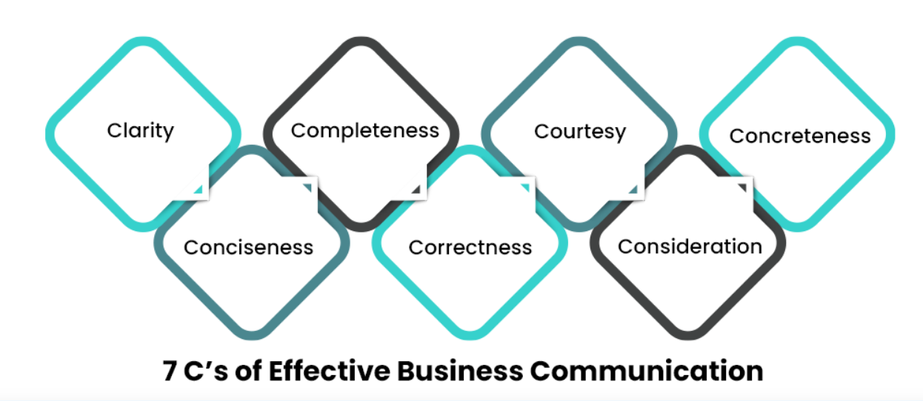
Dr Prabhat K Dwivedi, Associate Professor

Slide 16
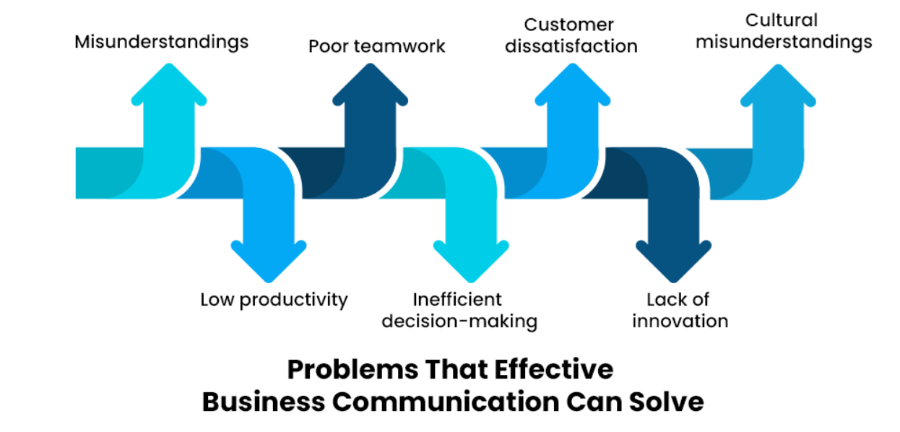
Dr Prabhat K Dwivedi, Associate Professor

Slide 17
How to improve business communication? OR
Important Business Communication Skills
Active listening
Clarity of expression
Storytelling
Empathy
Diplomacy
Negotiation skills
Cultural sensitivity
Etiquettes
Persuasion
Humour
Constructive feedback
Effective presentation
Dr Prabhat K Dwivedi, Associate Professor

Slide 18

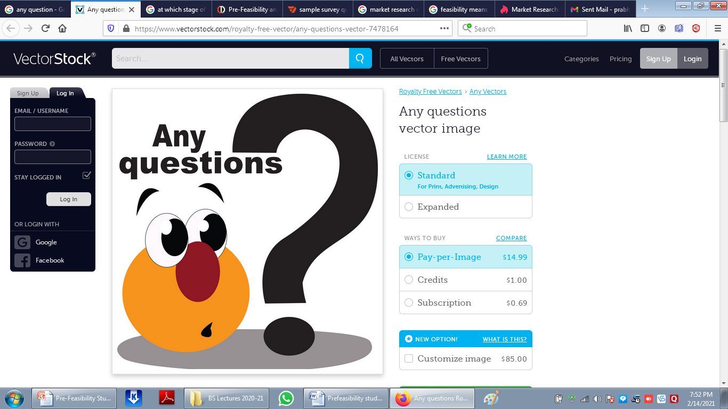
Dr Prabhat K Dwivedi, Associate Professor

Slide 19
References
https://clearinfo.in/blog/what-is-business-communication/
https://www.managementstudyguide.com/management_principles.htm
https://getuplearn.com/blog/motivation-in-hrm/
Porter, L. W. & Lawler, E. E. (1968). Managerial attitudes and performance. Dorsey Press.
https://collegevidya.com/blog/business-communication-explained/
Dr Prabhat K Dwivedi, Associate Professor

Slide 20

Dr Prabhat K Dwivedi, Associate Professor

