Slide 1


BUSINESS COMMUNICATION
L13: Effective Presentation
Dr Prabhat K Dwivedi, Associate Professor
School of Business Management

Slide 2
Topics to be covered
Effective Presentation Skills
Dr Prabhat K Dwivedi, Associate Professor

Slide 3

Dr Prabhat K Dwivedi, Associate Professor

Slide 4
What is Effective Presentation
An effective presentation is a, clear, engaging, and purposeful communication event that connects with the audience, leaving a lasting impression or driving action. It blends, structured, concise, content with, confident, delivery, utilizing, visual aids and, storytelling to, explain complex ideas simply.
Dr Prabhat K Dwivedi, Associate Professor

Slide 5
Key Elements of Effective Presentation
Targeted Content
Clear Structure
Engaging Delivery
Simple Visuals
Preparation
Purpose & Impact

Slide 6
4Ps of Presentation Skills
Plan
Prepare
Practice
Present

Slide 8
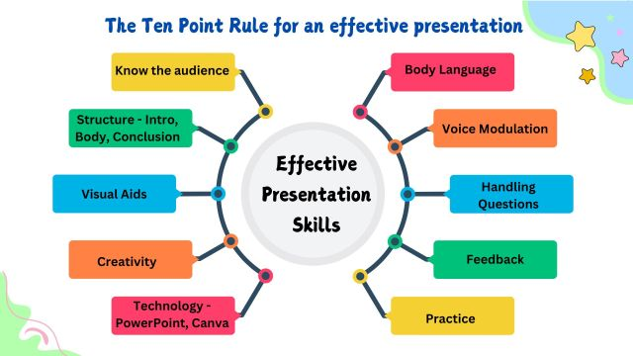
Dr Prabhat K Dwivedi, Associate Professor

Slide 9

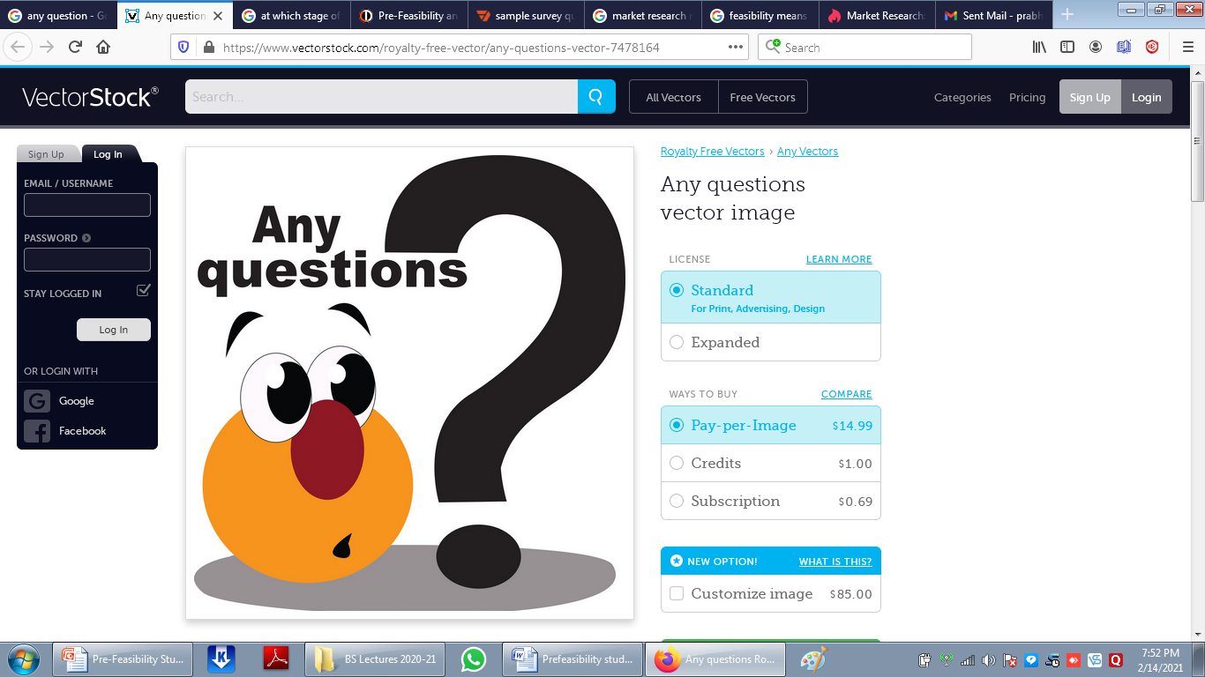
Dr Prabhat K Dwivedi, Associate Professor

Slide 10
References
https://boldspeaker.com/storage/2020/10/Boldspeaker.com-4Steps-Speech.pdf
/www.google.com/search?q=whT+IS+Effective+presentation&client
Dr Prabhat K Dwivedi, Associate Professor

Slide 11

Dr Prabhat K Dwivedi, Associate Professor

