Slide 1

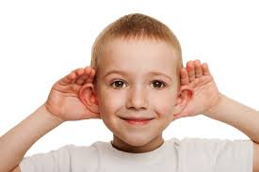
BUSINESS COMMUNICATION
L16: Listening
Dr Prabhat K Dwivedi, Associate Professor
School of Business Management

Slide 2
Topics to be covered
Meaning of listening
Effective listening
Listening Skills
Importance
Listening Mistakes
Dr Prabhat K Dwivedi, Associate Professor

Slide 3
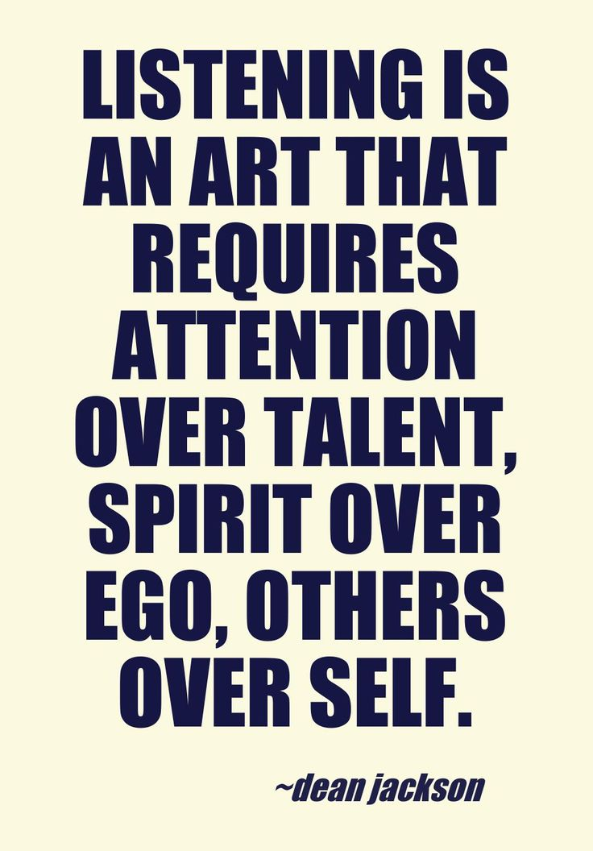
Dr Prabhat K Dwivedi, Associate Professor

Slide 4
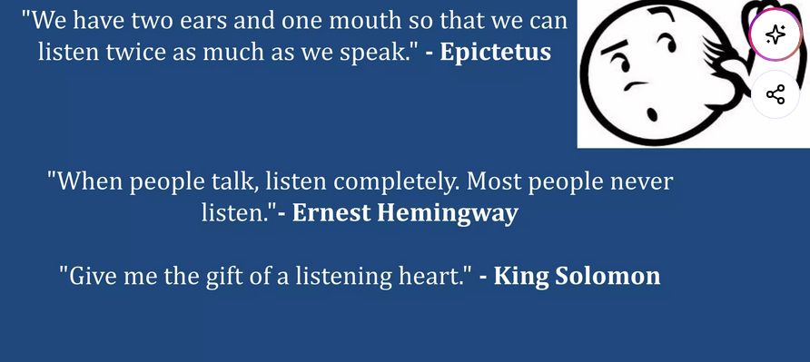

Slide 5
What is Listening?
Listening is the active, conscious process of receiving, interpreting, and responding to both verbal and non-verbal messages, essential for effective communication, empathy, and learning.
It involves more than just hearing, requiring focused attention to understand meaning, build relationships, and resolve conflicts.
Dr Prabhat K Dwivedi, Associate Professor

Slide 6
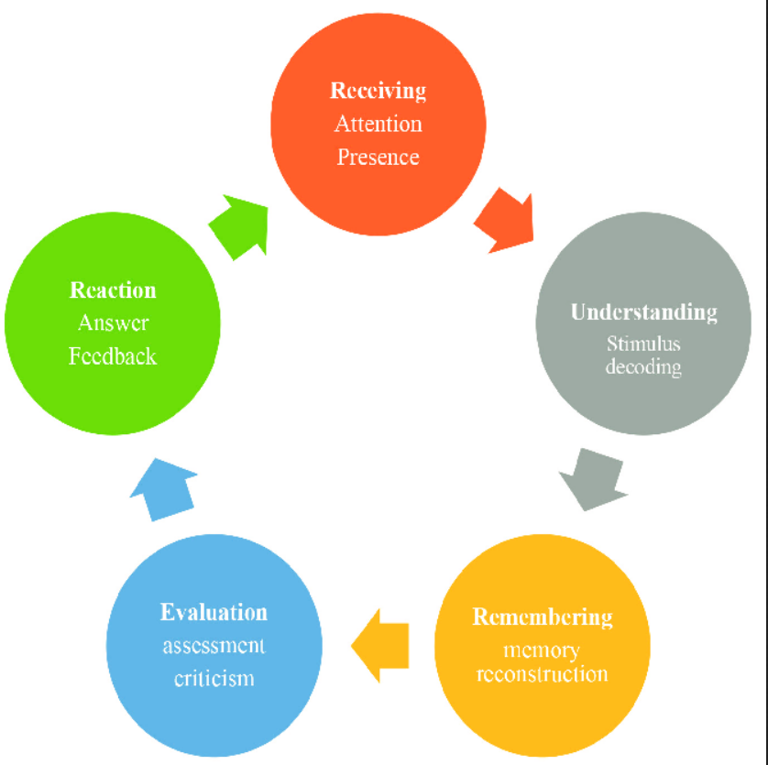
Listening Process
Barker & Gaut, 1996; DeVito, 2014; Brownell, 2015)
Receiving (Hearing): The physical,,, receiving stage is the initial step where the listener hears sound, selects which sound to focus on, and receives the message.
Understanding (Interpreting): This stage involves decoding the message, interpreting language, and understanding the context, tone, and emotion.
Remembering (Recalling): This involves recalling the information to use it later, which requires moving information from short-term to long-term memory.
Evaluating (Assessing): The listener analyzes, judges, and assesses the message for credibility, bias, and logic.
Responding (Feedback): The final step where the listener gives feedback, either verbally or nonverbally, confirming their understanding and reaction to the message.

Slide 7
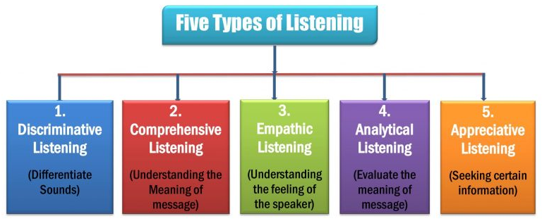
Dr Prabhat K Dwivedi, Associate Professor

Slide 8
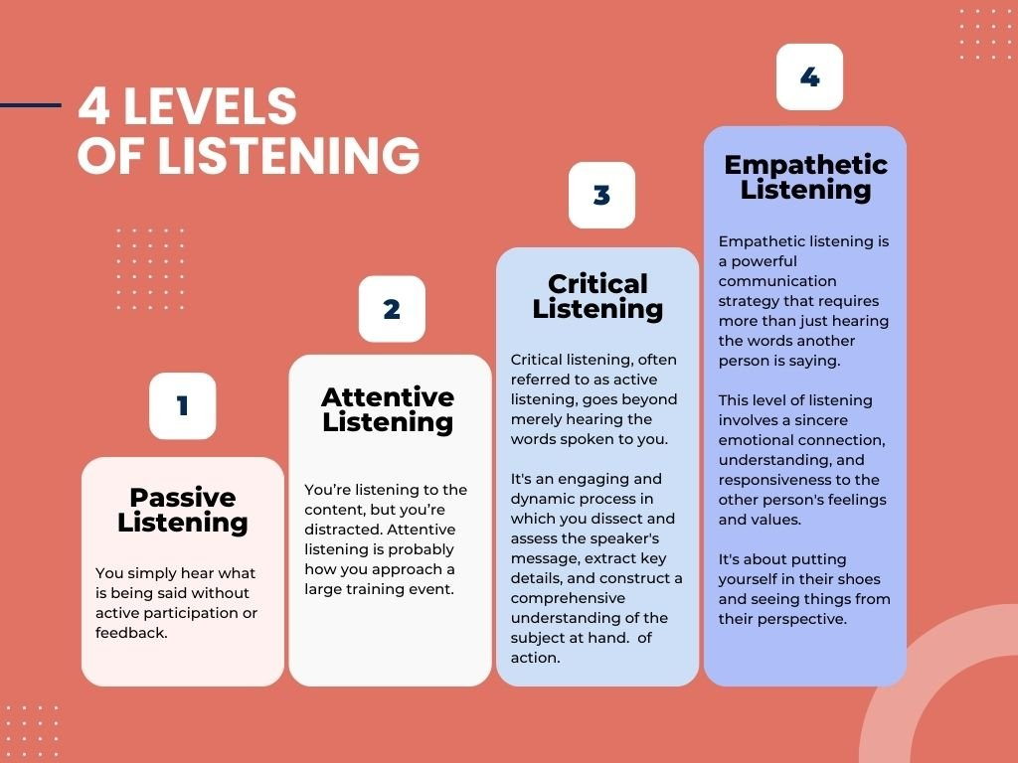
Dr Prabhat K Dwivedi, Associate Professor

Slide 9
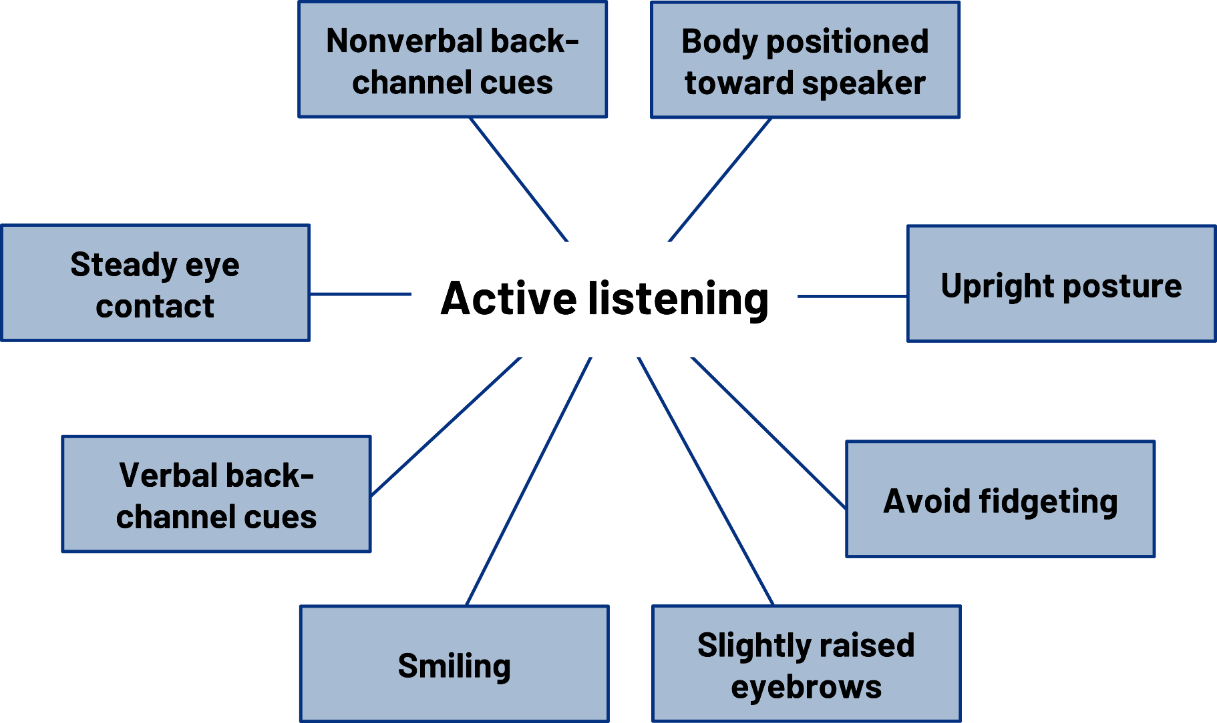
Do’s & Don’t’s
Dr Prabhat K Dwivedi, Associate Professor

Slide 10
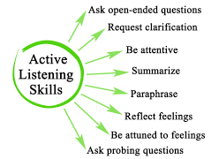

Slide 11
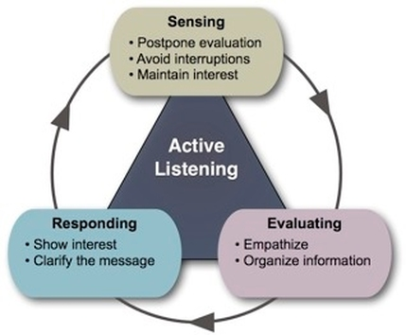

Slide 12
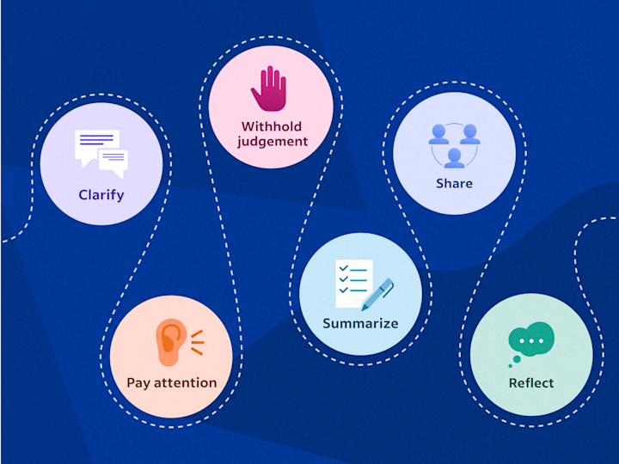
Qualities of a Good Listener
Dr Prabhat K Dwivedi, Associate Professor

Slide 13
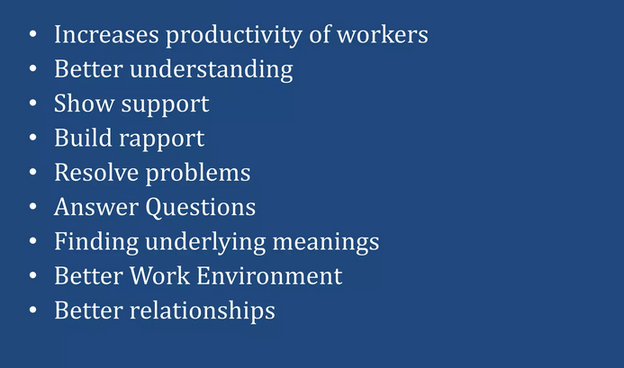
Importance of Listening
Dr Prabhat K Dwivedi, Associate Professor

Slide 14
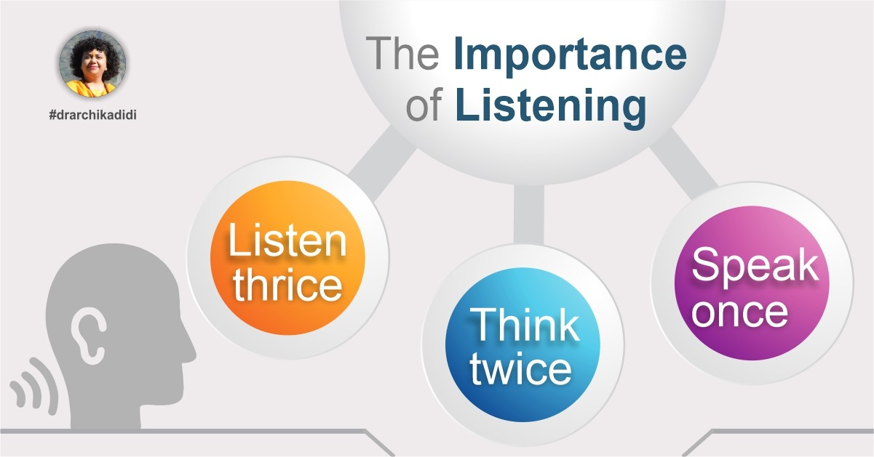

Slide 15
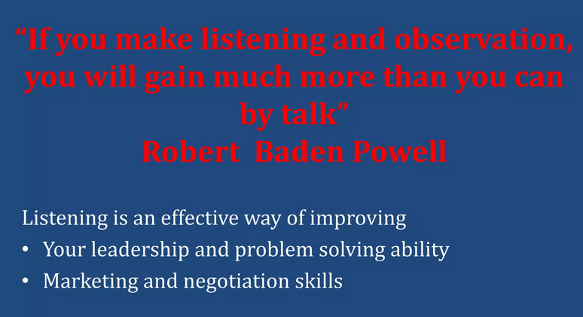
Dr Prabhat K Dwivedi, Associate Professor

Slide 16
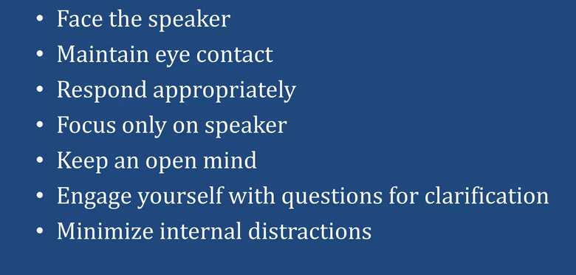
Methods to Improve Listening
Dr Prabhat K Dwivedi, Associate Professor

Slide 17
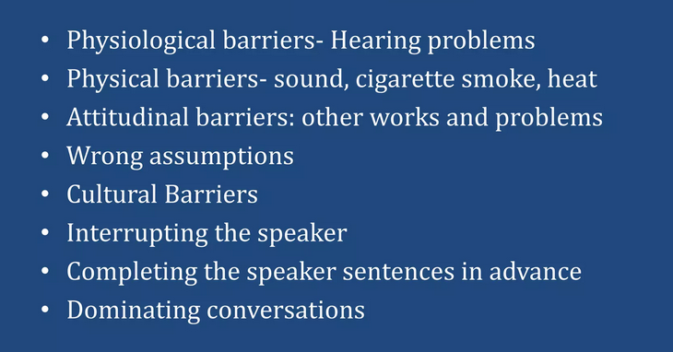
Listening Mistakes
Dr Prabhat K Dwivedi, Associate Professor

Slide 18
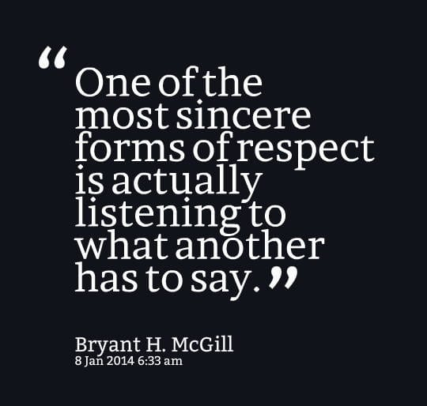
Dr Prabhat K Dwivedi, Associate Professor

Slide 19


Dr Prabhat K Dwivedi, Associate Professor

Slide 20
References
https://www.slideshare.net/slideshow/listening-148110708/148110708
https://www.google.com/search?q=importance+of++listening&client=firefox-b-d&hs=8y09&sca_esv
https://www.linkedin.com/pulse/importance-listening-dr-archika-didi
Barker, D., & Gaut, D. A. (1996). Communication skillbook: A practical guide for interpersonal success. Prentice Hall.
Brownell, J. (2015). Listening: Attitudes, principles, and skills (5th ed.). Routledge.
DeVito, J. A. (2014). The interpersonal communication book (13th ed.). Pearson.
Dr Prabhat K Dwivedi, Associate Professor

Slide 21

Dr Prabhat K Dwivedi, Associate Professor

