Slide 1

BUSINESS COMMUNICATION
L21-22: Essentials of Business Letters
Dr Prabhat K Dwivedi, Associate Professor
School of Business Management

Slide 2
Topics to be covered
Essentials of Business Letters
Letter to Bank and insurance companies
Dr Prabhat K Dwivedi, Associate Professor

Slide 3

Dr Prabhat K Dwivedi, Associate Professor

Slide 4
Elements of a Standard Business Letter
Return Address: Your address (or the address of the company you represent). If you are using preprinted stationery, there is no need to retype the information.
Date: Leave two blank lines after the return address. Always spell out the month and include the day, a comma, and the year.
Inside Address: Leave two blank lines after the date. Then type the address of the person or company to whom you are writing.
Salutation: Type Dear, followed by the person’s name. End the line with a colon. If you don’t know the name of the person, use a title instead (i.e., Dear Editor, Dear Madam).
Body: Align your message on the left margin. Skip a line before starting a new paragraph, but do not indent the paragraph’s first line. Make sure that each paragraph is clear and concise.
Dr Prabhat K Dwivedi, Associate Professor

Slide 5
Key Aspects of Corporate Communication Networks
Closing: Leave two lines of space after your last body paragraph, then use a conventional closing, followed by a comma (i.e., Sincerely, Sincerely Yours, Respectfully).
Signature: Your signature should appear below your closing. Unless you have established a personal relationship with the person you are writing, use both your first and last name.
Name and Position: Four lines after the closing, type your full name. Do not include a title (Mr. or Mrs.). If you are writing on behalf of an organization, type your title on the next line.
Dr Prabhat K Dwivedi, Associate Professor

Slide 6
Abbreviations at the end of a letter:
If you send a copy of a letter to someone other than the person addressed, use cc: and the person’s name. Use Enc. or Enclosure if you enclose something with the letter. If someone else types it, put the writer’s initials in capitals, then a slash and the typist’s initials in lowercase: MT/fjr. Just one abbreviation should appear on a line.
Dr Prabhat K Dwivedi, Associate Professor

Slide 7
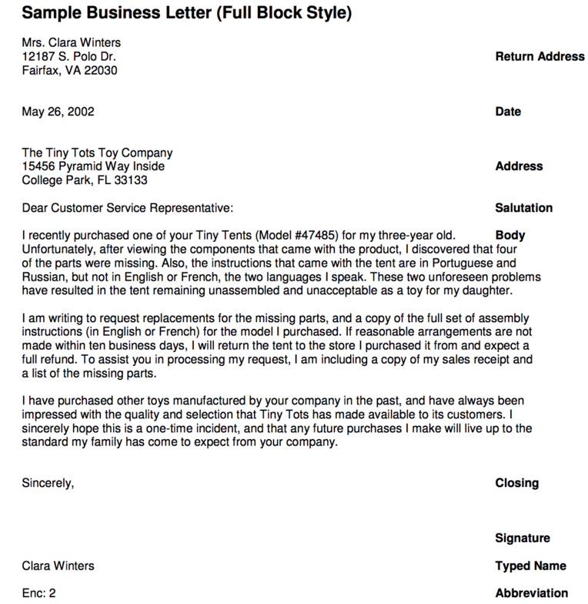
Dr Prabhat K Dwivedi, Associate Professor

Slide 8
Business Letter to a Bank
Purpose: Common reasons include account inquiries, loan applications, bank statements, or issue resolution.
Example: Requesting a Bank Statement
Header:
Your Name
Your Address
City, State, Zip Code
Email Address
Phone Number
Date:
June 30, 2024
Recipient Information:
Bank Manager’s Name
Bank’s Name
Bank’s Address
City, State, Zip Code
Salutation:
Dear [Bank Manager’s Name],
Dr Prabhat K Dwivedi, Associate Professor

Slide 9
Body:
Introduction:
  State your name and account number.
  Clearly state the purpose of your letter in the first paragraph.
    Example: I am writing to request a detailed bank statement for my account number [Your Account Number] for the period of January 1, 2024, to June 30, 2024.
Details:
  Specify any particular details or additional information required.
    Example: Please include all transactions, including deposits, withdrawals, and fees, for the specified period.
Conclusion:
  Mention how you would like to receive the statement (e.g., mail, email).
  Thank the recipient for their assistance and provide your contact information for any follow-up.
    Example: Please send the statement to my email address at [Your Email Address]. Should you require any further information, feel free to contact me at [Your Phone Number].
Closing:
Yours sincerely,
[Your Name]
Signature:
(Signature if sending a hard copy)
Dr Prabhat K Dwivedi, Associate Professor

Slide 10
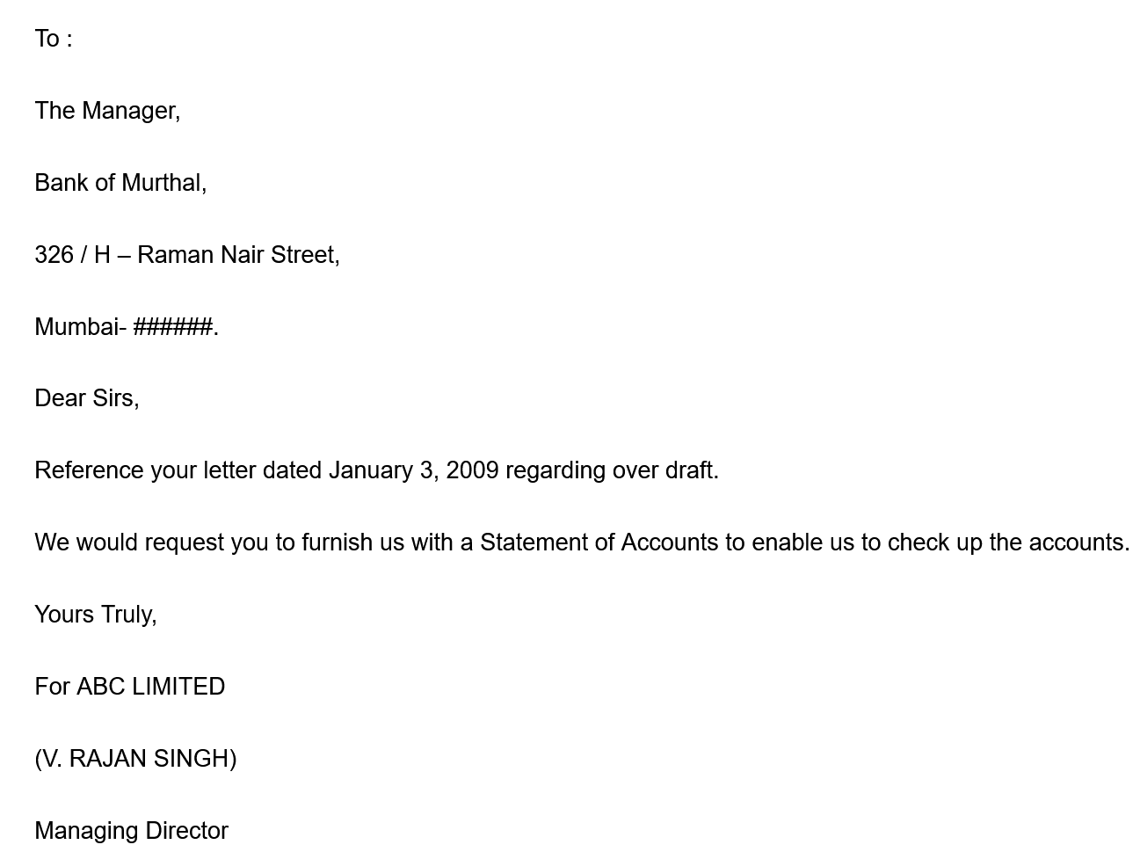
Sample Letter to Bank
Dr Prabhat K Dwivedi, Associate Professor

Slide 11
Business Letter to an Insurance Company
Purpose: Common reasons include policy inquiries, claims, policy changes, or premium payments.
Example: Filing an Insurance Claim
Header:
Your Name
Your Address
City, State, Zip Code
Email Address
Phone Number
Date:
June 30, 2024
Recipient Information:
Claims Department
Insurance Company’s Name
Insurance Company’s Address
City, State, Zip Code
Salutation:
Dear Claims Department,
Dr Prabhat K Dwivedi, Associate Professor

Slide 12
Body:
Introduction:
  State your name, policy number, and type of policy.
  Clearly state the purpose of your letter in the first paragraph.
    Example: I am writing to file a claim under my homeowner’s insurance policy, number [Your Policy Number], due to damage caused by a recent storm.
Details:
  Provide specific details about the incident: date, time, nature of the damage, and any immediate actions taken.
    Example: The storm occurred on June 25, 2024, causing significant damage to the roof and water leakage into the living room. I have attached photographs of the damage and a preliminary assessment report from a licensed contractor.
Conclusion:
  Mention any additional documents you are including (e.g., photos, reports).
  Request a prompt response or next steps.
    Example: I request that an adjuster be sent to assess the damage as soon as possible. Please inform me of any further information or documentation required to process this claim.
Closing:
Thank you for your prompt attention to this matter.
Yours sincerely,
[Your Name]
Signature:
(Signature if sending a hard copy)
Dr Prabhat K Dwivedi, Associate Professor

Slide 13
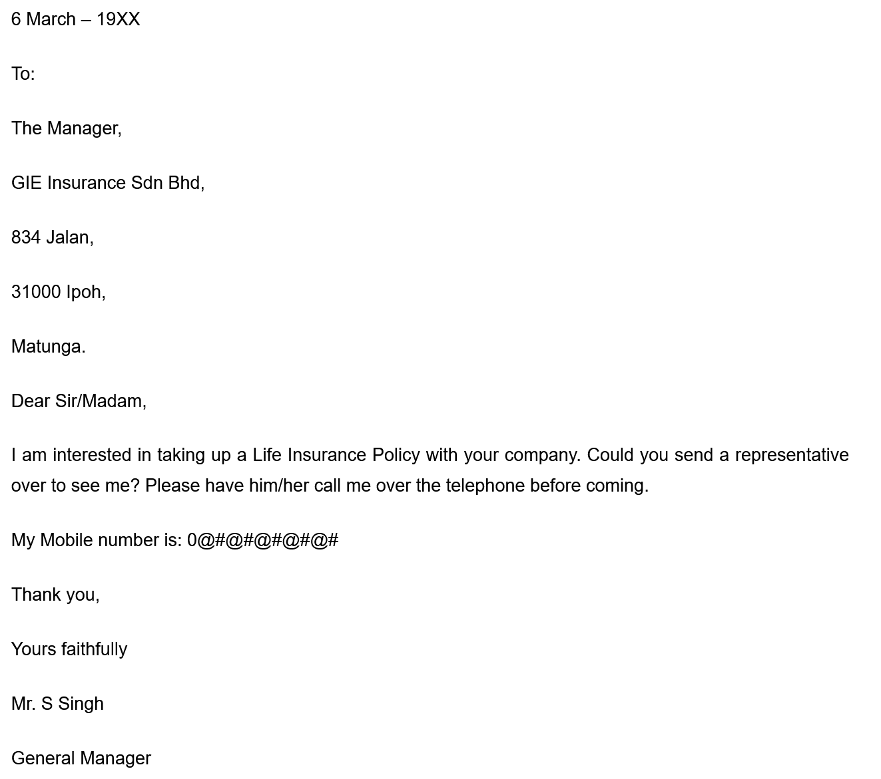
Sample Letter to Insurance Company
Dr Prabhat K Dwivedi, Associate Professor

Slide 14
General Tips for Writing Business Letters
Be Clear and Concise:
  Avoid unnecessary jargon and get straight to the point.
  Use short paragraphs and bullet points if necessary for clarity.
Use Professional Language:
  Maintain a formal tone and avoid casual language.
  Proofread for spelling and grammatical errors.
Include All Relevant Details:
  Ensure all necessary information is included to avoid back-and-forth communication.
  Attach supporting documents as required.
Be Polite and Courteous:
  Use polite language and express gratitude for the recipient’s time and assistance.
Keep a Copy:
  Always keep a copy of the letter and any correspondence for your records.
Dr Prabhat K Dwivedi, Associate Professor

Slide 15

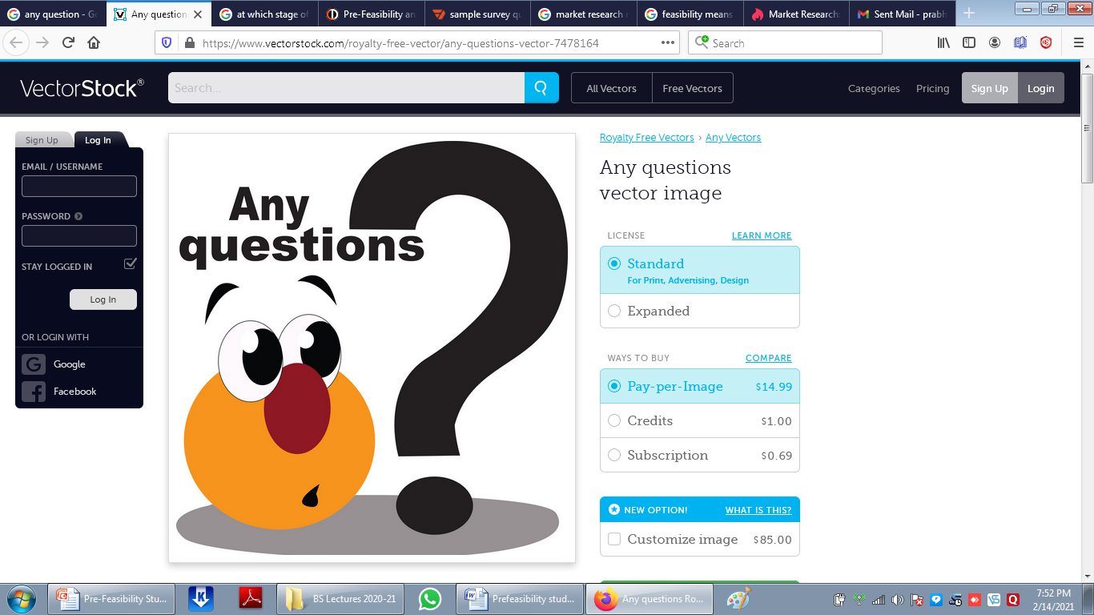
Dr Prabhat K Dwivedi, Associate Professor

Slide 16
References
https://writingcenter.gmu.edu/writing-resources/different-genres/writing-business-letters
https://theintactone.com/2019/12/28/writing-important-business-letters-including-correspondence-with-bank-and-insurance-companies/
Dr Prabhat K Dwivedi, Associate Professor

Slide 17

Dr Prabhat K Dwivedi, Associate Professor

