Slide 1


BUSINESS COMMUNICATION
L11-12: Oral Presentation
Dr Prabhat K Dwivedi, Associate Professor
School of Business Management

Slide 2
Topics to be covered
Principles of Oral Presentation
Factors affecting Presentation
Dr Prabhat K Dwivedi, Associate Professor

Slide 3

Dr Prabhat K Dwivedi, Associate Professor

Slide 4
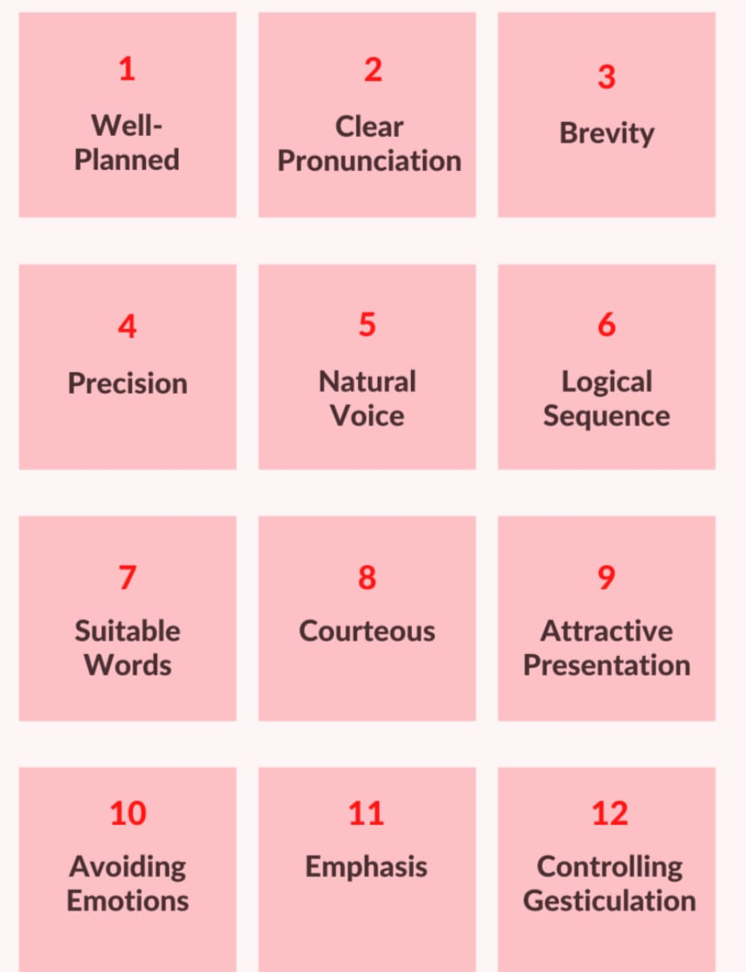
Principles of Effective Oral Communication
Dr Prabhat K Dwivedi, Associate Professor

Slide 5
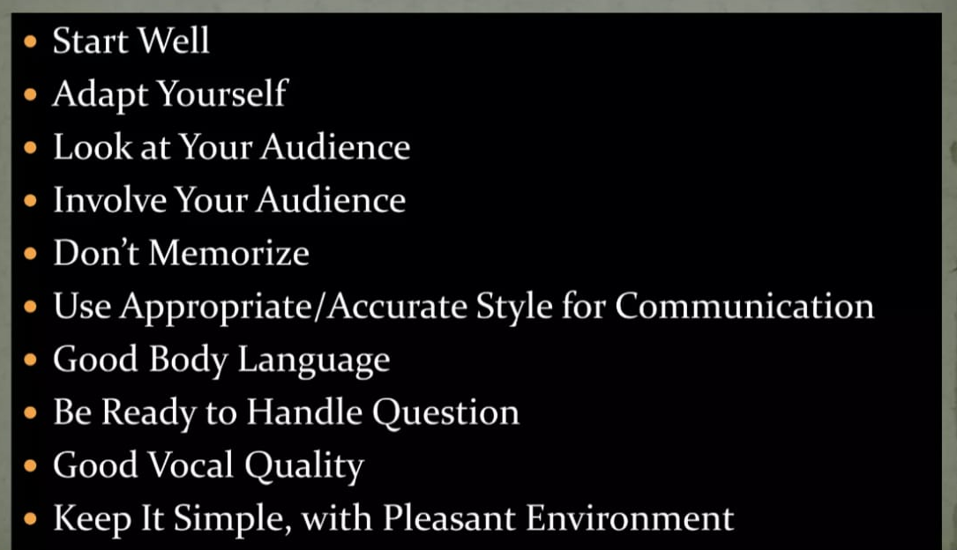
Do’s & Don’ts of Oral Communication
Dr Prabhat K Dwivedi, Associate Professor

Slide 6
What is an oral presentation?
Oral presentations, also known as public speaking or simply presentations, consist of an individual, or a group of people, verbally addressing an audience on a particular topic. The aim of this academic exercise is to educate, inform, entertain or present an argument.
Oral presentations are seen within workplaces, classrooms and even at social events such as weddings.
An oral presentation at university assesses the presenter’s ability to communicate relevant information effectively in an interesting and engaging manner.
Dr Prabhat K Dwivedi, Associate Professor

Slide 7
In other words, a presentation is:
Carefully prepared
Judiciously structured
Well researched
Heavily scripted (though you must not read a script)
Highly improvised
Dr Prabhat K Dwivedi, Associate Professor

Slide 8
Group Presentations Tips
Divide the topic of your presentation into subtopics, and allocate one to each group member.
Rehearse together as a group.
Ensure the presentation is consistent by using a consistent style for your visual aids.
Use a cloud-based service or platform to create your presentation.
Dr Prabhat K Dwivedi, Associate Professor

Slide 9
Planning and presenting an oral presentation
Planning your oral presentation.
Review the subject outline.
Review the assessment criteria.
Analyse the task or the purpose of the presentation
Consider the audience.
Brainstorm.
Do the research.
Organise your ideas.
Pay attention to the language you are using.
Dr Prabhat K Dwivedi, Associate Professor

Slide 10
Audience interaction and engagement
Examples of ways to ensure audience interaction are:
Asking questions, testing the audience, providing a quiz
Allowing the audience to ask questions
Providing handouts- consider a ‘fill in the blank’ document that goes hand-in-hand with a slideshow or the information you are presenting
Asking someone to volunteer if there are demonstrations
Dr Prabhat K Dwivedi, Associate Professor

Slide 11
Using visual aids
Keep your visual aids clear and to the point, and ensure that they are easily readable by your audience.
Make sure that all the visual elements you include are directly related to the topics you present.
If you decide to include a chart, table or graph, make sure you comment on the figures during the presentation.
It is the job of the presenter to extract and present the most relevant information in a succinct way.
Dr Prabhat K Dwivedi, Associate Professor

Slide 12
Recorded presentations
Start by thinking about the overall structure of your narrative (the skeleton), then base the slides on the main points you are discussing
Make sure each slide has clear headings and sub-headings to orient the reader
Include clear topic sentences to introduce the subject matter
Make sure you define technical terms and explain what they mean
Illustrate your points through carefully selected examples
Use appropriate sources to support your argument and reference the sources on the PowerPoint slides
Make sure you provide a reference list at the end
Consider background: a busy background will be distracting
Consider lighting: from the front, rather than behind you
Composition: how large will you be in the frame?
Minimise background noise.
Dr Prabhat K Dwivedi, Associate Professor

Slide 13
How many slides? How many words?
For a PowerPoint presentation:
Aim for 1-2 slides per minute as a rough guide
Avoid displaying too much information on any one slide: just provide the key points
In your narration, explain or expand on the key points
Make sure your text is between 14 - 20 point, with at least single spacing between lines
Only use images that complement the text
Do not use visuals for decoration purposes
Aim for around 100 – 150 words (maximum) per minute, then practice to check your timing
Dr Prabhat K Dwivedi, Associate Professor

Slide 14
Preparing to present
When practicing your speech consider these aspects:
Speak slowly and clearly
Demonstrate enthusiasm and keen interest in the topic
Vary pitch, tone and speed to retain audience interest
Do not read off your palm cards
Maintain eye contact with the audience
Maintain good posture so you can be clearly heard
Use natural hand gestures
Use a natural tone of voice
Practice to improve your confidence
Practice pronunciation of difficult words by breaking them into syllables
Be mindful of your body language
Time yourself to make sure you are within the time limits
Dr Prabhat K Dwivedi, Associate Professor

Slide 15
On the day of your presentation
On the day of your presentation, you might feel anxious or nervous and that is completely normally.
Have confidence in your ability, the presentation you have planned, and the preparation you have done!
Dr Prabhat K Dwivedi, Associate Professor

Slide 16

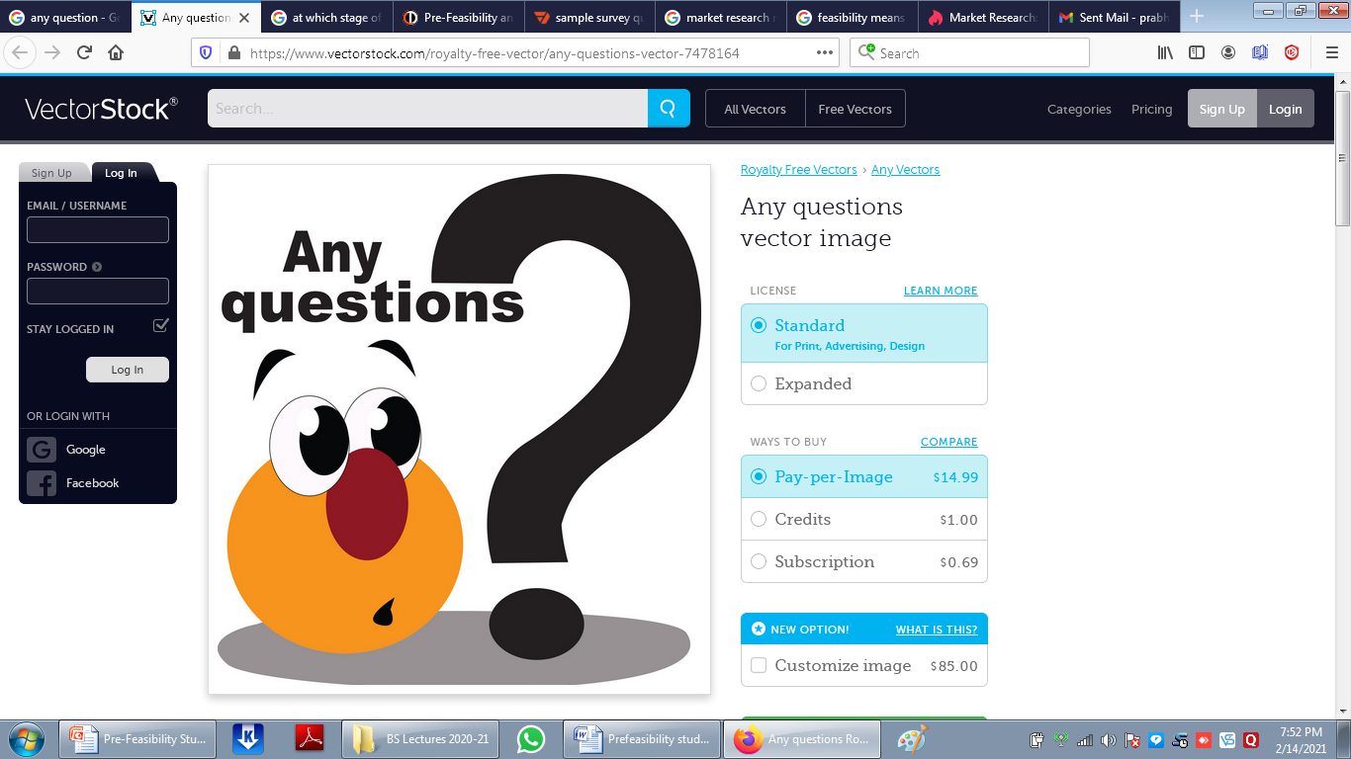
Dr Prabhat K Dwivedi, Associate Professor

Slide 17
References
https://www.uow.edu.au/student/support-services/academic-skills/online-resources/assessments/presentations/
Dr Prabhat K Dwivedi, Associate Professor

Slide 18

Dr Prabhat K Dwivedi, Associate Professor

