Slide 1

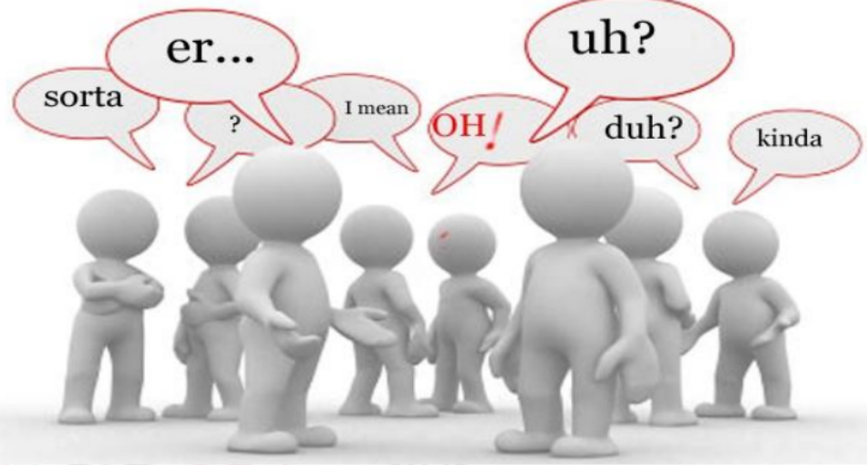
BUSINESS COMMUNICATION
L14-15: Paralanguage
Dr Prabhat K Dwivedi, Associate Professor
School of Business Management

Slide 2
Topics to be covered
Understand what paralanguage is and how it is different from language.
Know about voice, pitch, volume, tone, articulation, speed.
Learn the advantages of paralanguage in conversations.
Dr Prabhat K Dwivedi, Associate Professor

Slide 3
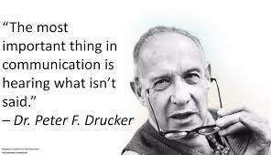
Dr Prabhat K Dwivedi, Associate Professor

Slide 4
What is Paralanguage?
Paralanguage is an essential part of non-verbal communication and as it is non verbal, it does not consist of words but without it words do not convey the intentional meaning.
“Para means „like‟, hence paralanguage literally means „like language‟ and „paralinguistic‟ is the systematic study of how a speaker verbalizes” (Sinha, K.K., 2012).
Even without hearing the words Paralanguage conveys the message about what people are communicating.
Dr Prabhat K Dwivedi, Associate Professor

Slide 5
Paralanguage, a critical aspect of nonverbal communication, encompasses the nuances and tones in our speech that convey meaning beyond the actual words.
It’s a powerful tool that, when used effectively, enhances our ability to communicate, particularly in situations where body language and facial expressions are limited or absent.
Dr Prabhat K Dwivedi, Associate Professor

Slide 6
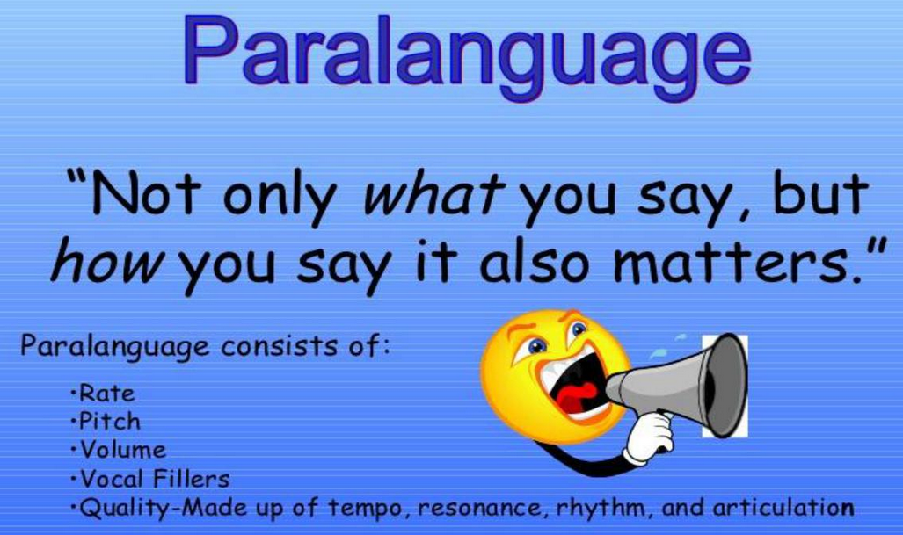
Dr Prabhat K Dwivedi, Associate Professor

Slide 7
What is the Effective Use of Paralanguage in Nonverbal Communication?
Voice Modulation: Altering pitch, volume, and tone helps in emphasizing important points, expressing emotions, and ensuring clarity in conveying messages.
Pause for Impact: Strategic pauses can create emphasis, allow information absorption, and generate suspense or interest.
Emotional Resonance: Using paralanguage to match the emotional tone of the conversation can build empathy and understanding.
Clarity and Pace: Speaking clearly and at an appropriate speed ensures that the message is understood, especially in educational or professional settings.
Consistency with Verbal Content: Paralanguage should complement and reinforce the spoken words for cohesive communication.

Slide 8
Importance of Paralanguage in Nonverbal
Expressing Emotions
Enhancing Verbal Messages
Substituting Words
Cultural Expression
Building Relationships
Facilitating Learning
Professional Communication
Detecting Deception or Discomfort
Dr Prabhat K Dwivedi, Associate Professor

Slide 9
Role of Paralanguage in Nonverbal Communication
Conveying Attitudes
Social Interaction
Conflict Resolution
Enhancing Persuasiveness
Influencing Perceptions
Aiding in Non-Verbal Contexts
Regulating Conversations
Personal Identity
Dr Prabhat K Dwivedi, Associate Professor

Slide 10
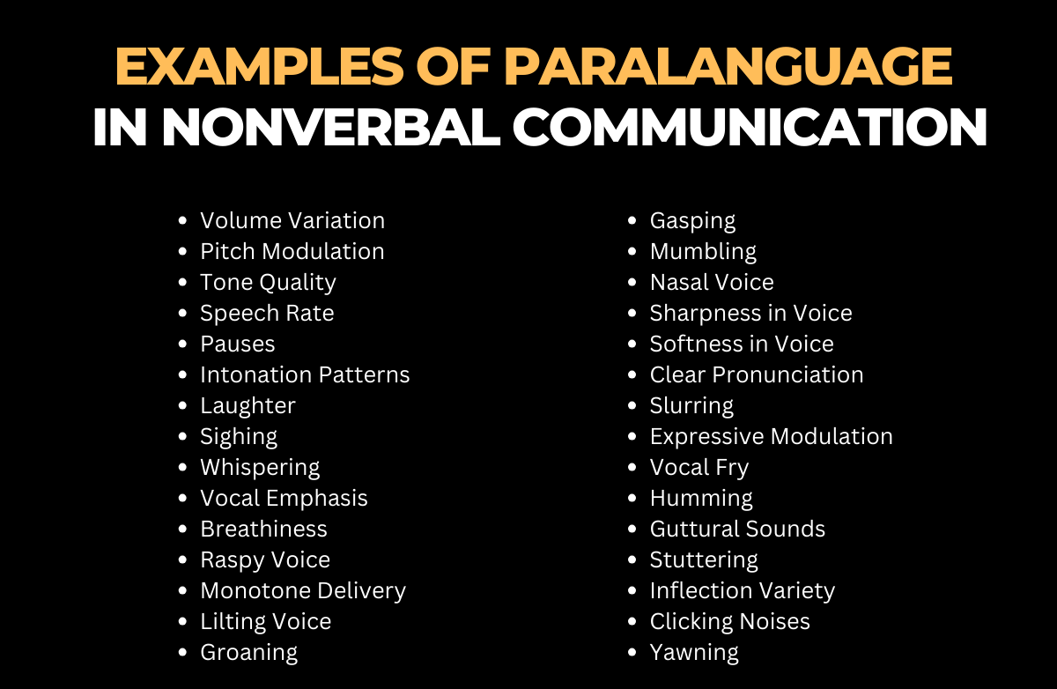
Dr Prabhat K Dwivedi, Associate Professor

Slide 11
Terms explained
Volume Variation: Adjusting the loudness or softness of the voice can convey different emotions. For instance, speaking softly can indicate secrecy or intimacy, while a loud voice might show excitement or anger. Example: “I can’t believe it!” she exclaimed loudly, her voice reflecting her surprise.
Pitch Modulation: High and low pitches can express excitement or seriousness. A high pitch often signifies excitement or urgency, whereas a lower pitch might indicate seriousness or authority. Example: His voice lowered to a serious tone as he discussed the important news.
Tone Quality: The warmth or harshness in one’s voice can set the emotional tone of a conversation. A warm tone might indicate friendliness, while a harsh tone could suggest anger or annoyance. Example: “Please, be careful,” she said with a warm, caring tone.
Speech Rate: The speed at which someone speaks can indicate their emotional state or the importance of the message. Rapid speech might suggest excitement or nervousness, while a slower rate can imply thoughtfulness or seriousness. Example: He spoke quickly, his words tumbling out in his excitement.
Dr Prabhat K Dwivedi, Associate Professor

Slide 12
Pauses: Strategic silences in speech can emphasize points or create suspense. A pause before a key point can draw attention to it, while pauses can also give listeners time to process information. Example: “And the winner is… pause… John Smith!”
Intonation Patterns: The rise and fall of voice can convey different meanings or emotions. Rising intonation might indicate a question or uncertainty, while falling intonation often signifies a statement or conclusion. Example: “You’re going where?” she asked, her voice rising at the end.
Laughter: Laughter can convey friendliness, irony, or nervousness. It can ease tension in conversations or indicate amusement. Example: He laughed nervously, unsure how to respond to the awkward situation.
Dr Prabhat K Dwivedi, Associate Professor

Slide 13
Sighing: Sighs can express a range of emotions from relief to frustration. A sigh might indicate resignation or tiredness as well. Example: She sighed in relief as she finished her presentation.
Whispering: Whispering can imply secrecy, intimacy, or the need for discretion. It can also create a sense of closeness between speakers. Example: “We need to be very careful,” he whispered, glancing around.
Whispering: Whispering can imply secrecy, intimacy, or the need for discretion. It can also create a sense of closeness between speakers. Example: “We need to be very careful,” he whispered, glancing around.
Vocal Emphasis: Stressing certain words can highlight their importance or convey specific emotions. Emphasis can change the meaning of a sentence or indicate the speaker’s feelings. Example: “I really need this done today,” she emphasized ‘today’ to convey urgency.
Breathiness: A breathy voice can convey softness, intimacy, or lack of confidence. It often adds a personal touch to the message. Example: His breathy voice hinted at his nervousness as he asked her out.
Raspy Voice: A raspy or hoarse voice can indicate tiredness, emotion, or illness. It can add a sense of realism or urgency to the message. Example: “I’ve been working all night,” he said in a raspy voice.
Dr Prabhat K Dwivedi, Associate Professor

Slide 14
Monotone Delivery: Speaking in a monotone can indicate boredom, disinterest, or detachment. It often makes the speech less engaging. Example: His monotone lecture made the students struggle to stay awake.
Lilting Voice: A lilting, musical quality in the voice can convey happiness or light-heartedness. It often makes the conversation more pleasant. Example: Her lilting laugh made everyone in the room smile.
Groaning: Groans can express discomfort, dissatisfaction, or reluctance. It’s a non-verbal indicator of negative emotions. Example: He groaned at the thought of another long meeting.
Gasping: A gasp can indicate surprise, shock, or the need for air. It is a sudden and involuntary reaction. Example: She gasped in surprise when she saw the unexpected gift.
Mumbling: Mumbling can suggest insecurity, indifference, or a lack of clarity. It often makes the speaker seem less confident. Example: He mumbled his response, avoiding eye contact.
Dr Prabhat K Dwivedi, Associate Professor

Slide 15
Nasal Voice: A nasal tone can be characteristic or indicate an ailment. It often affects the clarity of speech. Example: His nasal voice was more pronounced due to his cold.
Sharpness in Voice: A sharp tone can convey irritation, anger, or authority. It often commands attention. Example: “Enough!” she said sharply, silencing the room.
Softness in Voice: Speaking softly can indicate calmness, intimacy, or secrecy. It often draws the listener in closer. Example: “Don’t worry, everything will be alright,” she said softly.
Clear Pronunciation: Articulating words clearly can convey professionalism, education, or clarity of thought. It often makes the message more understandable. Example: His clear pronunciation ensured everyone understood the complex terms.
Slurring: Slurring words can indicate intoxication, tiredness, or a medical condition. It often hampers effective communication. Example: His slurred speech made it hard to understand his words.
Dr Prabhat K Dwivedi, Associate Professor

Slide 16
Expressive Modulation: Using a variety of pitches and tones to convey emotions. Expressive modulation makes the speech more engaging and emotive. Example: Her voice rose and fell dramatically as she recounted the exciting story.
Vocal Fry: A low, creaky vibration in the voice can indicate fatigue, disinterest, or a stylistic choice. It adds a unique texture to speech. Example: Her vocal fry was noticeable as she spoke in a tired voice.
Humming: Humming can indicate contentment, nervousness, or a habit. It often serves as a non-verbal filler. Example: He hummed a tune absentmindedly while working.
Guttural Sounds: Guttural noises can express disgust, disagreement, or emphasis. They add a primal element to speech. Example: He made a guttural sound of disapproval.
Dr Prabhat K Dwivedi, Associate Professor

Slide 17
Stuttering: Repetition or prolongation of sounds can indicate nervousness, excitement, or a speech disorder. It can affect the flow of communication. Example: “I-I just don’t know what to do,” she stuttered, overwhelmed.
Inflection Variety: Using different inflections to convey questions, statements, or commands. Inflection variety makes the speech more dynamic and expressive. Example: “Are you coming with us?” her voice rose at the end, turning the sentence into a question.
Clicking Noises: Making clicking sounds with the tongue can indicate impatience, irritation, or a cultural speech pattern. It often adds emphasis or rhythm to speech. Example: He clicked his tongue in impatience as he waited.
Yawning: Yawning can indicate tiredness, boredom, or a need for oxygen. It’s often an uncontrollable response. Example: She tried to hide her yawn, but it was clear she was tired.
Dr Prabhat K Dwivedi, Associate Professor

Slide 18
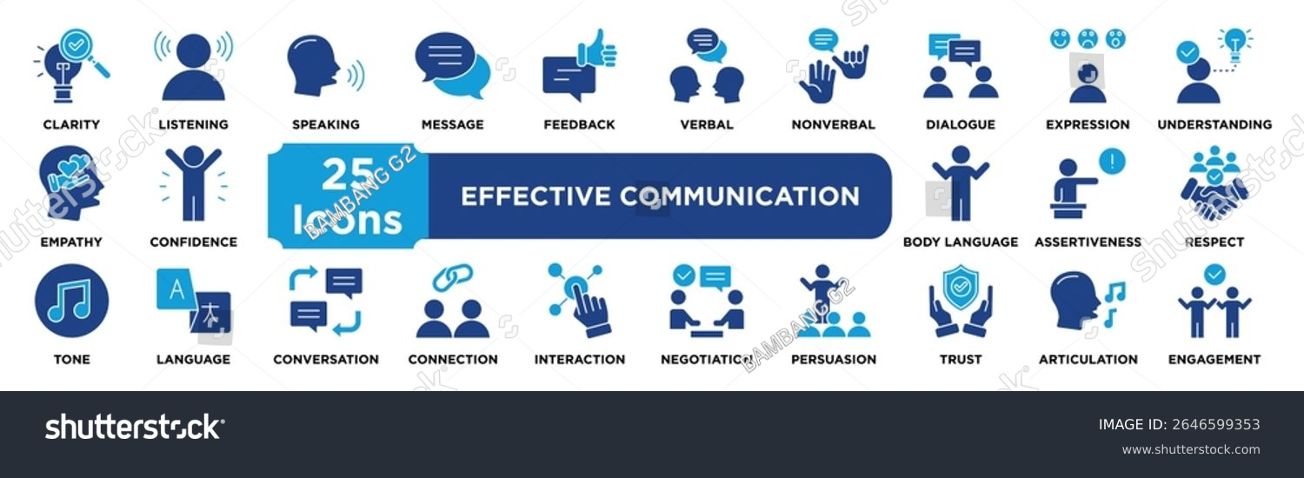
Dr Prabhat K Dwivedi, Associate Professor

Slide 19

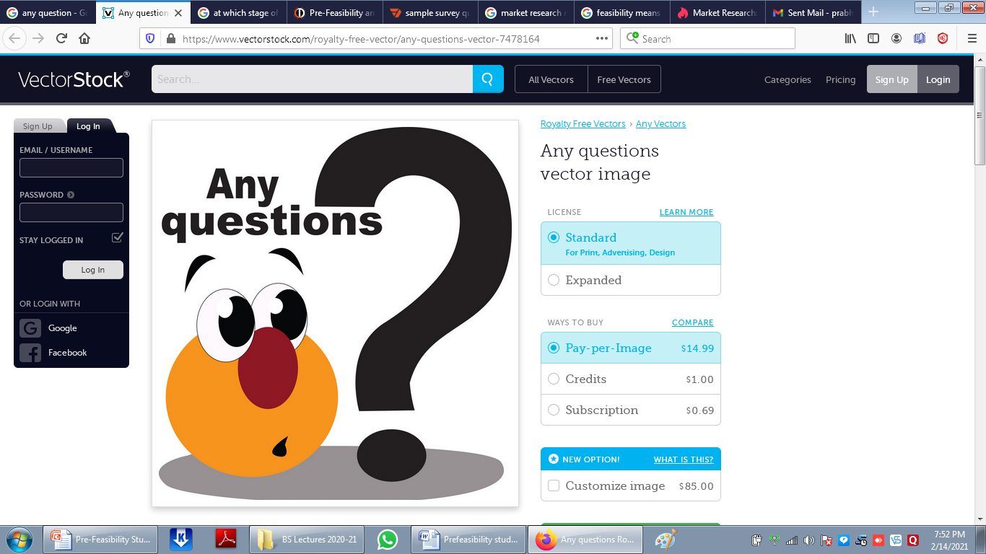
Dr Prabhat K Dwivedi, Associate Professor

Slide 20
References
https://www.examples.com/english/paralanguage-vocalics-in-nonverbal-communication.html/www.google.com/search?q=whT+IS+Effective+presentation&client
Dr Prabhat K Dwivedi, Associate Professor

Slide 21

Dr Prabhat K Dwivedi, Associate Professor

