Slide 1

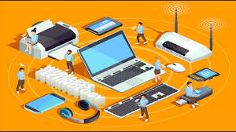
BUSINESS COMMUNICATION
L17: Modern Forms of Communication
Dr Prabhat K Dwivedi, Associate Professor
School of Business Management

Slide 2
Topics to be covered
Know about various forms of modern communication
Advantages and Disadvantages of modern communication
Dr Prabhat K Dwivedi, Associate Professor

Slide 3
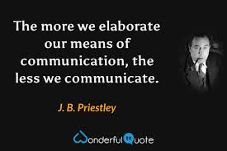
Dr Prabhat K Dwivedi, Associate Professor

Slide 4
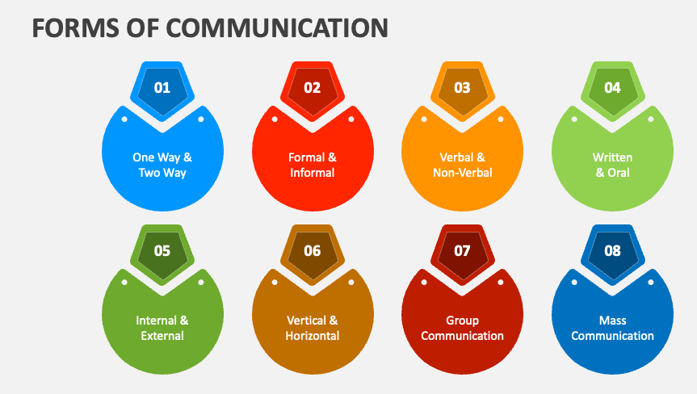

Slide 5
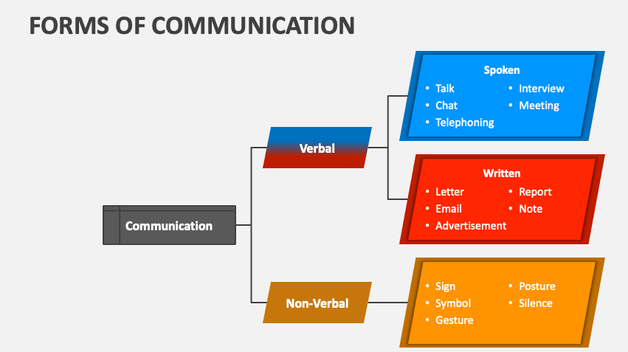
Dr Prabhat K Dwivedi, Associate Professor

Slide 6
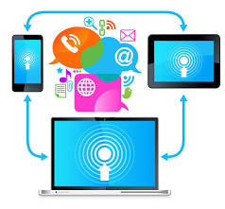
Modern Means of Communication
Modern means of communication are high-speed digital technologies that enable instant, global information exchange, revolutionising how people connect.
Key examples include smartphones, email, internet, social media, video conferencing, instant messaging (SMS/MMS), and cloud collaboration tools.
These tools facilitate remote work, real-time interaction, and widespread access to information.
Dr Prabhat K Dwivedi, Associate Professor

Slide 7
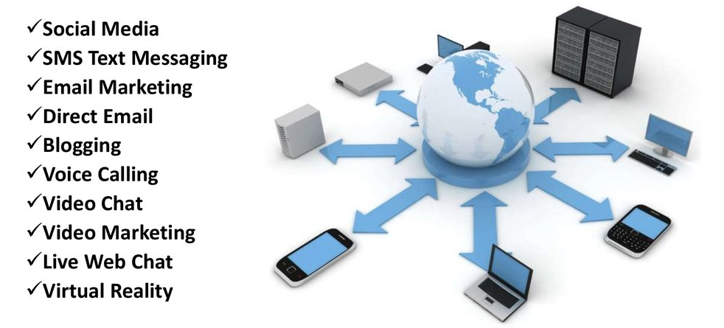
Modern Forms of Communication
Dr Prabhat K Dwivedi, Associate Professor

Slide 8
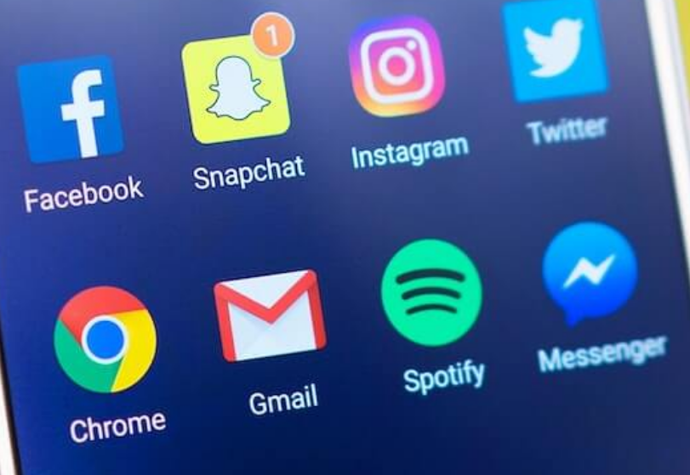
Advantages of Modern Means of Communication
Transmission speed: Messages may be delivered or received within a few seconds.
Expansion of coverage areas: the process of communication covered all regions of the earth so that the world has become a little town.
Low cost: The application of current techniques considerably decreases the work, cost, and time.
Benefit from others: thoughts and notes are exchanged, and an instant reply is achieved on a certain issue.
Manage company operations throughout the world. Even one can promote their company through modern means of communication.
Businessmen may easily oversee their commercial activities with the use of video conferencing and email technology.
Dr Prabhat K Dwivedi, Associate Professor

Slide 9

Disadvantages of Modern Means of Communication
Modern technology can also result in wate of time and inefficiency
Technology causes distraction from work and study
Technology reduces the creativity of people
Isolate people
Dr Prabhat K Dwivedi, Associate Professor

Slide 10

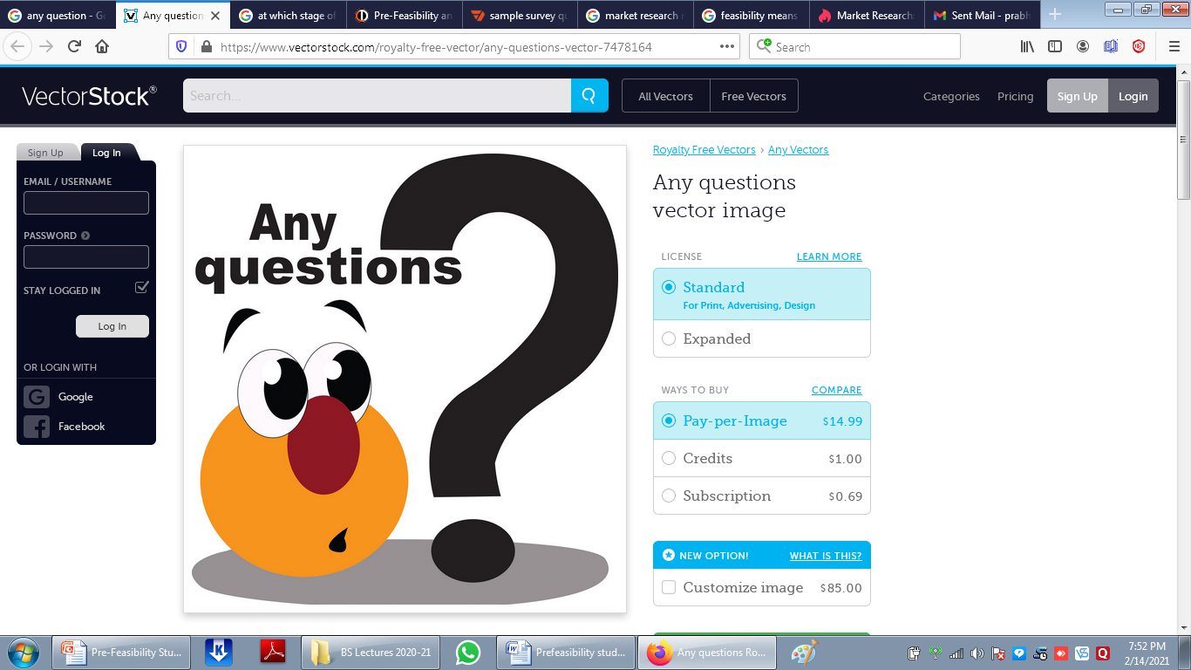
Dr Prabhat K Dwivedi, Associate Professor

Slide 11
References
https://www.google.com/search?q=Modern+Forms+of+Communication&client=firefox-bd&hs=3mLp&sca_esv=9459100
https://www.collidu.com/presentation-forms-of-communication
https://qualitytechtalk.com/the-advantages-and-disadvantages-of-modern-means-of-communication/
https://en.ppt-online.org/746297
Dr Prabhat K Dwivedi, Associate Professor

Slide 12

Dr Prabhat K Dwivedi, Associate Professor

