Slide 1

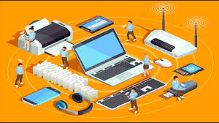
BUSINESS COMMUNICATION
L18: International Communication
Dr Prabhat K Dwivedi, Associate Professor
School of Business Management

Slide 2
Topics to be covered
Know about international communication
Challenges of int. communication
Dr Prabhat K Dwivedi, Associate Professor

Slide 3
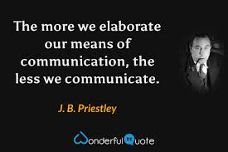
Dr Prabhat K Dwivedi, Associate Professor

Slide 4
What is international communication?
International communication refers to the exchange of information and ideas across national borders.
It is like navigating a complex global marketplace where effective communication bridges cultures, builds trust and paves the way for successful business ventures.
When doing business abroad, every business manager should assume differences between cultures: take responsibility, withhold judgment, show respect, empathize, tolerate ambiguity, look past the superficial, be patient, be persistent, admit cultural biases, remain flexible, look for common ground, send clear messages, deal with the individual, learn when to be direct and test your understanding

Slide 5
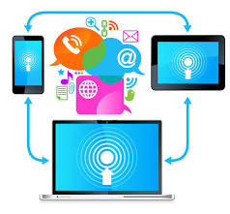
Key Elements of Communication
Intercultural
Multifaceted
Strategic
Dr Prabhat K Dwivedi, Associate Professor

Slide 6
Growing importance of int. communication
Market globalization
Company’s cultural diversity: a.) Culture, b.) Subculture , c.) Ethnocentrism, d.) Stereotyping
Dr Prabhat K Dwivedi, Associate Professor

Slide 7
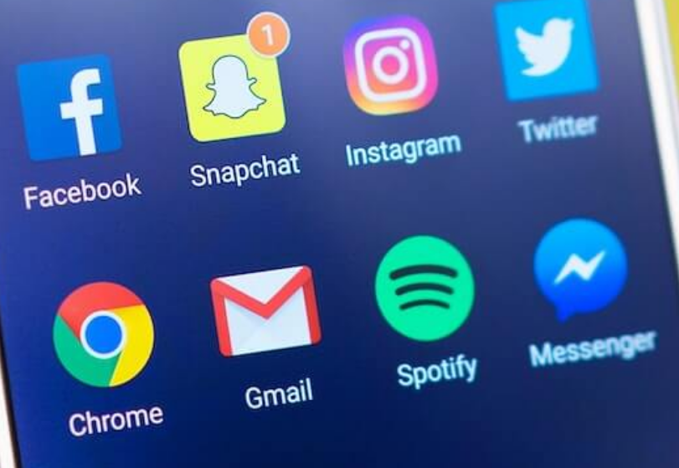
Importance of recognizing cultural differences
Recognizing cultural differences helps to:
Avoid sending inappropriate signals.
Correctly interpret the signals from others.
Understand that everyone’s thoughts and actions are just like ours.
Dr Prabhat K Dwivedi, Associate Professor

Slide 8
12 guidelines for speaking across cultures more effectively
Try to eliminate noise. Pronounce words clearly. Be brief.
Look for feedback. Be alert to signs of confusion in your listener
Use plain English. Speak slowly and rephrase your sentence when necessary. If someone does not seem to understand you, choose simpler words. Do not just repeat the sentence in a louder voice.
Be clear. Clarify your true intent with repetition and examples. Be aware of unintentional meanings that may be read into your message.
Use proper addresses. Do not talk down to the other person. Do not blame the listener for not understanding.
Use objective, accurate language. Avoid throwing around adjectives such as fantastic, fabulous, effervescent, etc.
Learn foreign phrases. Learn common greetings and a few phrases in the other person’s native language.
Listen carefully and patiently.
Adapt your conversation style to the other person’s.
Check frequently for comprehension.
Clarify what will happen next. At the end of the conversation, be sure that you and the other person agree on what has been said and decided.
Observe body language. Be alert for any expressions that signal the listener is lost or confused.

Slide 9


Dr Prabhat K Dwivedi, Associate Professor

Slide 10
References
https://www.google.com/search?q=Modern+Forms+of+Communication&client=firefox-bd&hs=3mLp&sca_esv=9459100
https://www.collidu.com/presentation-forms-of-communication
https://qualitytechtalk.com/the-advantages-and-disadvantages-of-modern-means-of-communication/
https://en.ppt-online.org/746297
Dr Prabhat K Dwivedi, Associate Professor

Slide 11

Dr Prabhat K Dwivedi, Associate Professor

