Slide 1

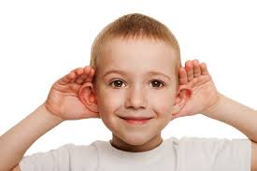
BUSINESS COMMUNICATION
L19-20: Corporate Communication Networks & Dynamics
Dr Prabhat K Dwivedi, Associate Professor
School of Business Management

Slide 2
Topics to be covered
Meaning of Corporate Communication Networks
Formal & Informal comm. networks
Dr Prabhat K Dwivedi, Associate Professor

Slide 3
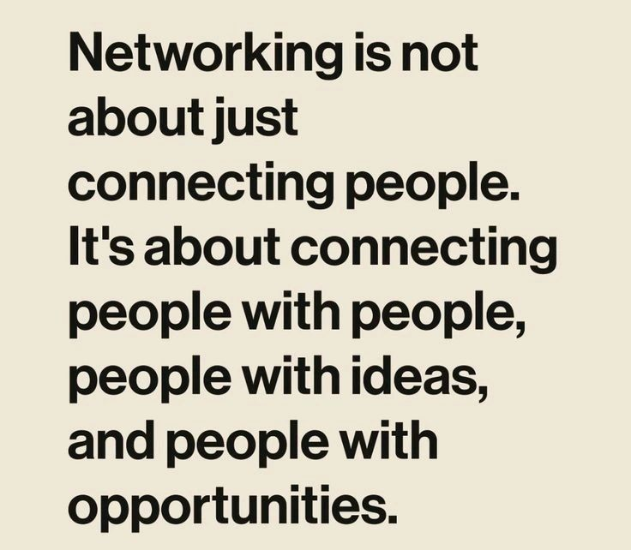
Dr Prabhat K Dwivedi, Associate Professor

Slide 4
What is Communication networks and dynamics ?
Communication networks and dynamics in corporate communication define how information flows through formal (hierarchical) and informal (grapevine) channels to shape organizational culture and performance. Key structures include chain, wheel, and all-channel networks. Dynamics involve navigating upward, downward, horizontal, and diagonal, and external, interactions to manage change and employee engagement.
Dr Prabhat K Dwivedi, Associate Professor

Slide 5
Key Aspects of Corporate Communication Networks
Formal Networks: These follow official authority structures, such as:
  Chain: Information moves systematically from top management down to lower levels.
  Wheel: A central leader dictates information to all employees directly.
  All-Channel: A decentralized, open-flow system where everyone communicates with everyone else, ideal for collaboration.
  Y-Network: Similar to a chain, but with a more hierarchical structure where information flows through intermediate layers before reaching others.
  Circle: Members communicate with those adjacent to them, often used in similar-rank groups.
Dr Prabhat K Dwivedi, Associate Professor

Slide 6
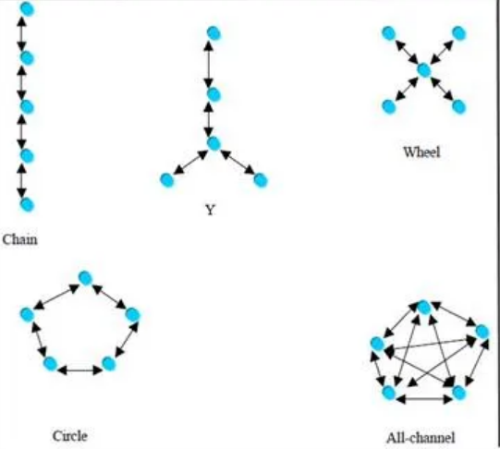
Dr Prabhat K Dwivedi, Associate Professor

Slide 7
Chain Communication Networks
  Chain type of communication is used where information flows upward and downward in a hierarchical manner.
  There is no lateral communication.
  This type of communication is best suited for organizations where reporting is strict and jobs are well defined.
  Lot of written communication takes place in the form of orders, instructions, etc.
Dr Prabhat K Dwivedi, Associate Professor

Slide 8
Inverted Y- Networks
Similar to a chain, but with a more hierarchical structure where information flows through intermediate layers before reaching others.
This type of communication represents one person having two subordinates. They report to the designated boss.
Dr Prabhat K Dwivedi, Associate Professor

Slide 9
Wheel Networks
  ‘Wheel’ type of communication represents manager in the center having control over superior officers i.e. a central leader dictates information to all employees directly.
  Wheel type of communication is very commonly used in most of the organization as it provides faster problem solving.
  This type communication displays lack of flexibility and shows the lowest job satisfaction.
Dr Prabhat K Dwivedi, Associate Professor

Slide 10
Circle Type Networks
  ‘Circle’ type of communication is used by a member to adjoining member only.
  Members communicate with those adjacent to them, often used in similar-rank groups.
  Communication is lateral.
Dr Prabhat K Dwivedi, Associate Professor

Slide 11
All-Channel Type Networks
“All channel” type of communication is used by a member to any member of the organization.
There is no leader but a person may assume leadership.
Members experience a greater level of satisfaction.
This is prevalent in decentralized organisations.
Dr Prabhat K Dwivedi, Associate Professor

Slide 12
Conclusion
More the centralization, poorer the satisfaction of employees.
A decentralized, open-flow system where everyone communicates with everyone else, ideal for collaboration.
Decentralized networks are suitable to the organizations where jobs are complex and members have to interact with various departments.
When the tasks are comparatively simple and of routine nature, centralized communication (Chain, Y, Wheel) is recommended.
Dr Prabhat K Dwivedi, Associate Professor

Slide 13
Informal Communication Networks
An informal communication network, often called the "grapevine," is an unofficial, spontaneous, and fast-moving channel of information in organizations that exists alongside formal, rigid structures.
It relies on social interactions, such as "water cooler" conversations, to share news, rumours, or, feedback.
Key types include, single-strand, gossip, probability, and cluster chains.
Dr Prabhat K Dwivedi, Associate Professor

Slide 14
Key Aspects of Informal Networks
Speed & Efficiency: It operates much faster than formal channels, allowing information to travel quickly through a company.
Unstructured: There is no fixed, official path for the message; it moves through friendships and personal relationships.
The Grapevine: It often spreads rumors or gossip, which can be unverified, but it also helps in building social bonds and employee engagement.
Dr Prabhat K Dwivedi, Associate Professor

Slide 15
Types of Informal Chains
Single Strand: Information passes in a direct line from one person to the next.
Gossip Chain: One person tells many others, usually spreading information in a, widespread, manner.
Probability Chain: An individual randomly selects others to share information with, often used for trivial, information.
Cluster Chain: One person tells a few selected, people, and then some of those people pass it on to another, select, group.

Slide 16
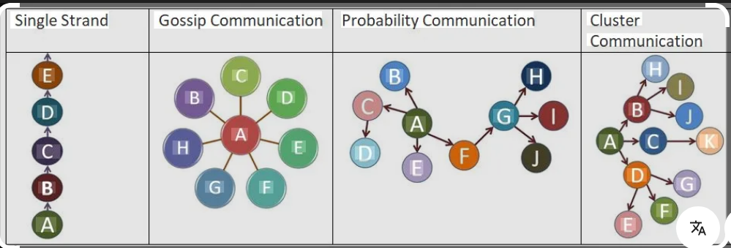
Dr Prabhat K Dwivedi, Associate Professor

Slide 17
Pros & Cons
Benefits: It builds strong, relationships, fosters a, positive work environment, and, allows for, quick, communication, for, problem-solving.
Demerits: It can, distort information, create, rumors, and, lead to the leak of confidential, data
Dr Prabhat K Dwivedi, Associate Professor

Slide 18

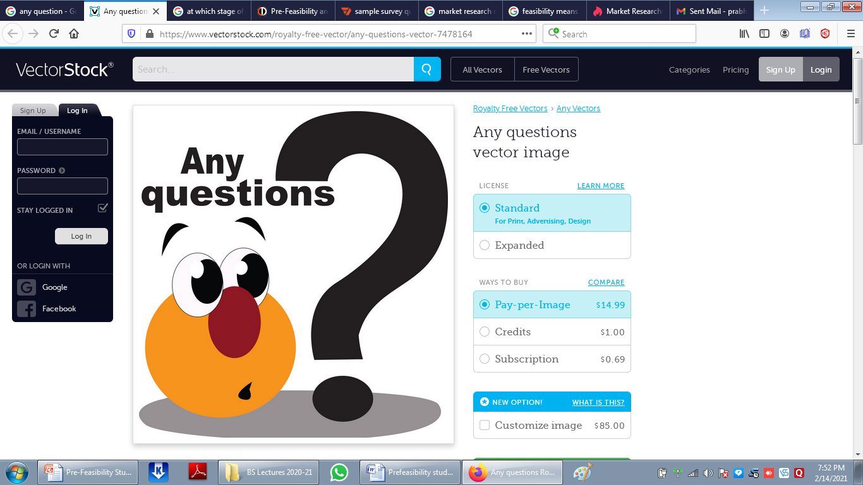
Dr Prabhat K Dwivedi, Associate Professor

Slide 19
References
https://nscpolteksby.ac.id/ebook/files/Ebook/Business%20Administration/Organizational%20Behaviour%20-%20V.%20G.%20KONDALKAR%20(2007)/Chapter%2013%20-%20The%20Dynamics%20of%20Communication.pdf
https://telecommunicationengineering.softecks.in/240/
www.study.com
https://www.google.com/search?source=lns.web.gisivli&vsdim=396,127&gsessionid=fDg_ecLo_ck9W92H1RgGgu04xm2a-BPACRVWh5eNxR5q6fsma-TOfQ&lsessionid=AdhCI7auX67pOXjXsZwTjZ8TZbAMoHn14G8LEpU4S7gAUtz5N9ETMA&lns_surface=19&authuser=0&biw=1280&bih=559&tbnid=LcXp0fpCriSRcM&vsrid=CNqZ0b6IiNeT2gEQBhgBIiQ3NzBDQThCNy1FNTQ4LTQ5NjYtOTM3Mi1CREQ4MkE1MTIyMDcyBiICdGEoIziZ6PKKmZ2TAw&udm=26&q&vsint=CAQqCgoCCAcSAggHIAE6IwoWDYAO8z4VAAAAPx2ADnM_JQAAgD8wARDtBxjDAiUAAIA_&lns_mode=un&qsubts=1773415984691&stq=1&cs=0&lei=Ii60acSqKNfS2roPr-qgyAY
Dr Prabhat K Dwivedi, Associate Professor

Slide 20

Dr Prabhat K Dwivedi, Associate Professor

