Slide 1

BUSINESS COMMUNICATION
L25: Conveying Bad News
Dr Prabhat K Dwivedi, Associate Professor
School of Business Management

Slide 2
Topics to be covered
Unpleasant Business Letters
Direct & Indirect ways
Template
Dr Prabhat K Dwivedi, Associate Professor

Slide 3
"It is much, much worse to receive bad news through the written word than by somebody simply telling you, and I’m sure you understand why. When somebody simply tells you bad news, you hear it once, and that’s the end of it. But when bad news is written down, whether in a letter or a newspaper or on your arm in felt tip pen, each time you read it, you feel as if you are receiving the bad news again and again." (Lemony Snicket, Horseradish: Bitter Truths You Can't Avoid. HarperCollins, 2007)
Dr Prabhat K Dwivedi, Associate Professor

Slide 4
What is a bad news message?
In business writing, a bad-news message is a letter, memo, or email that conveys negative or unpleasant information—information that is likely to disappoint, upset, or even anger a reader. It is also called an indirect message or a negative message.
Bad-news messages include rejections (in response to job applications, promotion requests, and the like), negative evaluations, and announcements of policy changes that don't benefit the reader.
A bad-news message conventionally begins with a neutral or positive buffer statement before introducing the negative or unpleasant information. This approach is called the indirect plan.

Slide 5
Key Takeaways
Bad news messages in business are indirect letters or emails with unpleasant information.
These messages start with a positive note before sharing bad news to soften the impact.
The closing of bad news messages should be kind and offer a positive option or solution.

Slide 6
Delivering a Bad News Message
Direct Approach
Indirect Approach
Dr Prabhat K Dwivedi, Associate Professor

Slide 7
Direct Approach
The direct approach is often used when the audience values brevity, the message needs to be concise, the message is very complex and might not be understood easily, the message is related to a known issue or problem (and bad news won’t be a surprise), or you’re terminating a business relationship.
Dr Prabhat K Dwivedi, Associate Professor

Slide 8
Sample
Your request for vacation time from August 1-30 was not approved because it is over your vacation days entitlement of 10 days.
Please re-submit your request for vacation days (up to a maximum of 10) to HR as soon as possible.
Dr Prabhat K Dwivedi, Associate Professor

Slide 9
Indirect Approach
When the bad news may have a significant impact on the recipient or you don’t know them very well, you may prefer to use the indirect approach
Dr Prabhat K Dwivedi, Associate Professor

Slide 10
Sample
Thank you for submitting your request for 10 days of vacation (your maximum entitlement) in August.
Summer is traditionally a time when many employees are out of the office and demands on the servers are reduced. In order to minimize the disruption to staff throughout the company, the IT department will be rolling out a server replacement project during July and August. Because this project will need to be completed in a more compressed timeframe, no vacation requests in July and August are possible for staff in the IT department. As a result, your request for vacation during August has not been approved. However, you are welcome to take vacation before and/or after the project rolls out. In compensation, HR is providing IT staff with three extra days of paid vacation.
We look forward to receiving your revised vacation request soon.

Slide 11
The indirect approach
The indirect approach for delivering bad news has five main parts:
Open with a buffer statement
Explain the situation
Break the bad news
Redirect or provide alternatives
End politely and forward-looking

Slide 12
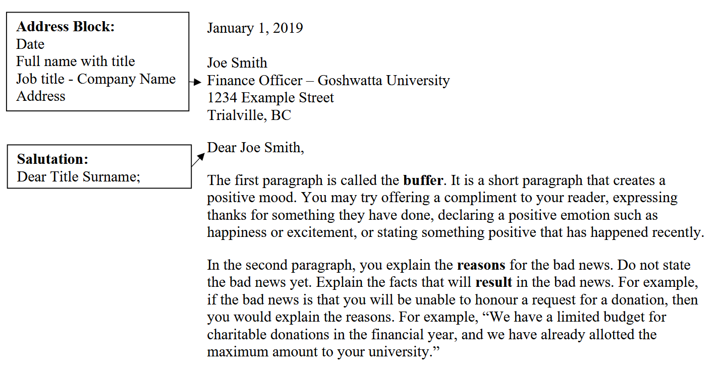
Bad News Letter Template

Slide 13
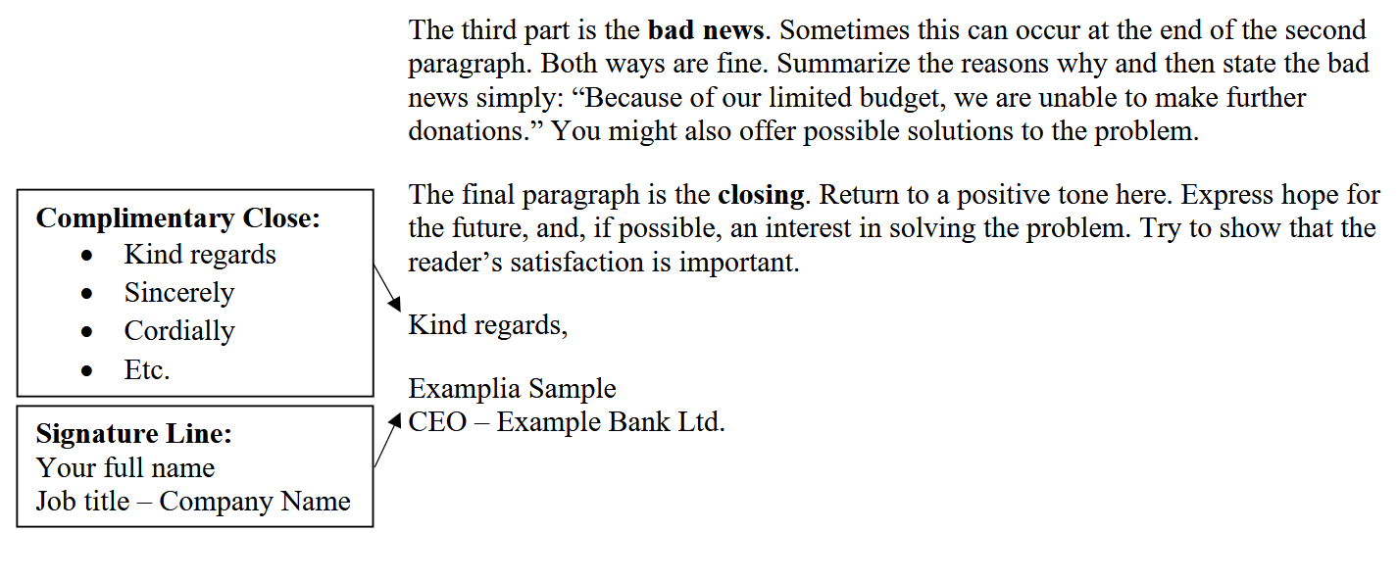

Slide 14
Sample: Rejection of a Grant Application
"It is much, much worse to receive bad news through the written word than by somebody simply telling you, and I’m sure you understand why. When somebody simply tells you bad news, you hear it once, and that’s the end of it. But when bad news is written down, whether in a letter or a newspaper or on your arm in felt tip pen, each time you read it, you feel as if you are receiving the bad news again and again." (Lemony Snicket, Horseradish: Bitter Truths You Can't Avoid. HarperCollins, 2007)

Slide 15

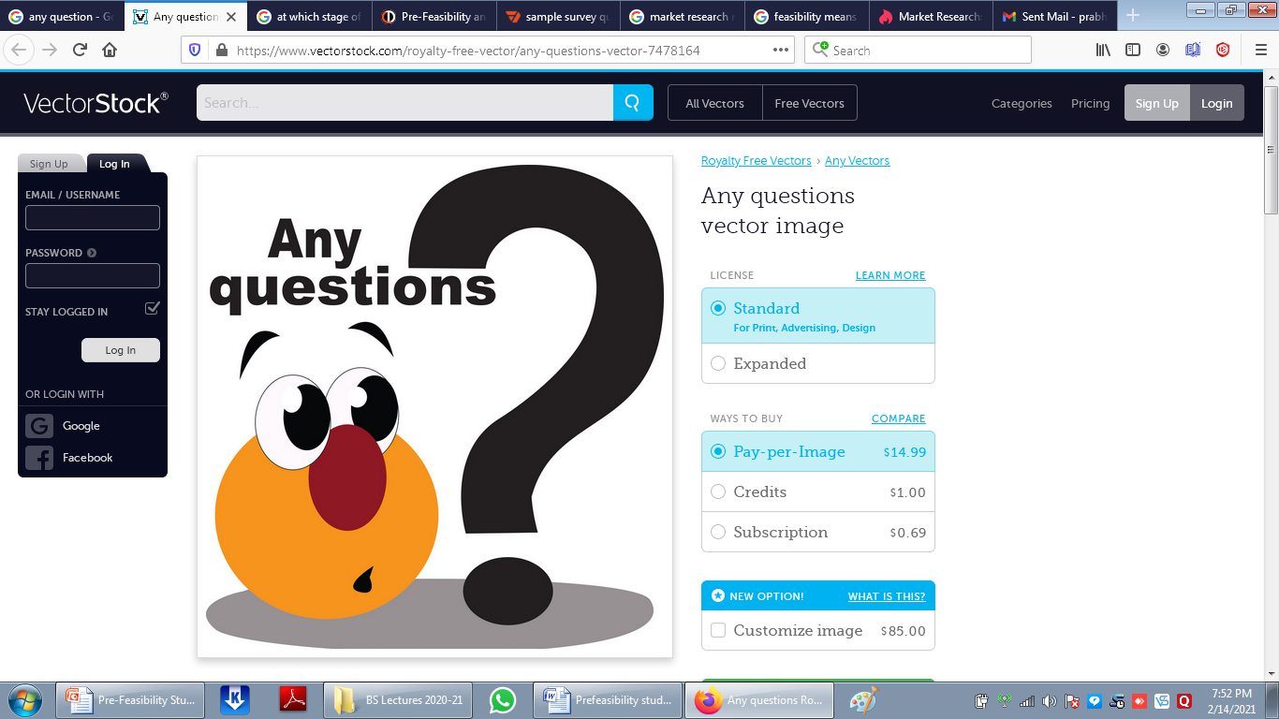
Dr Prabhat K Dwivedi, Associate Professor

Slide 16
References
https://kpu.pressbooks.pub/businesswriting/chapter/delivering-a-bad-news-message/
https://www.tru.ca/__shared/assets/Bad_News_Letter_Template42611.pdf
Dr Prabhat K Dwivedi, Associate Professor

Slide 17

Dr Prabhat K Dwivedi, Associate Professor

