Slide 1


BUSINESS COMMUNICATION
L30-33: Corporate Meetings
Dr Prabhat K Dwivedi, Associate Professor
School of Business Management

Slide 2
Topics to be covered
What is a Corporate Meeting?
Essentials
Types
Dr Prabhat K Dwivedi, Associate Professor

Slide 3
"It is much, much worse to receive bad news through the written word than by somebody simply telling you, and I’m sure you understand why. When somebody simply tells you bad news, you hear it once, and that’s the end of it. But when bad news is written down, whether in a letter or a newspaper or on your arm in felt tip pen, each time you read it, you feel as if you are receiving the bad news again and again." (Lemony Snicket, Horseradish: Bitter Truths You Can't Avoid. HarperCollins, 2007)
Dr Prabhat K Dwivedi, Associate Professor

Slide 4
What is a Corporate Meeting?
A corporate meeting is a formal gathering of stakeholders—directors, shareholders, or employees—convened to discuss, decide, and document business matters, often to meet legal compliance or governance requirements.
It serves as a forum for strategic planning, decision-making, and organizational communication to ensure transparency and accountability.

Slide 5
Requisites of a Valid Company Meeting
To be legally valid, most company meetings must meet certain basic requirements:
Proper notice must be given to all eligible participants.
Quorum must be present at the start and through voting.
The meeting must be called under the correct authority and for an allowed purpose.
Minutes must be recorded and, where required, filed with regulators.
These elements are central under formal company law regimes and should be checked for your jurisdiction.

Slide 6
Types of Important Meetings
Annual General Meetings (AGMs):
Formal annual meetings for shareholders to review financial statements and elect directors.
Board Meetings:
Regular gatherings of directors to decide on company policies and strategies.
Operational/Staff Meetings:
Routine team meetings to coordinate projects, discuss performance, and align goals.
Extraordinary General Meetings (EGMs):
Meetings called for urgent matters outside the AGM schedule.
Committee Meetings:
Smaller groups focused on specific areas like audits or compensation.
Creditor Meetings:
Called when a company is restructuring or restructuring debt.
Dr Prabhat K Dwivedi, Associate Professor

Slide 7
IMPORTANCE OF CORPORATE MEETINGS
Decision-Making
Communication
Problem Solving
Accountability
Team Building
Strategic Planning
Performance Evaluation
Stakeholder Engagement
Compliance and Governance
Innovation and Creativity
Conflict Resolution
Feedback Gathering
Dr Prabhat K Dwivedi, Associate Professor

Slide 8

Key Techniques for Group Decision Making
BRAINSTORMING
Purpose: To generate a high volume of creative, free-flowing ideas in a non-judgmental environment.
Process: A group gathers to brainstorm solutions for a specific problem. Evaluation is deferred to encourage wild, innovative ideas.
Best Use: Initial stages of brainstorming solutions where creativity is needed.

Slide 9
What is brainstorming?
Brainstorming is a collaborative ideation method where teams generate, develop, and evaluate ideas to solve specific problems or explore new opportunities.
The practice combines individual thinking with group interaction to surface diverse perspectives and push past obvious solutions.
This leads to more effective meetings, ensuring they remain focused and deliver tangible results.

Slide 10
Brainstorming…
The concept emerged in 1953 when advertising executive Alex Osborn published "Applied Imagination," introducing four core principles:
Defer judgment — Separate idea generation from evaluation
Encourage wild ideas — Unconventional thinking often leads to breakthrough solutions
Build on others' ideas — Combine and improve concepts collaboratively
Go for quantity — More ideas increase the likelihood of finding great ones

Slide 11
Nominal Group Technique (NGT)
Purpose: A structured variation of brainstorming that forces equal participation, reduces the influence of dominant members, and provides a quick, consensus-based decision.
Best Use: Sensitive topics, team decisions, or when quick, balanced consensus is required.

Slide 12
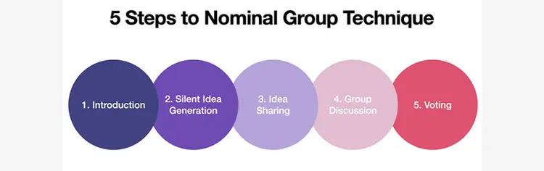

Slide 13
Nominal Group Technique (NGT)
Process (Steps 1–6):
Introduction: Define the problem.
Silent Generation: Individuals write down ideas silently.
Round-Robin Sharing: Each member presents one idea, recorded by a facilitator.
Discussion: Each idea is discussed for clarification, not criticism.
Voting/Ranking: Members privately rank their top ideas.
Final Selection: The highest-ranked ideas are selected as the final decision.

Slide 14
What is the Delphi Method?
The Delphi Method is a structured communication approach employed for forecasting and decision-making, involving a panel of experts.
The process consists of multiple rounds of questionnaires where experts provide anonymous responses.
These responses are aggregated and shared with the group, allowing for adjustments based on the collective input to achieve a consensus opinion.
Starting with selecting experts, the method progresses through rounds of comments until a consensus is reached.
While offering advantages such as aggregating diverse opinions without physical meetings and ensuring anonymity, it may lack the depth of live discussions and face challenges like potential dropouts and the risk of aligning views with the majority.

Slide 15
Delphi Technique
Purpose: To gain consensus from experts without having them meet face-to-face, avoiding groupthink or pressure.
Process: Experts answer questionnaires independently. A facilitator summarizes the views and sends them back to the experts for further refinement over multiple rounds.
Best Use: Long-term planning, forecasting, or complex, strategic,, or controversial issues.

Slide 16
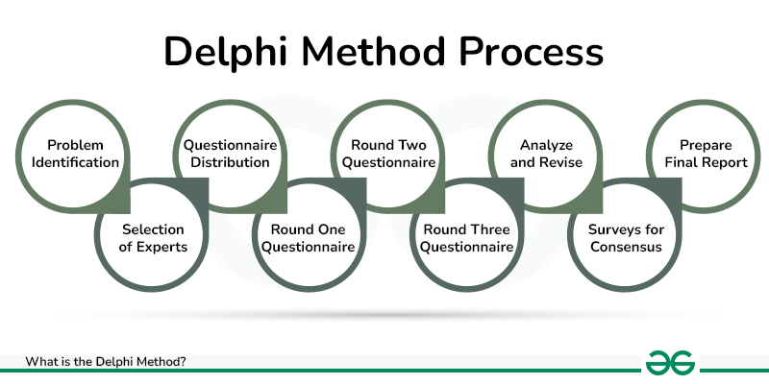

Slide 17
Comparison of Techniques
Interaction: NGT requires direct, face-to-face interaction, while Delphi is conducted anonymously without interaction.
Time: NGT is faster, often done in a single session, whereas Delphi takes longer due to multiple feedback rounds.
Structure: Both NGT and Delphi are highly structured, unlike traditional, informal brainstorming.

Slide 18

Group Discussion
A group discussion (GD) is a formal, interactive communication method where 6–12 participants exchange ideas on a topic to demonstrate teamwork, leadership, communication skills, and subject knowledge, usually observed by panelists for selection purposes. Unlike debates, GDs are cooperative, aiming for consensus rather than just winning.

Slide 19
Key Aspects of a Successful Group Discussion
Assessment Areas: Evaluators judge communication skills, leadership, interpersonal skills, and behaviour under pressure.
Key Roles: Participants should aim to initiate, contribute fresh points, act as a mediator, and summarise.
Types of Topics: Usually, topics are factual (e.g., "Impact of Technology"), controversial (e.g., "Should X be banned?"), or abstract/case studies.
Dos & Don'ts: Do maintain eye contact, display active listening, and offer constructive points. Don't be too emotional, aggressive, or interrupt others

Slide 20
Important Tips for Success
Structure Your Points: Present logical, well-reasoned arguments.
Be a Team Player: Encourage others to speak and build on others' ideas rather than just repeating your own.
Keep it Clear and Concise: Focus on quality contributions over being the loudest voice

Slide 21
Common Mistakes to Avoid
Repetition: Repeating points makes your contribution weak.
Ignoring Non-Verbal Cues: Poor body language (e.g., slouching, lack of eye contact) implies a lack of confidence.
Getting Overly Emotional: Staying calm shows maturity and leadership.

Slide 22
What is a Group Discussion About?
Testing Communication Skills
Teamwork and Leadership
Problem-Solving and Decision-Making
Knowledge and Awareness
Time Management
Convincing and Persuasive Skills
Handling Pressure

Slide 23
Corporate Interview
A corporate interview is a formal, two-way assessment process between a company representative and a candidate to evaluate suitability for a job role. Common types include screening, panel, behavioral, technical, and one-on-one interviews. These interviews focus on technical skills, behavior, and company fit, with structured, unstructured, and stress formats often used.

Slide 24
Major Types of Corporate Interviews
Screening Interviews: Usually, a short (10-30 min) phone or video call with HR to check if you meet minimum qualifications.
One-on-One Interviews: A traditional, personal meeting with a single interviewer, often the direct manager.
Panel Interviews: Involves two or more interviewers—typically HR, hiring managers, and future team members—who evaluate the candidate together.
Behavioral Interviews: Focus on the principle that past behavior predicts future performance, requiring examples of how you handled specific situations.
Case/Technical Interviews: Common in consulting or IT roles, these test technical knowledge, problem-solving skills, and industry proficiency.

Slide 25
Group Interviews: Multiple candidates are assessed together to evaluate team interaction, leadership, and communication skills.
Situational Interviews: Present hypothetical business problems or scenarios to evaluate the candidate's thought process and analytical skills.
Stress Interviews: Intentionally designed by the interviewer to be demanding or abrasive to see how a candidate handles high pressure.
Second or On-Site Interviews: A more detailed, in-depth, and often long-lasting (half or full-day) interview, frequently the last stage before a job offer.

Slide 26
Structural Formats
Structured: All candidates are asked the same set of predetermined questions to maintain consistency and reduce bias.
Unstructured: A conversational, flexible interview where questions can change, often used to gauge a candidate's personality and fit.
Sequential: A series of interviews where you meet multiple interviewers one-by-one, often in different sessions.

Slide 27
Purpose-Based Interviews
Informational Interview: Aimed at learning about a company or sector, often for networking.
Appraisal Interview: A formal review between an employee and manager regarding job performance.
Exit Interview: A conversation with an employee leaving the organization to gain feedback.

Slide 28

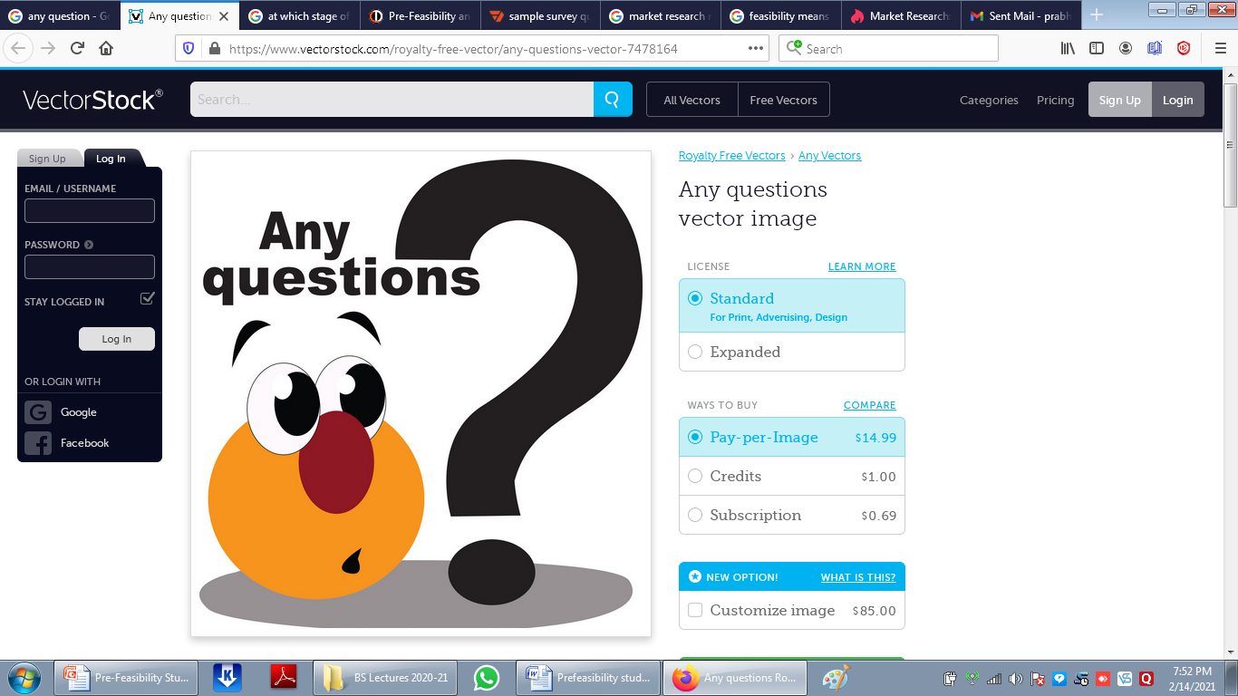
Dr Prabhat K Dwivedi, Associate Professor

Slide 29
References
https://www.naukri.com/blog/what-is-group-discussion/
https://www.geeksforgeeks.org/business-studies/delphi-method-meaning-uses-process-and-application/
Dr Prabhat K Dwivedi, Associate Professor

Slide 30

Dr Prabhat K Dwivedi, Associate Professor

