Slide 1

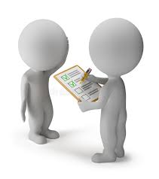
BUSINESS COMMUNICATION
L34-35: Surveys & Psychometric Tests
Dr Prabhat K Dwivedi, Associate Professor
School of Business Management

Slide 2
Topics to be covered
What is a survey?
Purpose & Types
What are psychometric tests?
Purpose & Types
Dr Prabhat K Dwivedi, Associate Professor

Slide 3
What is a survey?
A survey is a research method used to gather data, opinions, or behaviors from a specific group of people using questionnaires, interviews, or polls.
They are essential for analyzing trends, measuring satisfaction, and making informed decisions across industries.

Slide 4
Purpose & Applications of Surveys
Purpose:
To collect structured, quantifiable data from a sample to understand a larger population.
Applications:
Customer feedback, employee satisfaction, academic research, and market research.

Slide 5
Methods/ Types of Surveys
Common types include
online forms,
email surveys,
telephone interviews,
face-to-face interviews.
Key Components
Clear, unbiased questions are essential for valid results.

Slide 6



Common Survey Platforms
SurveyMonkey:
Known for wide reach and AI-powered insights.
Jotform:
Offers secure and offline mobile surveys.
SurveyLegend:
Focuses on visually appealing, customizable surveys.

Slide 7
What are psychometric tests?
Psychometric tests are a standard and scientific method used to measure individuals' mental capabilities and behavioural style.
Psychometric tests are designed to measure candidates' suitability for a role based on the required personality characteristics and aptitude (or cognitive abilities).
They identify the extent to which candidates' personality and cognitive abilities match those required to perform the role.
Employers use the information collected from the psychometric test to identify the hidden aspects of candidates that are difficult to extract from a face-to-face interview.

Slide 8
Types of Psychometric tests
Most psychometric tests can be grouped into two.
The first group of psychometric tests is measuring your cognitive or aptitude abilities.
These psychometric tests are based on timers and the idea behind them is that in order to separate between people’s cognitive abilities, we need to use ask them to complete a list of questions in a very limited time.
Those better at the cognitive ability measured will be able to get more questions solved correctly than those who are less strong in the ability measured.
This group of psychometric tests includes tests such as abstract tests, numerical tests, verbal tests, mechanical tests and emotional intelligence tests.

Slide 9
Abstract type psychometric tests
This psychometric test measures your ability to solve problems, think strategically and think on your feet.
The typical test question styles used in the abstract psychometric test are two.
The first style is offering a group of shapes and you need to decide what is a missing shape, or what is the next shape or which is the odd-one-out shape.
The concept behind this style of test questions is that you need to identify the logical rules that apply to the group of shapes and use them to identify the missing shape.
The second style of test questions is offering you a group on initial shapes then there are some processes applied on the shapes to transform them to the final shapes. Your task is to find what each process does. Then use this knowledge to identify how a group of initial shapes will transform to final shapes. The abstract type of psychometric test has a timer either for the entire test or per test question.
Dr Prabhat K Dwivedi, Associate Professor

Slide 10
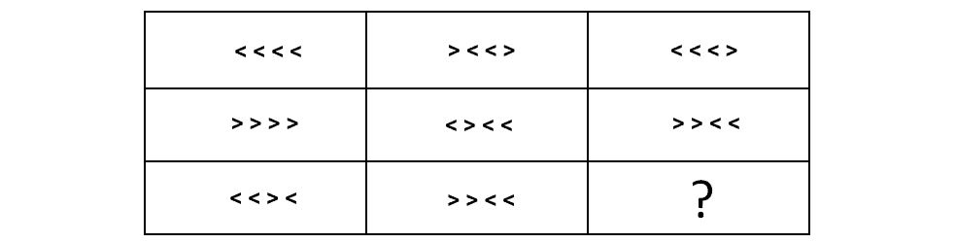
Example of the abstract type of psychometric tests
What is the next figure?
Soln.:
To solve this abstract psychometric test question, we need to find the logical rules that apply to the shapes going from left to right or top to bottom. We can see that each cell contains four arrowheads, some pointing left, and some pointing right. The last cell in each row is a combination of the first two arrowhead of the first cell, then the last two arrowhead of the middle cell. So, if we look at our top row, the first two arrowheads in first cell are < < and the last two arrowheads of middle cell are < >. If we combine them, we get < < < >.
Dr Prabhat K Dwivedi, Associate Professor

Slide 11
Verbal type psychometric tests
This type of psychometric test measures your ability to process information in a logical manner to make a decision. It also measures your ability to identify and focus on the critical information rather than on all the information provided. The verbal psychometric test has several different test question styles.
Let’s review some examples of verbal psychometric test questions.
The first style of verbal psychometric test questions is one in which you are presented with a list of facts and a conclusion. Your task is to quickly identify which facts lead to the conclusion being correct.

Slide 12
Example
Which two statements together prove that Tim has a red car?
A. Gil likes Tim's car colour
B. Tim likes fast cars
C. Gil has a fast car
D. Gil likes only red cars
E. Tim's car is not silver

Slide 13
Solution
To answer this verbal psychometric test question, we need to first examine what each statement says. If we take statement A ‘Gil likes Tim’s car colour’ and combine it with statement D ‘Gil likes only red cars’ then those alone prove that Tim has a red car. The logic is that if Gil likes only red cars (D) and he likes Tim’s car colour (A) then Tim’s car must be red.

Slide 14
A second style of verbal psychometric test
A second style of verbal psychometric test questions is test questions in which you have a passage to read and a set of 3 questions to answer. However, in this style the test questions are not only offering 3 answer options - true, false and can't say but they offer a list of statements as answer options.

Slide 15
In epistemology, the Munchausen trilemma is a thought experiment used to demonstrate the impossibility of proving any truth, even in the fields of logic and mathematics. If it is asked how any knowledge is known to be true, proof may be provided. Yet that same question can be asked of the proof, and any subsequent proof. The Munchausen trilemma is that there are only three options when providing proof in this situation: (a) the circular argument, in which theory and proof support each other; (b) the regressive argument, in which each proof requires a further proof, ad infinitum; and (c) the axiomatic argument, which rests on accepted precepts. The trilemma, then, is the decision among the three equally unsatisfying options.
The name Munchausen Trilemma was coined in 1968 by the German philosopher Hans Albert in reference to a trilemma of “dogmatism versus infinite regress versus psychologism” used by Karl Popper. It is a reference to the problem of ‘bootstrapping’, based on the story of Baron Munchausen pulling himself and the horse on which he was sitting out of a mire by his own hair.
Based on the passage, wwhich one of the following does NOT follow based on the content of the text?
a. Karl Popper was a German philosopher.
b. There are three argument options when providing proof of whether any knowledge is true.
c. The axiomatic argument is one which rests on accepted precepts.
d. When each proof requires further proof ad infinitum, it is called a regressive argument.
e. Baron Munchausen rode a horse.

Slide 16

Numerical type of psychometric tests
A second styl of numerical psychometric test question is questions in which you are given a list of numbers displayed in triangles or long grids. Your task is to find what are the two missing numbers. Let's check the following example psychometric test question:

Slide 17
To answer this psychometric test question you need to find the patterns or number sequences in this example. If we examine the numbers in the top line: 4, 12, 36... we can see that each consecutive number is product of multiplying the previous number by 3. For example, 4 x 3 = 12 and 12 x 3 = 36. Based on this the next number will be 36 x 3 = 108. The numbers at the bottom are created by subtracting 3 from the numbers above. For example, 4 - 3 = 1, 12 - 3 = 9, 36 - 3 = 33 and 108 - 3 = 105. The missing number at the bottom will be 108 x 3 = 324 then 324 - 3 = 321. So the missing numbers are 108 and 321.

Slide 18
What is the Delphi Method?
The Delphi Method is a structured communication approach employed for forecasting and decision-making, involving a panel of experts.
The process consists of multiple rounds of questionnaires where experts provide anonymous responses.
These responses are aggregated and shared with the group, allowing for adjustments based on the collective input to achieve a consensus opinion.
Starting with selecting experts, the method progresses through rounds of comments until a consensus is reached.
While offering advantages such as aggregating diverse opinions without physical meetings and ensuring anonymity, it may lack the depth of live discussions and face challenges like potential dropouts and the risk of aligning views with the majority.

Slide 19


Dr Prabhat K Dwivedi, Associate Professor

Slide 20
References
https://www.psychometricinstitute.com.au/psychometric-guide/introduction_to_psychometric_tests.html
https://www.geeksforgeeks.org/business-studies/types-of-surveys/
https://www.customerthermometer.com/customer-surveys/types-of-survey-questions/
Dr Prabhat K Dwivedi, Associate Professor

Slide 21

Dr Prabhat K Dwivedi, Associate Professor

