Slide 1
Biostatistics for Dummies
By- Amil Agarwal

Slide 2
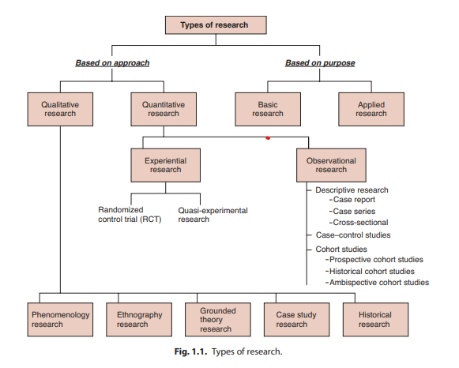

Slide 3
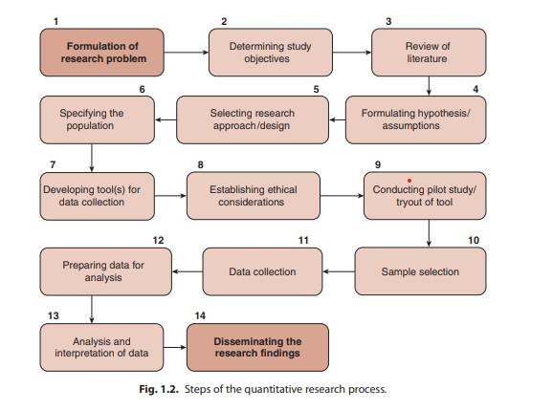

Slide 4
BIOSTATISTICS
Biostatistics is the term used when tools of statistics are applied to the data that is derived from biological sciences such as medicine.
Any science demands precision for its development, and so does medical science. For precision, facts, observations or measurements have to be expressed in figures.

Slide 5
Types of biostatistics
Descriptive statistics is used to organize and summarize the data to draw meaningful interpretations. It also allows the researcher to interpret the data meaningfully, so that research question can be answered completely and appropriately.
Inferential statistics helps in drawing inferences from data, e.g. finding the differences, relationship and association between two or more variables with the help of parametric and nonparametric statistical tests. The most commonly used inferential statistical tests are Z-test, t-test, analysis of variance [ANOVA], chi-square tests

Slide 6
Variable
A characteristic that takes on different values in different persons, places or things.
A quantity that varies within limits such as height, weight, blood pressure, age, etc.
It is denoted as X and notation for orderly series as X1 , X2 , X3 , …. Xn .
The suffix n is symbol for number in the series. Σ (sigma) stands for summation or results or observation

Slide 7
Types of Variables
Dependent variables: Variables that change as the independent variable is manipulated by the researcher; sometimes called criterion variables.
Independent variables: Variables that are purposely manipulated or changed by the researcher; also called manipulated variables. 
Research variables: These are the qualities, properties or characteristics that are observed or measured in a natural setting without manipulating and establishing cause-and-effect relationship. 
Demographic variables: The characteristics and attributes of the study subjects are considered demographic variables, e.g., age, gender, educational status, religion, social class, marital status, habitat, occupation, income and medical diagnosis.
Extraneous variables: Extraneous variables are the factors that are not part of the study but may affect the measurement of the study variables.

Slide 8
Discrete data: Data where are measured in whole numbers are called discrete data, e.g. number of children in a family, pulse rate, ESR, blood sugar and blood pressure.
Continuous data: Data which can be measured in fractional values, such as height, weight, body temperature and chest circumference, are called continuous data.

Slide 9
Data
A set of values recorded on one or more observational units.
Data are raw materials of statistics.

Slide 10
Population
It is an entire group of people or study elements— persons, things or measurements for which we have an interest at a particular time. Populations are determined by our sphere of interest.
It may be infinite or finite. If a population consists of fixed number of values, it is said to be finite. If population consists of an endless succession of values. The population is an infinite one. It has to be fully defined such as all human beings, all families joint or nuclear, all women of 15–45 years of age or only married women, all patients, all doctors in service or in practice and so on. Such a population invariably gives qualitative data. If it is finite or limited in number it can easily be counted.
A statistical population may also be birth weights, hemoglobin levels, readings of a thermometer, number of RBCs in the human body, etc.
Such a population mostly gives quantitative data. It is finite or small in number or infinite or unlimited in number that cannot be easily counted

Slide 11
Types of Population
Target population: The entire population in which the researchers are interested and to which they would like to generalize the research findings.
Accessible population: The aggregate of cases that conform to designated inclusion or exclusion criteria and that are accessible as subjects of the study.

Slide 12
Sampling unit
Each member of a population

Slide 13
Sample
It may be defined as a part of a population.
It is a group of sampling units that form part of a population, generally selected so as to be representative of the population whose variables are under study.
There are many kinds of sample that can be selected from a population.
Various methods employed are described later in the book.

Slide 14
STATISTICAL DATA
The data collected may be for profile or prospective studies at local, state, national or international level.
They are analyzed to assess changes in health or disease situations in the community or population by standard parameters.
The statistical data obtained from the above sources can be divided into two broad categories:
1. Qualitative
2. Quantitative

Slide 15
Qualitative (or Discrete) Data
In such data there is no notion of magnitude or size of the characteristic or attribute as the same cannot be measured.
They are classified by counting the individuals having the same characteristic or attribute and not by measurement. There is only one variable, i.e. the number of persons and not the characteristic.
Persons with the same characteristic are counted to form specific groups or classes such as attacked, escaped, died, cured, relieved, vaccinated, males, young, old, treated, not treated, on drug, on placebo, etc.

Slide 16
The characteristic such as being attacked by a disease or being treated by a drug is not a measurable variable, only the frequency of persons treated or diseased, varies.
By one line of treatment 20 survive out of 25 while on the other line, 15 may survive out of 25. The characteristic, i.e. survival, remains the same but the number or frequency of survivors varies. Qualitative data are discrete in nature such as number of deaths in different years, population of different towns, persons with different blood groups in a population and so on.

Slide 17
Quantitative (or Continuous) Data
In statistical language any character, characteristic or quality that varies is called variable.
In qualitative data as explained above the characteristics such as births, attacked or died do not vary, only the frequency, i.e. the number born or attacked varies.
The quantitative data have a magnitude.
The characteristics is measured either on an interval or on a ratio scale. In such classification, there are two variables—the characteristics such as height and the frequency, i.e. the number of persons with the same characteristic and in the same range. Height varies from person to person, it may be 150 cm in one and 160 cm in another person of the same age and sex. Number of persons with 150 cm, or in the range of 150–152 cm, may be 10 while those with height 160 cm or in the range of 160–162 cm, may be 20. Thus, we find the characteristic as well as the frequency both vary from person to person as well as from group to group.

Slide 18
The quantitative data obtained from characteristic variable are also called continuous data as each individual has one measurement from a continuous spectrum or range such as body temperature from 35–42°C, height from 150–180 cm, pulse rate from 68–84 Sources and Presentation of Data 13 per minute and so on. The observations ascend or descend from 0 or any starting point in the range of spectrum, such as systolic blood pressure of 100 individuals rising from lowest 90 mmHg to the highest 150 mmHg.

Slide 19
METHODS OF PRESENTATION
There are two main methods of presenting frequencies of a variable character or a variable.
• Tabulation
• Drawing

Slide 20
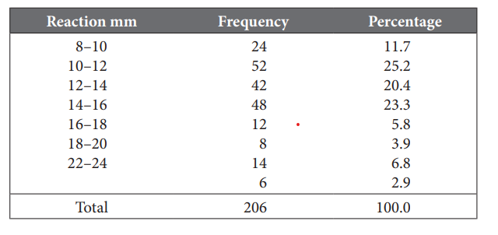
FREQUENCY DISTRIBUTION

Slide 21
Presentation of quantitative, continuous or measured data is through graphs. The common graphs in use are:
• Histogram
• Frequency polygon Frequency curve
• Line chart or graph
• Cumulative frequency diagram
• Scatter or dot diagram.

Slide 22
Presentation of qualitative, discrete or counted data is through diagrams. The common diagrams in use are:
• Bar diagram
• Pie or sector diagram
• Pictogram or picture diagram
• Map diagram or spot map.

Slide 23
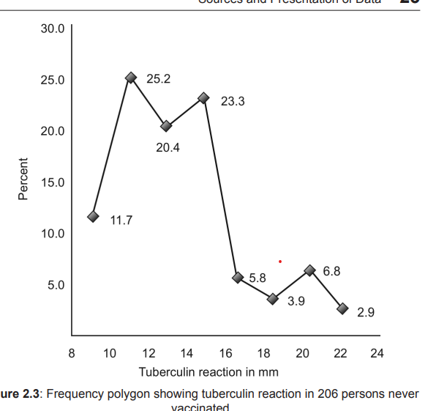
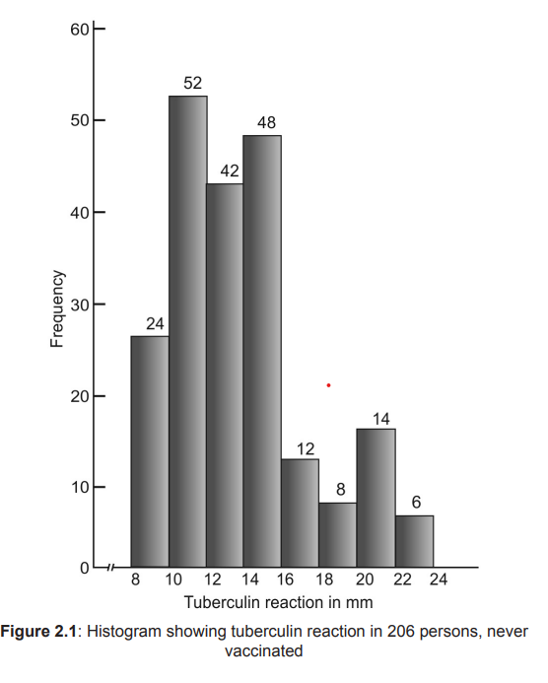

Slide 24
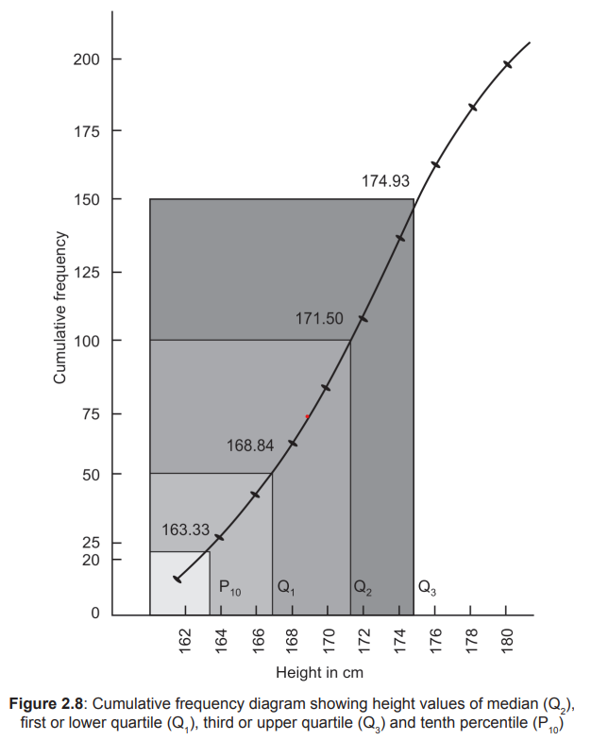
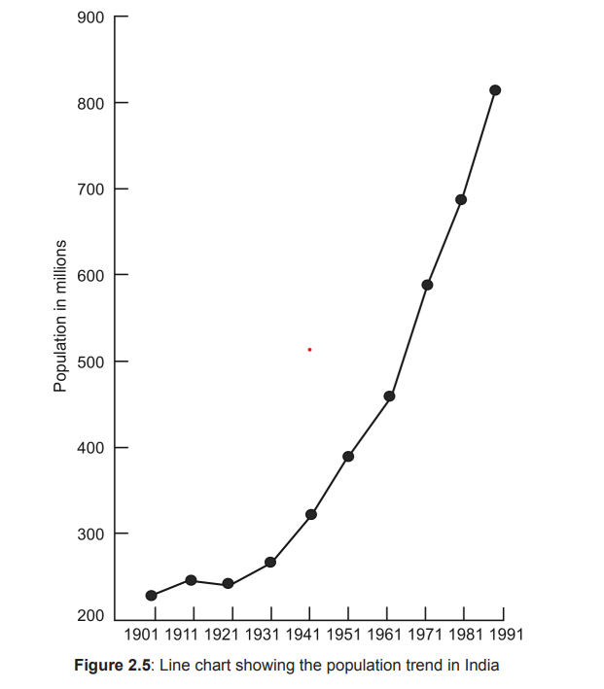

Slide 25
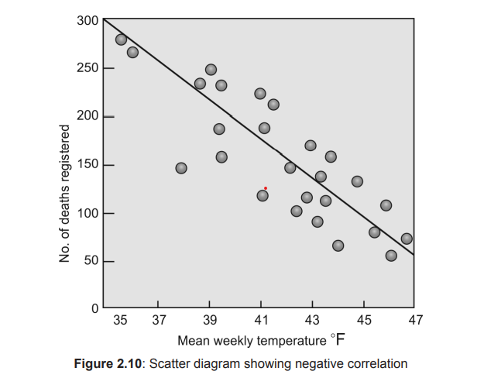

Slide 26
