Slide 1
Arousal, Attention, Orientation, and Cognition
KHUSHBOO ANJUM
ASSISTANT PROFESSOR
SHS, CSJMU KANPUR

Slide 2
AROUSAL

Slide 3
AROUSAL
Arousal is the physiological readiness of the human system for activity
To identify the patient’s level of consciousness.
These terms include
alert,
lethargic,
obtunded,
stupor, and
Coma
represent a continuum of physiological readiness for activity

Slide 4
AROUSAL
Alert. The patient is awake and attentive to normal levels of stimulation. Interactions with the therapist are normal and appropriate.
Lethargic. The patient appears drowsy and may fall asleep if not stimulated in some way. Interactions with the therapist may get diverted. The patient may have difficulty in focusing or maintaining attention on a question or task.

Slide 5
AROUSAL
Obtunded. The patient is difficult to arouse from a somnolent state and is frequently confused when awake. Repeated stimulation is required to maintain consciousness. Interactions with the therapist may be largely unproductive.
.Stupor (semicoma). The patient responds only to strong, generally noxious stimuli and returns to the unconscious state when stimulation is stopped. When aroused, the patient is unable to interact with the therapist.

Slide 6
AROUSAL
. Coma (deep coma). The patient cannot be aroused by any type of stimulation. Reflex motor responses may or may not be seen.

Slide 7
ATTENTION

Slide 8
ATTENTION
Attention is selective awareness of the environment or responsiveness to a stimulus or task without being distracted by other stimuli. Attention can be examined by asking the patient to repeat items on a progressively more challenging list. These repetition tasks can begin with two or three items and gradually progress to longer lists.

Slide 9
ATTENTION
For example, the patient might be asked to repeat a series of numbers, letters, or words.
Another approach to examining attention is to ask the patient to spell words backwards (e.g., book, fork, bottle, garden). The task can be made more challenging by using progressively longer words. Individuals with a high attention span will be able to perform the task. Attention deficits will be apparent when the order of letters is confused.

Slide 10
ORIENTATION
Orientation assesses awareness of person, place, time and situation.
PERSON | PLACE | TIME | Situation
What is your name? How old are you? Who is this person? When were you born? | Where are you? What hospital/clinic is this? Which city are we in? | What day is it? What month? What year? Approximately what time is it? | Why are you in the hospital? What happened to you?

Slide 11
COGNITION
Cognition is defined as the process of knowing and includes both awareness and judgment.
Nolan suggests three areas for testing cognition-dependent functions: (1) fund of knowledge, (2) calculation ability, and (3) proverb interpretation.
Fund of knowledge is defined as the sum total of an individual’s learning and experience in life, which will be highly variable and different for each patient.
Calculation ability examines foundational mathematical abilities.63,64 Two associated terms are acalculia (inability to calculate) and dyscalculia (difficulty in accomplishing calculations)
Proverb interpretation examines the patient’s ability to interpret use of words outside of their usual context or meaning.

Slide 12
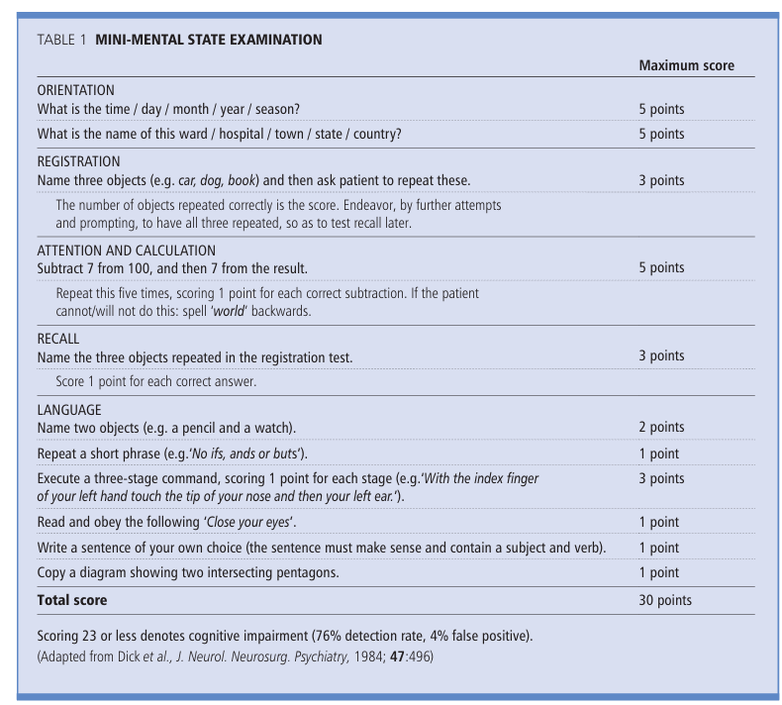
MMSE

Slide 13
MEMORY
Anterograde: recall of recent events (hours, days); recall of three items after 3 minutes; learning of a word list (e.g. tulip, seventeen, belt, Toyota, cabbage, camel, goose, river) read to the patient for the list to be recalled immediately; this is repeated five times and scored. After 20 minutes a delayed free recall is tested (normal is at least six items) and then recalled with cues.
Retrograde: names of family members; politicians; sports events; precise chronologic details about personal events in the patient’s life; ‘What has been in the news lately?’.
Semantic: naming pictures; pointing at named pictures; defining words or pictures; semantic fluency in naming from categories in 1 minute (e.g. animals or fruits; normal is >15); draw objects (e.g. a pyramid).

