Slide 1
Persons with Disabilities Act, 1995
BY DR KHUSHBOO ANJUM
ASSISTANT PROFESSOR
SHS, CSJMU, KANPUR

Slide 2
INTRODUCTION
The Persons with Disabilities (Equal Opportunities, Protection of Rights and Full Participation) Act, 1995.
(1 of 1996)
PUBLISHED IN PART II, SECTION 1 OF THE EXTRAORDINARY GAZETTE OF INDIA
MINISTRY OF LAW, JUSTICE AND COMPANY AFFAIRS
(Legislative Department)

Slide 3
The following Act of Parliament received the assent of the President on the 1st January, 1996, and is hereby published for general information
An Act to give effect to the Proclamation on the Full Participation and Equality of the People with Disabilities in the Asian and Pacific Region.

Slide 4
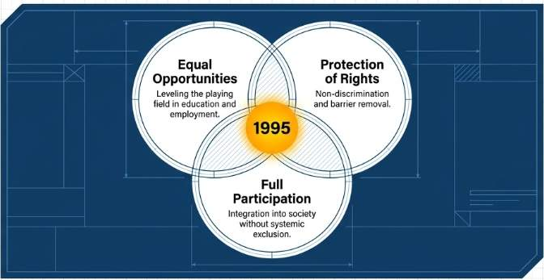
Purpose
To promote equal opportunities for persons with disabilities.
To provide protection of rights.
To promote full participation of persons with disabilities.
The Act was enacted in the context of India's commitment to the Asian and Pacific Decade of Disabled Persons (1993–2002)

Slide 5
Disability
The Act included 7 categories:
Blindness
Low vision
Leprosy-cured
Hearing impairment
Locomotor disability
Mental retardation
Mental illness

Slide 6
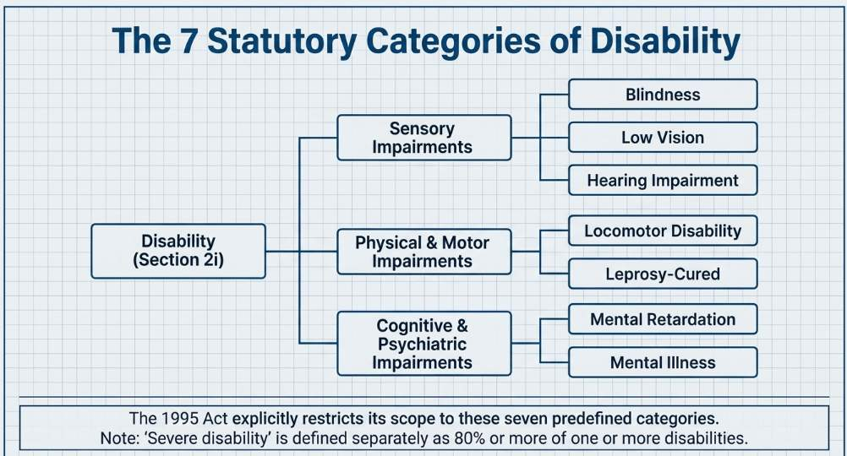

Slide 7
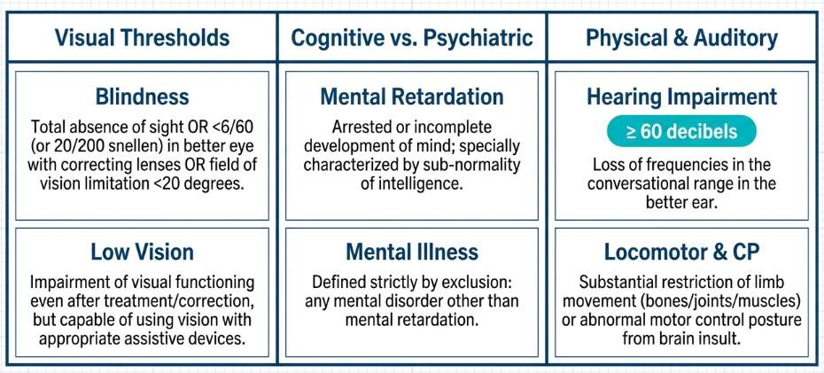

Slide 8
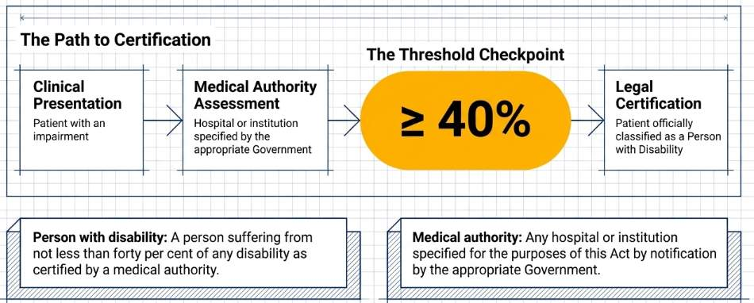
PERSON WITH DISABILITY

Slide 9
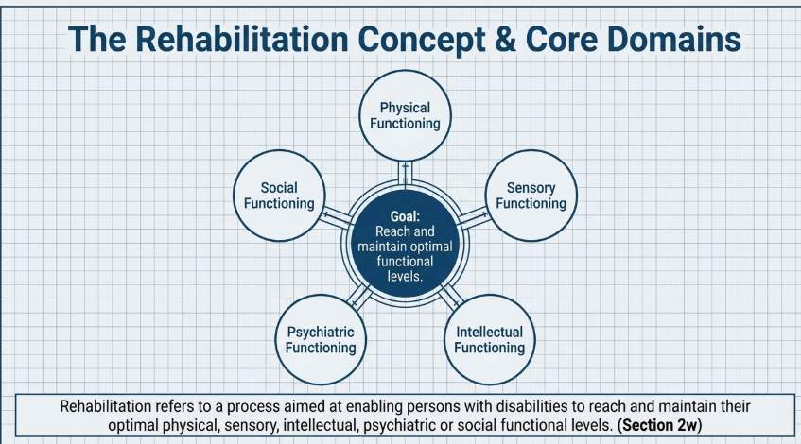

Slide 10
Central Coordination Committee
Constituted by the Central Government.
Serves as the national focal point for disability matters.
Includes representatives from:
  Government departments
  Health
  Education
  Employment
  Welfare
  Science and technology
  Railway
  Labour
  Parliament
  National institutes
  NGOs and persons with disabilities.

Slide 11
Major Functions
Coordinate activities of the Government and NGOs.
Develop national disability policy.
Advise the Central Government regarding:
  Policies
  Programmes
  Legislation
  Projects
Promote schemes for persons with disabilities.
Promote barrier-free environments.
Monitor and evaluate disability programmes.
Promote equality and full participation.

Slide 12
Meetings
Central Coordination Committee: at least once every 6 months.
Central Executive Committee: at least once every 3 months.

Slide 13
Prevention and Early Detection of Disabilities

Slide 14
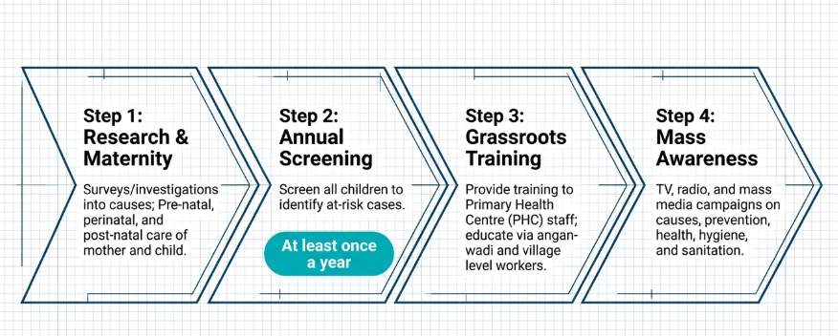
Prevention and Early Detection of Disabilities

Slide 15
EDUCATIONAL RIGHTS

Slide 16
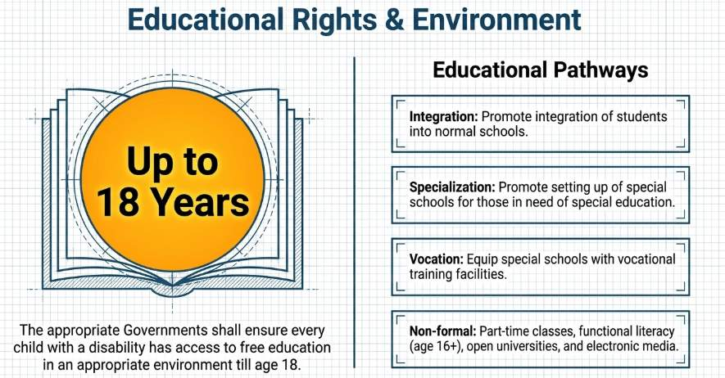

Slide 17
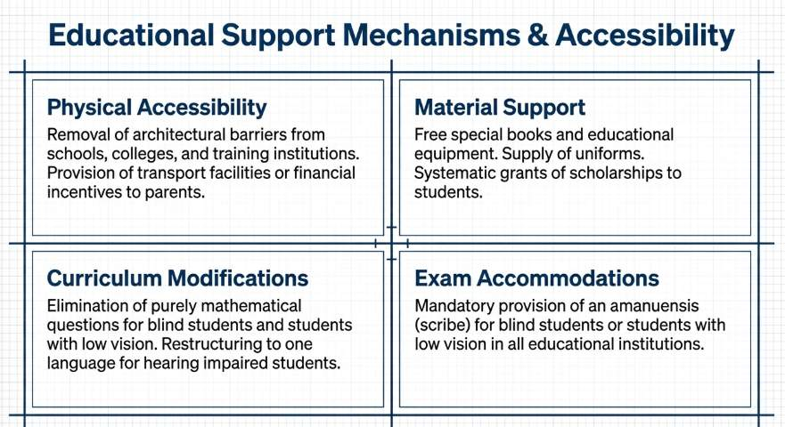

Slide 18
Employment

Slide 19
Identification of Posts
The government should identify posts suitable for persons with disabilities.
Identified posts should be reviewed periodically, not exceeding 3 years.

Slide 20
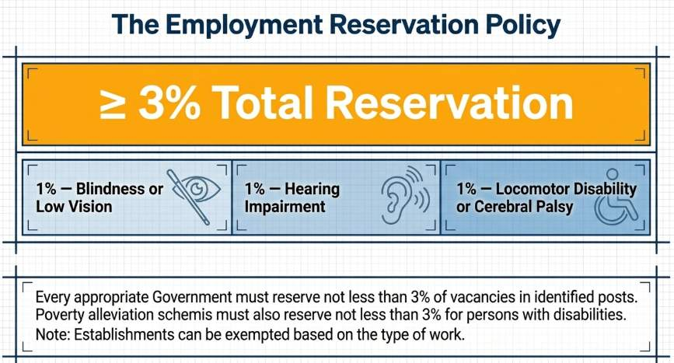
RESERVATION OF POSTS

Slide 21
Special Employment Exchange
Employers may be required to provide information regarding disability-related vacancies to the designated Special Employment Exchange

Slide 22
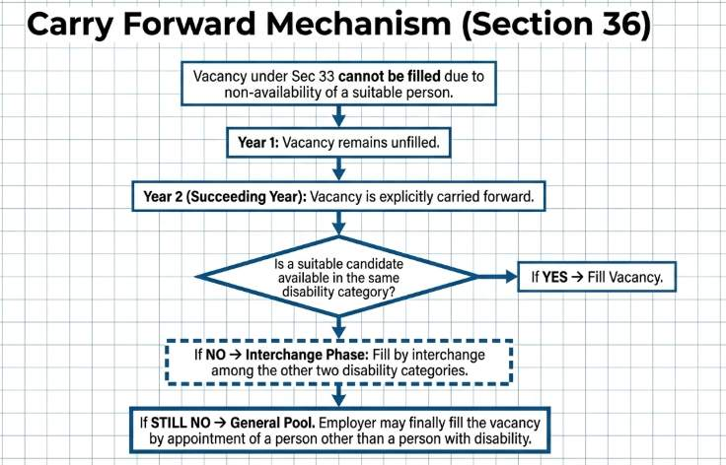

Slide 23
Reservation in Education and Poverty Alleviation
Educational Institutions | Poverty Alleviation Schemes | Employment Incentive
Government and government-aided educational institutions should reserve not less than 3% seats for persons with disabilities. | At least 3% reservation in poverty alleviation schemes for persons with disabilities. | Government/local authorities should provide incentives to employers to ensure that at least 5% of their workforce consists of persons with disabilities

Slide 24
Affirmative Action

Slide 25
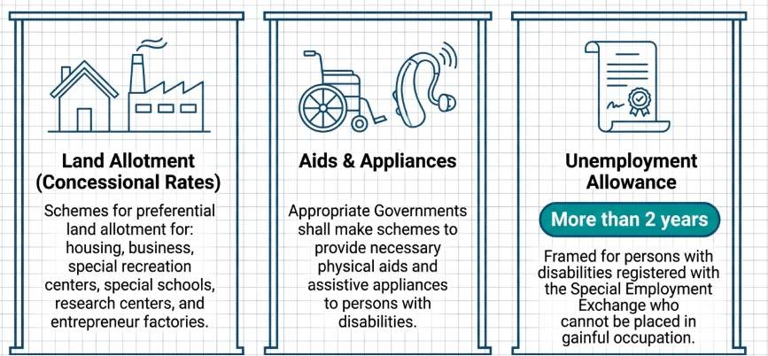

Slide 26
NON-DISCRIMINATION

Slide 27
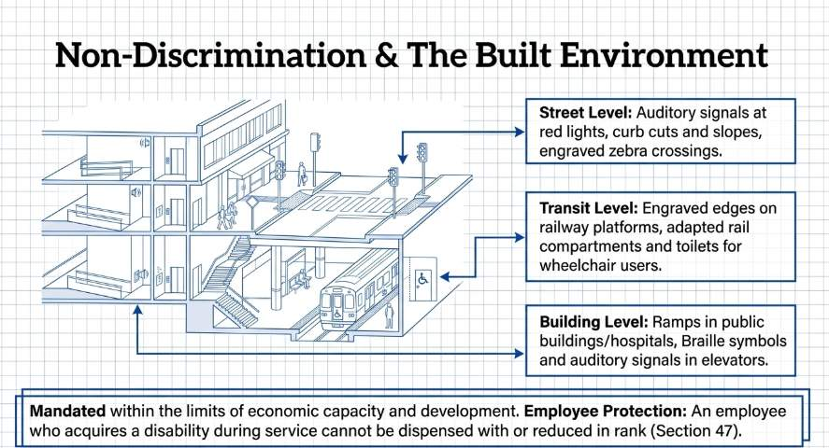

Slide 28
Punishment for Fraudulent Benefits
Fraudulently obtaining or attempting to obtain benefits meant for persons with disabilities:
Imprisonment up to 2 years, or
Fine up to ₹20,000, or
Both.

Slide 29
REFERENCE
Government of India. The Persons with Disabilities (Equal Opportunities, Protection of Rights and Full Participation) Act, 1995. New Delhi: Ministry of Law, Justice and Company Affairs; 1995.

Slide 30
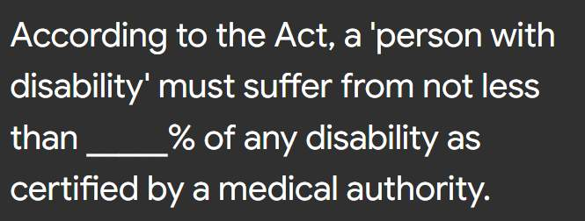

Slide 31


Slide 32
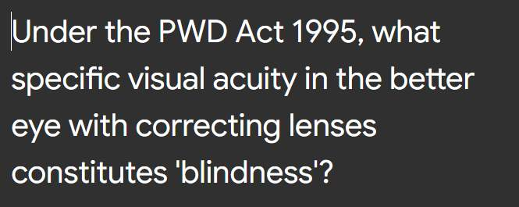

Slide 33
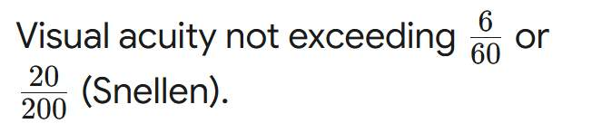

Slide 34
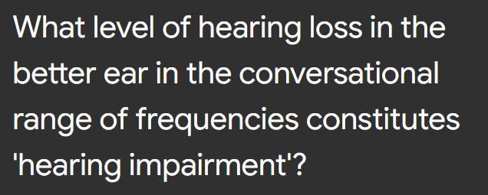

Slide 35


Slide 36
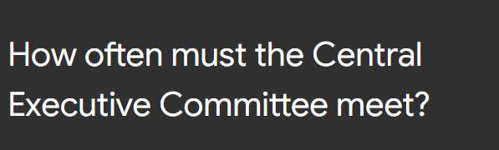

Slide 37


Slide 38
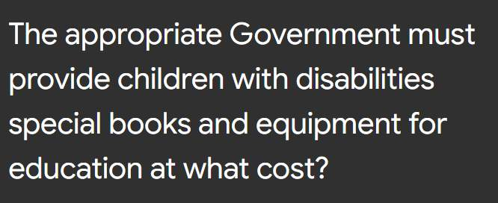

Slide 39


Slide 40
THANK YOU……..

