Slide 1
Congenital Abnormalities of the Central Nervous System (CNS)
BY DR KHUSHBOO ANJUM (PT)
ASSISTANT PROFESSOR (NEUROLOGY)
SHS, CSJMU

Slide 2
Congenital CNS abnormalities arise due to disturbances during embryonic brain and spinal cord development.
Advances in genetics have improved understanding of their causes
Classification is based on the developmental stage affected
Early diagnosis helps with prognosis, treatment, and genetic counselling

Slide 3
Normal CNS Development
Induction: Mesoderm signals ectoderm to form neural tissue.
Neural tube formation: Neural plate folds to form the neural tube.
Regionalisation: Formation of forebrain, midbrain, hindbrain, and spinal cord.
Cell proliferation & migration: Neurons and glial cells multiply and migrate to their final positions.
Connection & selection: Synapses form, and unnecessary neurons undergo apoptosis.

Slide 4
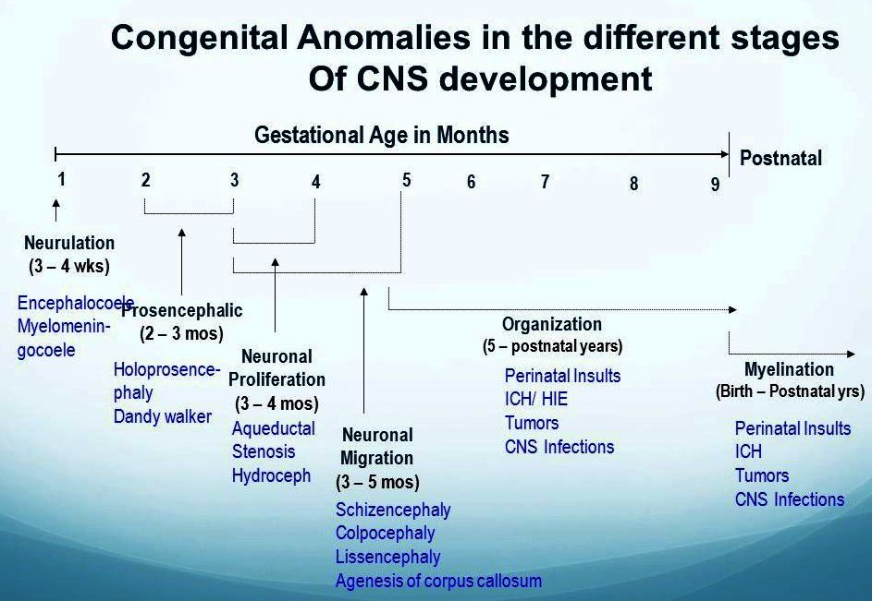

Slide 5
Neural Tube Defects (NTDs)
Occur due to failure of neural tube closure (18 to 26 days after ovulation).
Major types:
Anencephaly
Encephalocele
Spina bifida
Spina bifida occulta
Among the most common congenital CNS defects.

Slide 6
Causes of NTDs
Genetic factors | Environmental factors
Familial predisposition Chromosomal abnormalities | Folic acid deficiency Maternal medications: Sodium valproate Carbamazepine Phenytoin Phenobarbital Trimethoprim and other folate antagonists NOTE: Folic acid supplementation before conception and during early pregnancy significantly reduces risk.

Slide 7
Prenatal Diagnosis
Maternal serum α-fetoprotein (AFP) screening (16 to 18 weeks).
Ultrasonography: Detects anencephaly from 12 weeks.
Detects spina bifida from 16 to 20 weeks.
MRI when indicated.

Slide 8
Spinal Dysraphism
Spina bifida cystica | Spina bifida occulta | Syringomyelia
Usually, myelomeningocele causes motor weakness, bladder and bowel dysfunction. Frequently associated with hydrocephalus and Chiari II malformation | Often asymptomatic. Skin markers (hair tuft, sinus, lipoma) may indicate occult spinal abnormalities requiring MRI. | Fluid-filled cavity within spinal cord. Often associated with Chiari I malformation.

Slide 9
Disorders of Regionalisation
Holoprosencephaly
Failure of forebrain to divide into two hemispheres.
Associated facial abnormalities:
  Cyclopia/anophthalmia
  Absent nose
  Hypotelorism
  Single central incisor.

Slide 10
Disorders of Cortical Development
A. Microcephaly | B. Megalencephaly
Head circumference below the 0.4th percentile. Causes: Genetic syndromes Congenital infections Radiation Drugs Perinatal hypoxia Often associated with developmental delay | Enlarged brain size. May present with: Learning disability Seizures Hemiparesis (hemimegalencephaly)

Slide 11
Disorders of Neuronal Migration
Lissencephaly (smooth brain)
Agyria or pachygyria.
Causes severe developmental delay and epilepsy.
Type I | Type II (Walker-Warburg syndrome) | Heterotopias | Polymicrogyria
Associated with LIS1 and DCX gene mutations. | Eye abnormalities, muscular dystrophy-like changes, hydrocephalus, or microcephaly. | Neurons fail to migrate correctly. Types: Periventricular heterotopia Nodular heterotopia Band heterotopia ("double cortex") May present with seizures or developmental delay. | Excessive small gyri due to abnormal cortical development. Causes: Genetic Infection Hypoxia Clinical features: Dysarthria Drooling Feeding difficulty Seizures.

Slide 12
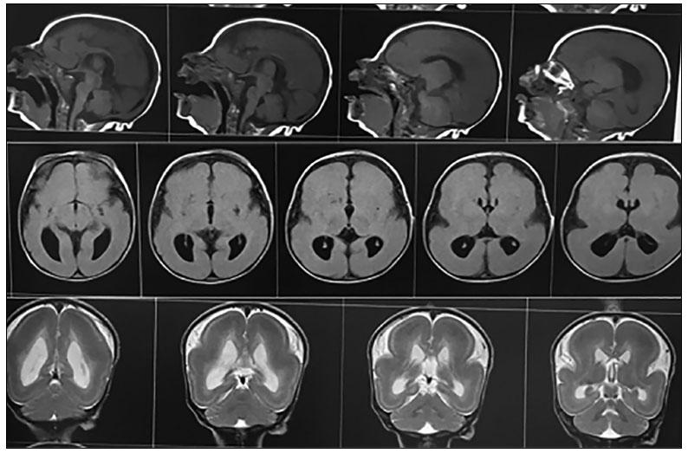
Miller–Dieker Syndrome (MDS) Is a rare, severe genetic neurodevelopmental disorder characterised by classical lissencephaly (smooth brain), distinctive facial dysmorphism, profound developmental delay, epilepsy, hypotonia, feeding difficulties, and multiple congenital abnormalities.

Slide 13
Agenesis of Corpus Callosum
Complete or partial absence of corpus callosum. May be: Asymptomatic
Associated with seizures
Learning disability
Cerebral palsy
Prenatal ultrasound can detect from about 20 weeks.

Slide 14
Porencephaly | Schizencephaly
Cystic cavity within cerebral hemisphere. Results from prenatal brain injury. May resemble cerebral palsy clinically. | Full-thickness cleft connecting ventricle to subarachnoid space. Types: Closed-lip Open-lip Features: Epilepsy Hemiplegia Developmental delay Speech impairment.

Slide 15
Posterior Fossa Malformations
Include: Cerebellar hypoplasia
Dandy-Walker malformation
Joubert syndrome
May present with motor, developmental, and coordination problems.

Slide 16
Investigations
MRI is the investigation of choice.
Chromosome analysis.
Gene mutation testing.
Metabolic investigations.
DNA storage when diagnosis remains uncertain

Slide 17
Genetic Counselling
Construct a three-generation family pedigree.
Estimate recurrence risk.
Offer prenatal diagnosis where appropriate.
Recommend folic acid supplementation for future pregnancies after NTDs.

Slide 18
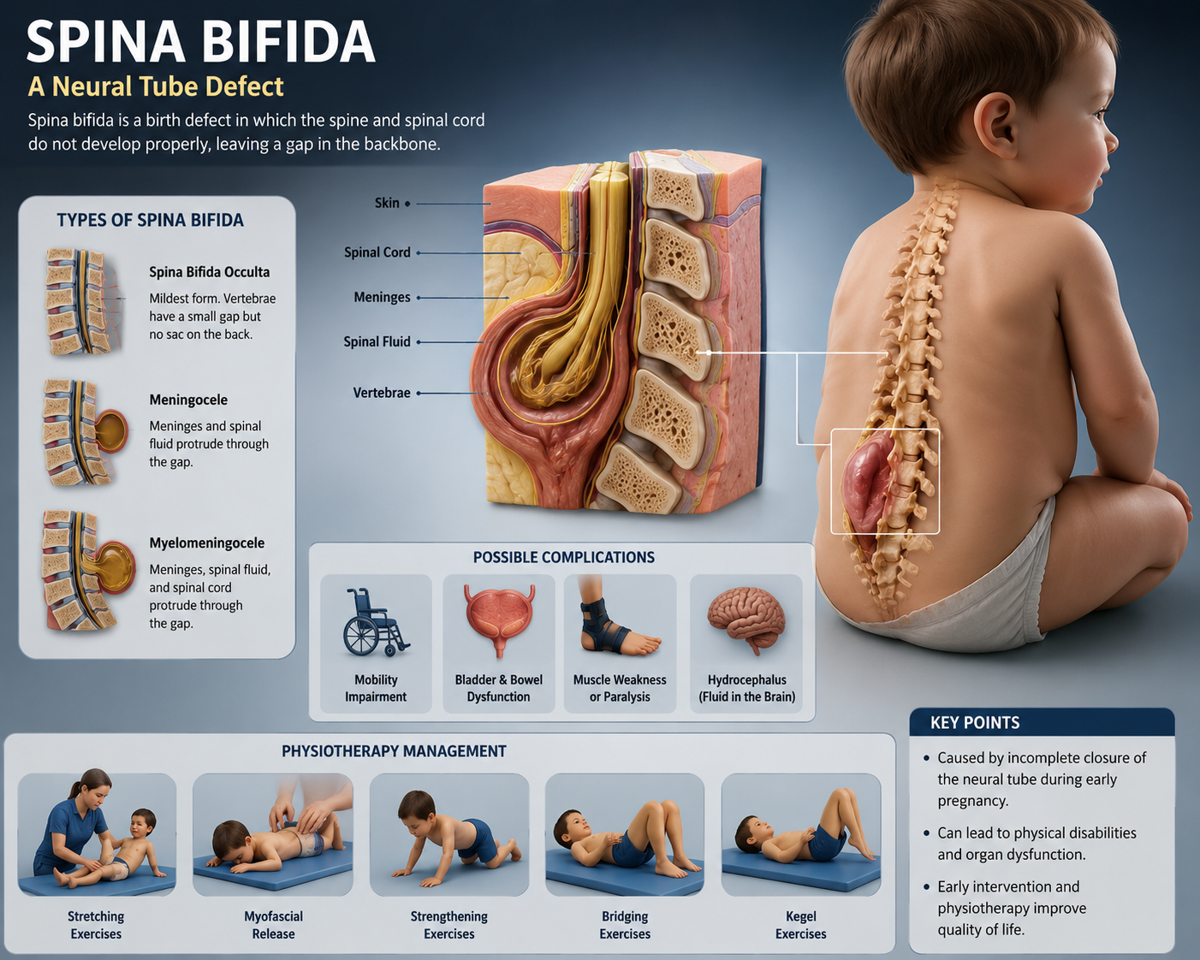
Physiotherapy Management in Spina Bifida Cases

Slide 19
THANK YOU…..

