Slide 1
SKULL X RAY
DR KHUSHBOO ANJUM (PT)
ASSISTANT PROFESSOR (NEUROLOGY)
SHS, CSJMU, KANPUR

Slide 2

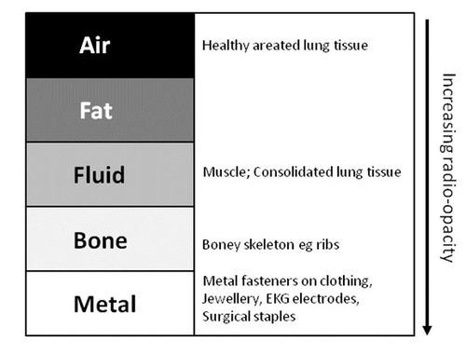

Slide 3
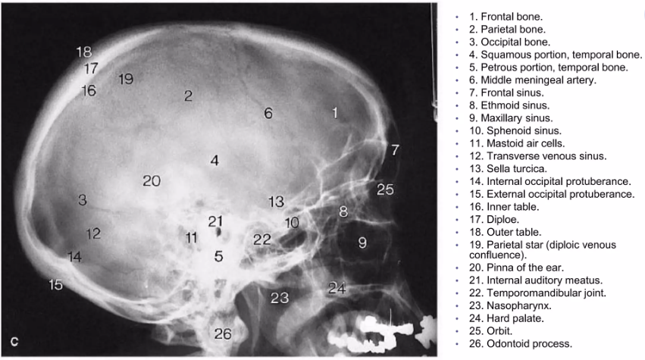

Slide 4
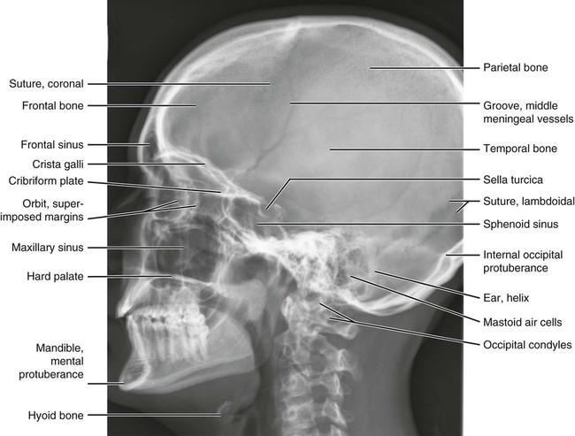

Slide 5
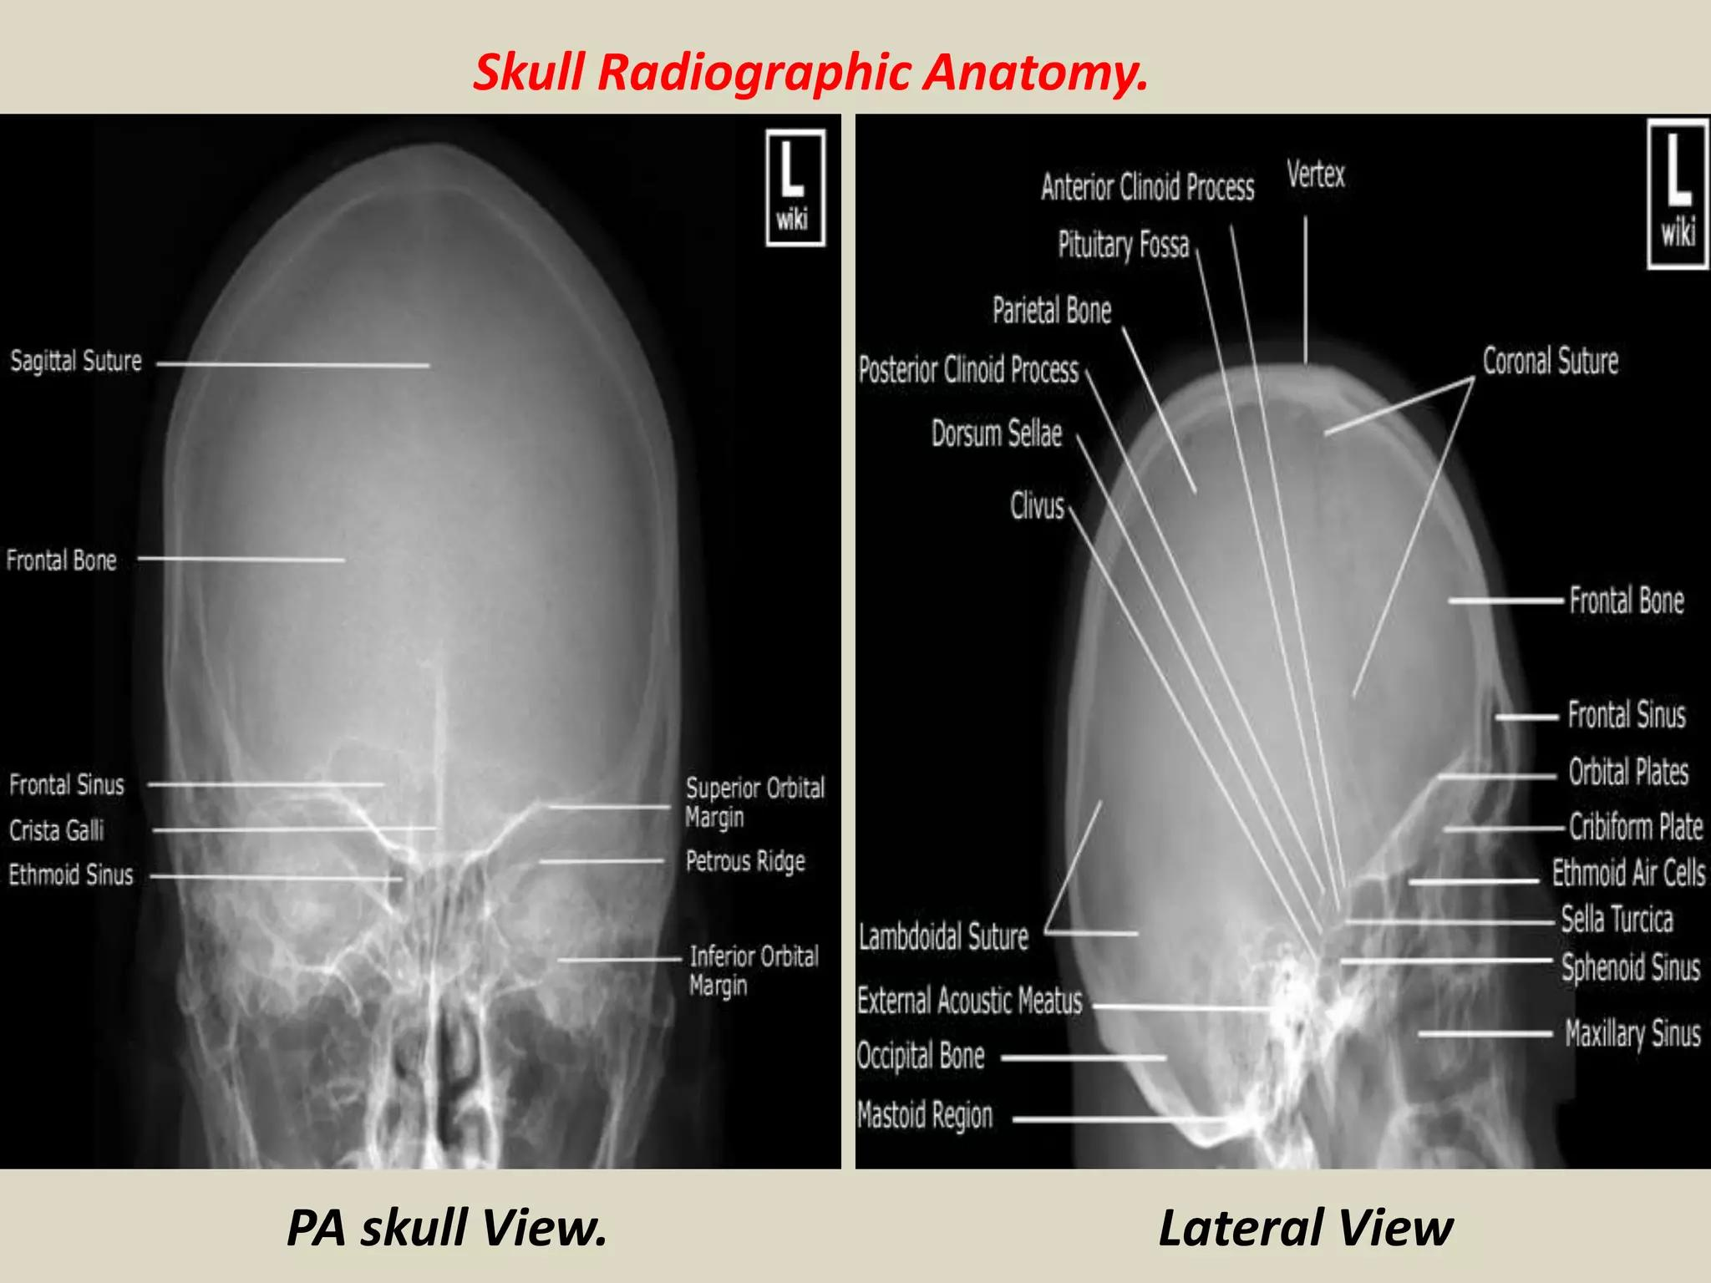
Skull radiography uses ionizing radiation to create a projection image.
It primarily demonstrates:
  Calvarial bones
  Skull base
  Sutures
  Facial bones
  Paranasal sinuses
  Bony lesions
  Some intracranial calcifications

Slide 6
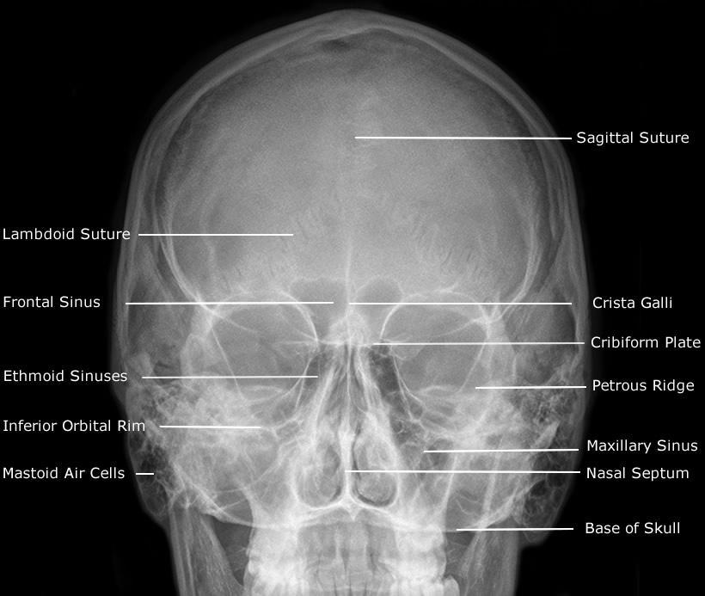
ADULT SKULL- PA (OCCIPITO-FRONTAL) WITH 15 DEGREE ANGULATION (CALDWELL)

Slide 7
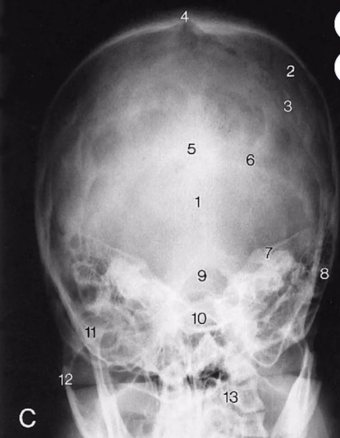
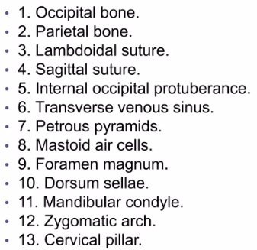
AP VIEW TOWNE’S PROJECTION

Slide 8
Identify systematically
Frontal bone
Parietal bones
Temporal bones
Occipital bone
Skull base
Cranial sutures
Sella turcica
Mastoid air cells
Paranasal sinuses
Orbits

Slide 9
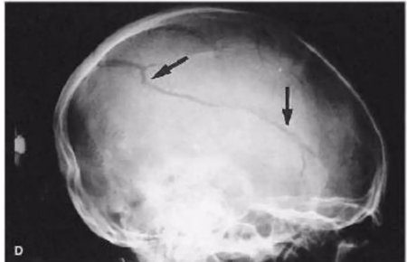
LATERAL, SKULL, PARIETAL FRACTURE: A LINEAR # EXTENDS THROUGH THE PARIETAL BONE

Slide 10
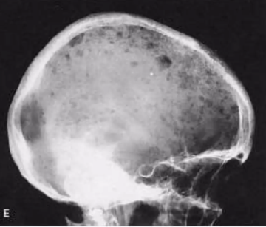
LATERAL, SKULL, MULTIPLE MYELOMA: Multiple, well-defined radiolucent lesions are visible throughout the parietal and frontal bones

Slide 11
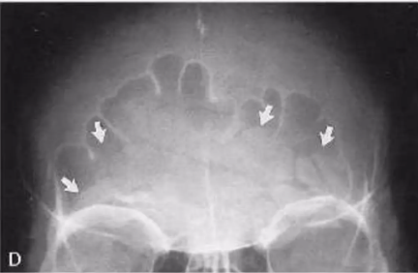
PA CALDWELL’S, SKULL, FRONTAL BONE FRACTURE: THE FRACTURE IS VISIBLE AS MULTIPLE RADIOLUCENT LINES. THE SINUS IS FILLED WITH HEMATOMA (ARROWS)

Slide 12
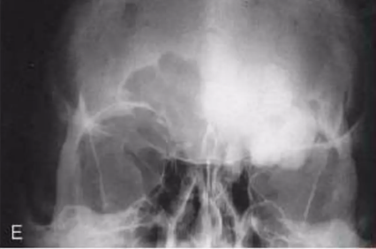
PA CALDWELL’S, SKULL, FRONTAL SINUS OSTEOMA: DENSE, IVORY- LIKE NEW BONE FILLS A FRONTAL SINUS

Slide 13
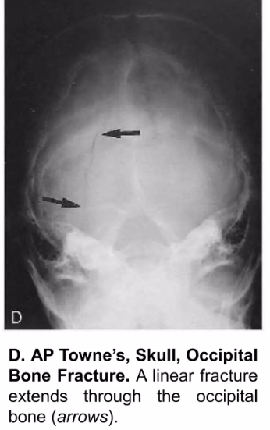
AP TOWNE’S, SKULL

Slide 14
THANK YOU…………………

